Slide 1
Compartments 41 and 39
Hadrian’s Wall
Woodland Management Plan January 2018 – January 2028

Slide 2
Contents
 | Page |  |  | Page
Section 1: Introduction | 1 |  | Section 4: Compartment Summaries
 |  |  | 32 | 12
Section 2: Our aims and Objectives | 2 to 5 |  | 33 | 13
 |  |  | 34 | 14
Section 3: Maps |  |  | 35 | 15
Compartments and Tree Species | 6-7 |  | 36 | 16
Work Programme | 8 |  | 37 | 17
Statutory Designations | 9-10 |  | 38 | 18
Ancient Woodlands and Biodiversity | 10-11 |  | 39 | 19
 |  |  | 40 | 20
 |  |  | 41 | 21
 |  |  | 42 | 22
 |  |  | 43 | 23
 |  |  | 44 | 24
 |  |  | 45 | 25
 |  |  | 46 | 26
 |  |  | 47 | 27
 |  |  | 48 | 28

Slide 3
The aim of this plan is to provide a ten year programme of woodland management that will meet the aims and objectives of the National Trust at Hadrian's Wall in Northumberland. The detail of the plan focusses on tree thinning and felling works at the site. Detail relating to the access and built structures at the site form the content of other plans.
Background to the Woodlands at Hadrian’s Wall
These woodland form part of the National Trust Hadrian's Wall and Tyne Valley Group of properties. The woodlands covered in this plan include compartments 32-48. The remaining compartments can be seen in the plans for Allen Banks and Staward Gorge, and Bellister woodlands. The majority of these woodlands will not see silvicultural interventions over the next 10 years and will be managed to maintain their function in the landscape and as shelter for livestock. Longer term management of these woodlands will see some thinning and felling to allow natural regeneration to take place ensuring the long term viability of these woodlands.
In total there are 14 woodland compartments covering 12.6 hectares.
The Hadrian’s Wall Estate is a part remnant of the 19th Century Chesters Estate. Owned at that time by John Clayton (1792-1890) it once totalled over 8000ha. Many of the plantations date from this period and form shelter belts and/or landscape features. There are 16 separate compartments, totalling 12.56 ha. including two areas of carr woodland associated with Broomlee and Crag Lough’s and some crag communities, which form the only notable ancient and semi-natural woodlands. There have been several additional shelter plantings in the latter part of the 20th Century.
The majority of plantings were carried out during 19th C. as broadleaf shelter belts with Scots Pine nurse crops. Due to labour shortages following the First World War and then the eventual break up of the estate in 1929, this nurse crop was never harvested. A consequence of this is that through the 20th C. the Scots Pine has become an integral part of the iconic images of Hadrian’s Wall. There has been little regeneration in these woodlands. Later plantations have been carried out along similar lines, but have used a spruce/pine mixture as nurse crop.
Topography:
The Hadrian’s Wall Estate lies within the Northumberland Pennine Moorland. The altitudinal range of the property is from c. 170 to 350 m.
Geology:
The estate is largely underlain by Lower Carboniferous sediments. These are cyclical deposits laid down near sea level. They are made up of bands of limestone, mudstone, sandstone, seatearth and coal. The area has been subjected to Pleistocene glaciations resulting in a ‘Cuesta’ landscape of shallow ridges and valleys running west-south-west to east-north-east. The harder bands occasionally outcrop as small, craggy cliffs facing north, sometimes with scree and a more gentle dip slope to the south. Through this runs a section of the massive Whin Sill, which runs across Northern England from Teesdale to the Farne Islands off the North Northumberland Coast. This has been intruded into the Carboniferous sediments, and is composed of quartz dolerite, a fine grained, basic igneous rock. It forms a prominent escarpment with the same structural trend as the surrounding rocks.
Soils:
The intricate geology and topography of the area has led to a very great diversity of soil types. Seasonally waterlogged loam and clay soils cover much of the property. Well drained soils occur on ridges. These include both acidic and alkaline soils. Peat development is quite widespread, including areas of valley-bog and a number of raised mires.
1

Slide 4
Compartment 45
Section 2: Our Aims and Objectives

Slide 5
What we want to do | Why we want to do it? | How can we achieve it?
Maximise the value of our woodlands for biodiversity through restoration of Ancient Woodland sites and to conduct management throughout our woodlands that creates a diverse age structure and sustainable, dynamic forest ecosystems. The work we do will aim to protect and enhance biodiversity in all woodlands and open habitats. | Britain’s woodland biodiversity is in trouble. Reports show that 60 per cent of our woodland species have decreased and 34 percent have decreased strongly over recent decades. Species decline is attributed to a lack of structural diversity in our woodlands with low management intervention and increased deer numbers resulting in uniform and aging woodlands. We want to do what we can to reverse this trend and help save Britain’s natural heritage. We’ve identified those species listed as being of high conservation importance, these are listed below: Bats: Myotis, pipistrelle, brown long eared and noctual. Birds: Barn owl, upland waders, skylark, spotted flycatcher, yellowhammer, black grouse, Mammals: Red squirrel, otter, badger, water vole. Reptiles: Adder, common lizard Fungi: Waxcaps Invertebrates: Large heath butterfly, soldier beetle spp, ground beetle spp Amphibians: Frogs, toads, and newts | Evaluate the current nature conservation value of the woodlands through stakeholder communications and survey work. Monitor priority species and habitats to help assess improvement and gain a better understanding of current position. Control non-native invasive species including rhododendron and grey squirrel. Manage and control deer populations where possible and appropriate. Encourage the development of greater structural and species diversity through supplementary tree planting where natural regeneration is not apparent or of the desired species. Increase dead wood volumes by ring barking selected trees away from areas of high public access. Identify and conserve veteran trees. Avoid felling large/veteran trees for safety reasons unless absolutely necessary. Ensure regeneration is protected from adjacent livestock farming through fence maintenance and when restocking, consider provenance and species in relation to climate change.
2

Slide 6
What we want to do | Why we want to do it? | How can we achieve it?
To improve access for management and enhance and encourage safe and sympathetic public access, extending opportunities for education, recreation and participation where this does not conflict with the other objectives | The quality of experience for our visitors is of high importance. This plan aims to maintain the woodlands’ wild feel and to ensure that our woodlands can be enjoyed by generations to come. | Assess the current access situation and maintain access to a high standard Develop opportunities for the local community of Tyne Valley to get involved in the site through the volunteer programme. Use the programme of woodland management as a tool to engage visitors and educate them about the importance of conservation and what our sites can offer.
Reduce our carbon footprint | The Earth’s temperature is warming a result of human activities. Global Warming is already having a terrible impact upon the lives of people and nature across the globe. If the global rise in temperature can be kept below 2 degrees Celsius, the negative effects of climate change can be minimised, this however will require a change in all of our carbon outputs. We therefore wish to minimise carbon outputs and sequester as much carbon as possible through natural processes. | To conduct woodland management which promotes the growth of new trees and rapid growth through tree species selection for replanting and silvicultural systems such as coppicing. To undertake silvicultural practices which minimise soil erosion and promote soil formation. Work which allows more light to the woodland floor will facilitate this process.
Improve the capacity of our woodlands for resource protection and flood resilience, slowing the flow of water across our land to improve water quality coming off our land and play a part in protecting downstream communities at risk of Flooding. | Flooding is becoming an increasing risk to both urban and rural communities. We wish to play our part in the mitigation of the impacts of these storm events. | Undertake management works which increase the structural diversity of the woodland stand and increase the density and diversity of ground flora. Undertake best practice during operations to protect soils using brash mats and avoid watercourses.
3

Slide 7
What we want to do | Why we want to do it? | How can we achieve it?
Contribute to the local economy | We want our land to contribute to the quality of life for local people. One of the ways we seek to achieve this is by contributing to the local economy. | Where possible and appropriate, trees will be harvested when they achieve their optimal economic potential Apply for appropriate woodland/countryside grant schemes and regional funding to achieve stated objectives Where possible generate timber income through harvesting programmes to help fund the ecological restoration process and wider woodland improvement programmes. Work with regional contractors to develop a contractor base adapted to woodlands with access issues.
Ensure the woodland habitats are resilient to climate change and plant diseases | Climate change presents an unprecedented threat to our woodland ecosystems. By creating woodlands diverse in structure and species we will increase the overall resilience of these ecosystems. | Remove species known to increase the likelihood of disease transmission e.g Rhododendron Seek opportunities to increase habitat connectivity Survey HWTVG to identify the potential for habitat creation.
To manage health and safety at the site in line with the ‘Tree Safety Management in the National Trust’ procedure Sep 2015 | There are risks of injury to staff, volunteers and the public from falling trees and branches. There are also risks of damage to buildings, property and vehicles. The Trust has a statutory and common law duty to assess and manage these risks. The duty is established in criminal law under the Health and Safety at Work Act, and in civil law under the Occupier’s Liability Act. The Trust must take all precautions as far as is reasonably practicable to avoid risks to the safety of members of the public, staff and volunteers. Therefore there is a need to inspect trees in and near public places and adjacent to buildings and working areas, to assess whether they represent a risk to life and/or property, and to take remedial action as appropriate. | By following National Trust Health and Safety procedures.
4

Slide 8
What we want to do | Why we want to do it? | How can we achieve it?
Conserve the historic and cultural landscape in ways that enhance the Spirit of Place | We recognise our responsibility towards the protection of our historic environment and seek to maintain and enhance it for ongoing enjoyment and education. This will conserve the historic and cultural landscape in ways that enhance the Spirit of Place | Using the Site and Monuments register record the condition of the archaeological features across HWTVG. When carrying out woodland work ensure that the historic environment is protected in line with guidance from Historic England. Working with the NT archaeologist discuss the further research recommendations from historic environment report (where applicable) and the potential to achieve them. The historic environment report highlights a certain number of management concerns and recommendations address these as part of the management of the sites. Maintain and protect designed woodland landscape elements across the site.
5

Slide 9
Compartment 39
Section 3: Site Maps

Slide 10
January 2020- January 2022
6

Slide 11
January 2020- January 2022
7

Slide 12
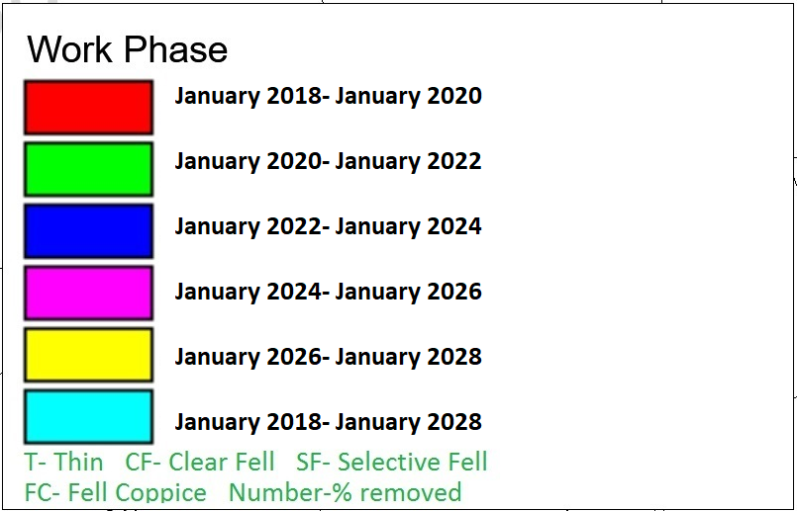
January 2020- January 2022
8

Slide 13
January 2020- January 2022
9

Slide 14
January 2020- January 2022
10

Slide 15
January 2020- January 2022
11

Slide 16
Section 4: Compartment Summaries
Compartment 34

Slide 17
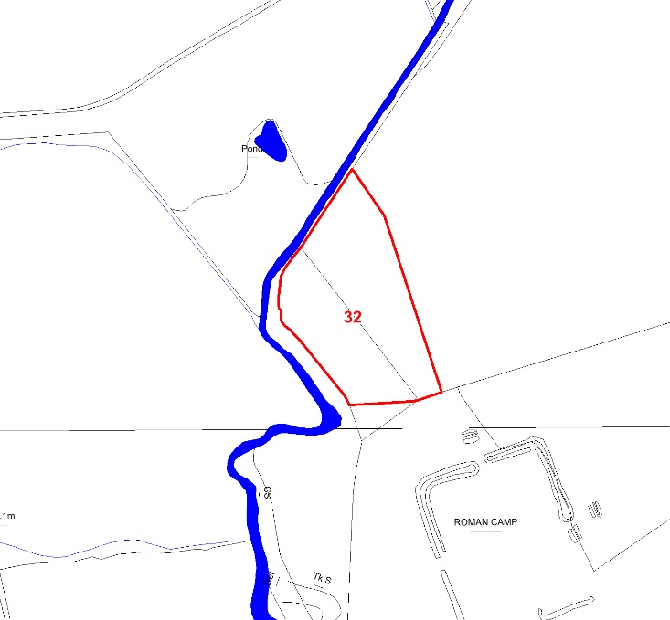
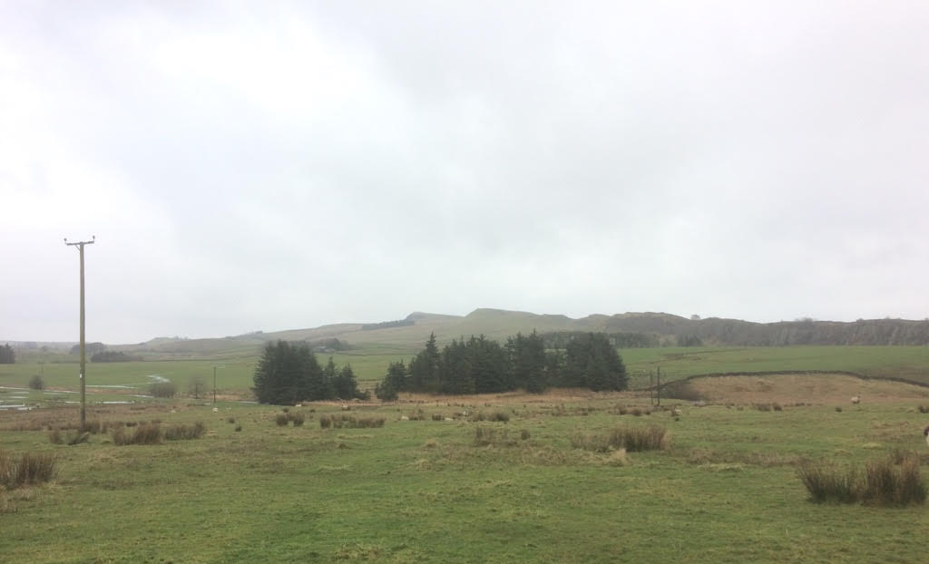
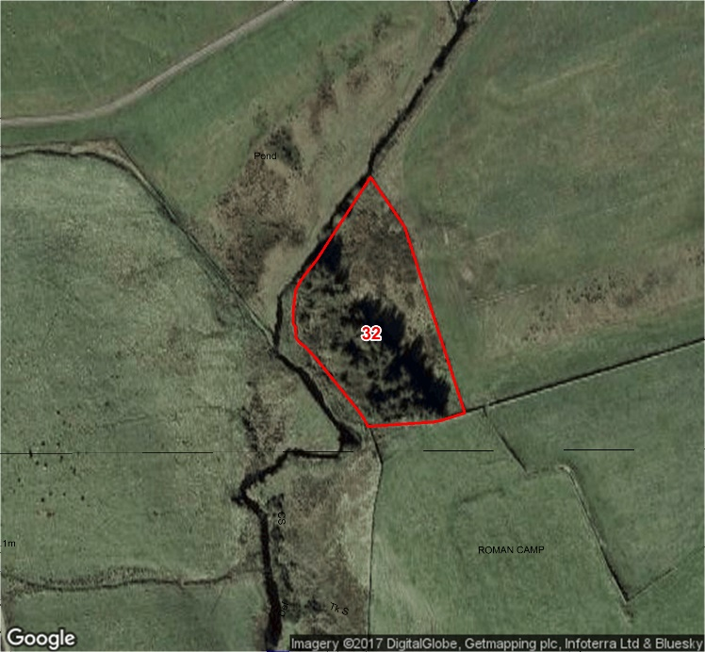
Compartment: 32 Species: Norway Spruce Hectares: 0.31
Designations: None Issues: None Intervention: None
Description: A mature conifer plantation.
Aims: To manage for visual amenity, health and safety, and biodiversity.
12

Slide 18
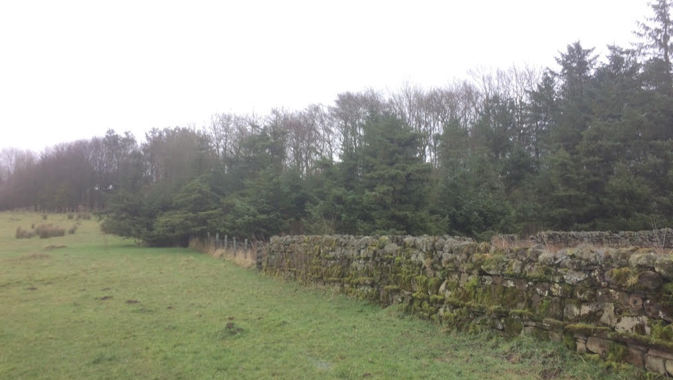
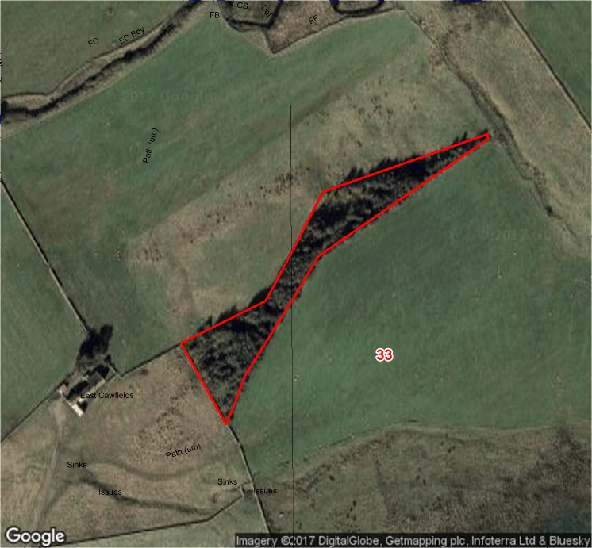
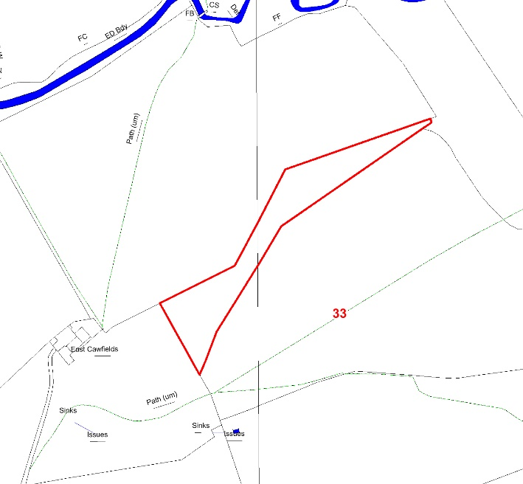
Compartment: 33 Species: Sycamore with Scots Pine and Sitka Spruce Hectares: 0.53
Designations: None Intervention: None
Issues: None
Description: A mature mixed non native woodland with a varied structure.
Aims: To manage for visual amenity, health and safety, and biodiversity.
13

Slide 19
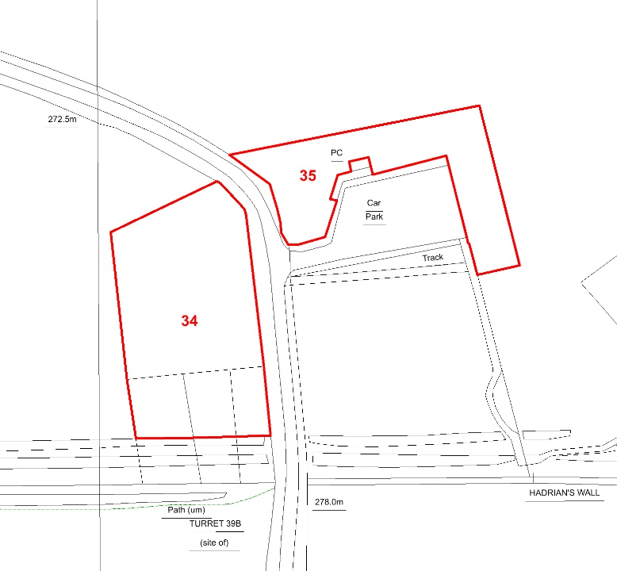
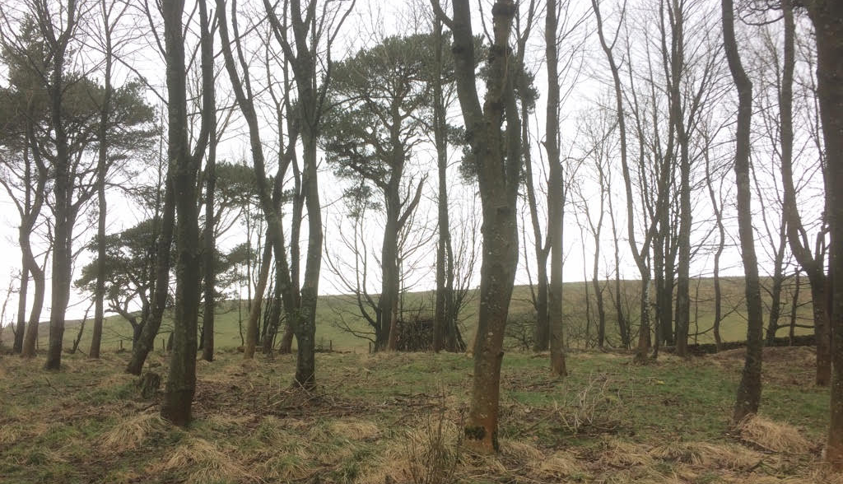
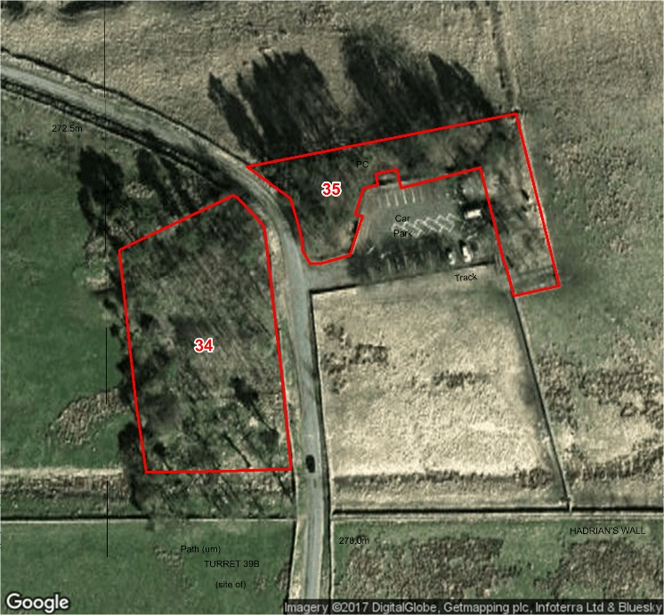
Compartment: 34 Species: Sycamore, Scots Pine, and Ash Hectares: 0.33
Designations: SSSI Intervention: None
Issues: None
Description: A mature mixed woodland with an even structure.
Aims: To manage for visual amenity, health and safety, and biodiversity.
14

Slide 20
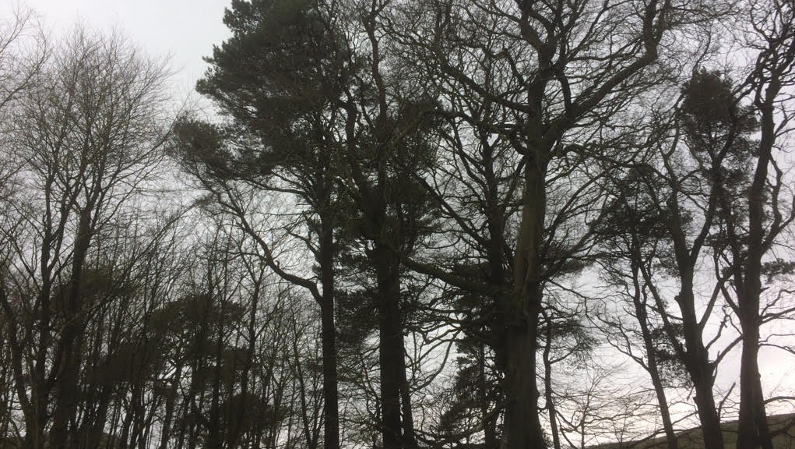
Compartment: 35 Species: Beech with Scots Pine, Ash, and Norway Spruce Hectares:0.19
Designations: SSSI Intervention: None
Issues: None
Description: A mature mixed woodland with an even structure.
Aims: To manage for visual amenity, health and safety, and biodiversity.
15

Slide 21
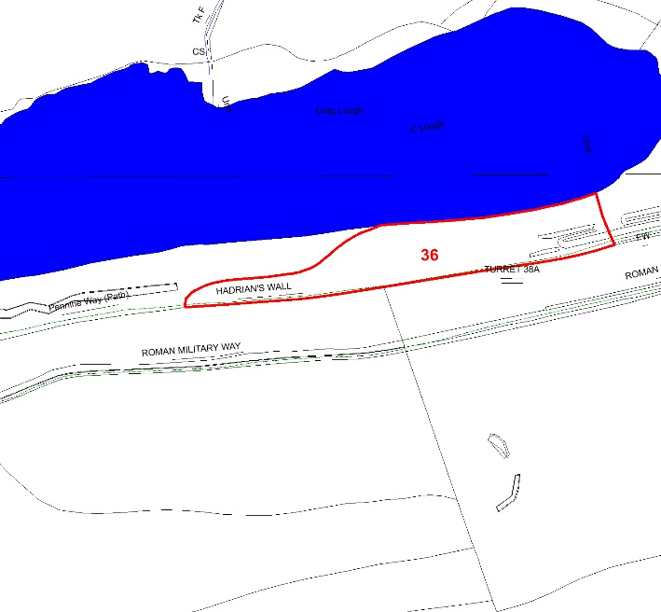
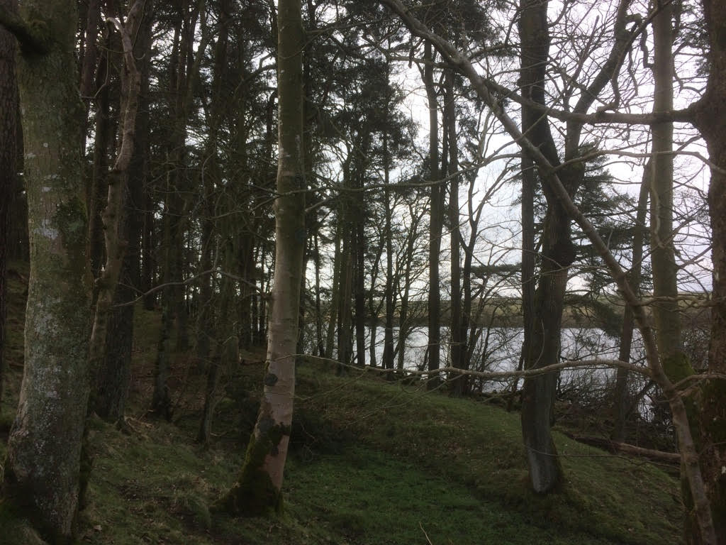
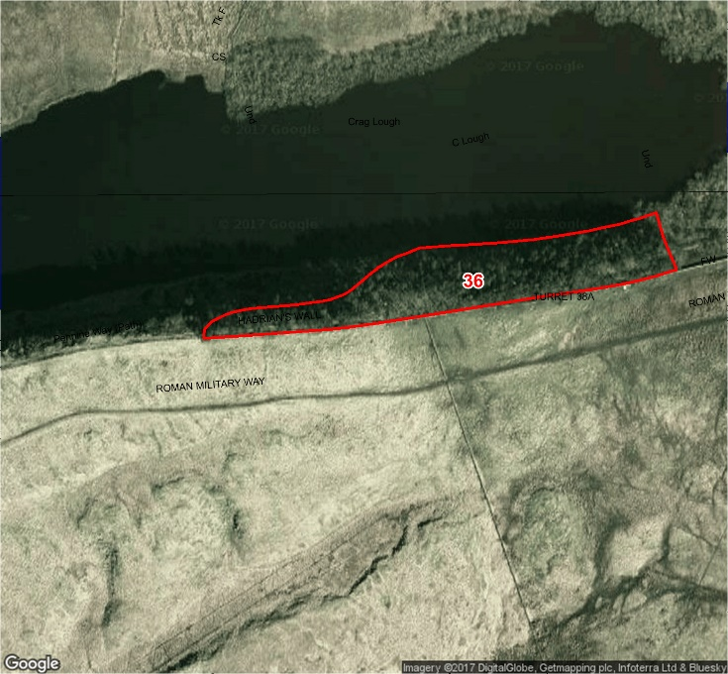
Compartment: 36 Species: Scots Pine with Ash and Sycamore Hectares: 1.1
Designations: SSSI, SAC Intervention: None
Issues: None
Description: A mature mixed woodland with an even structure.
Aims: To manage for visual amenity, health and safety, and biodiversity.
16

Slide 22
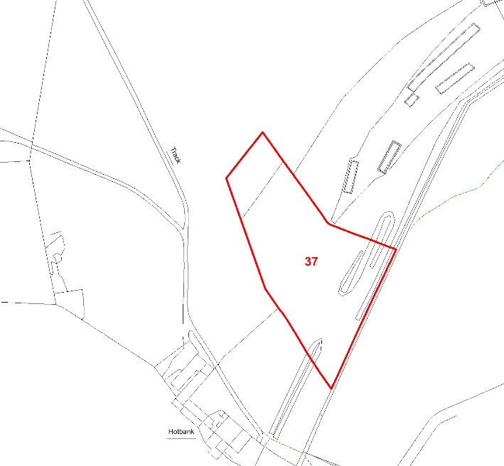
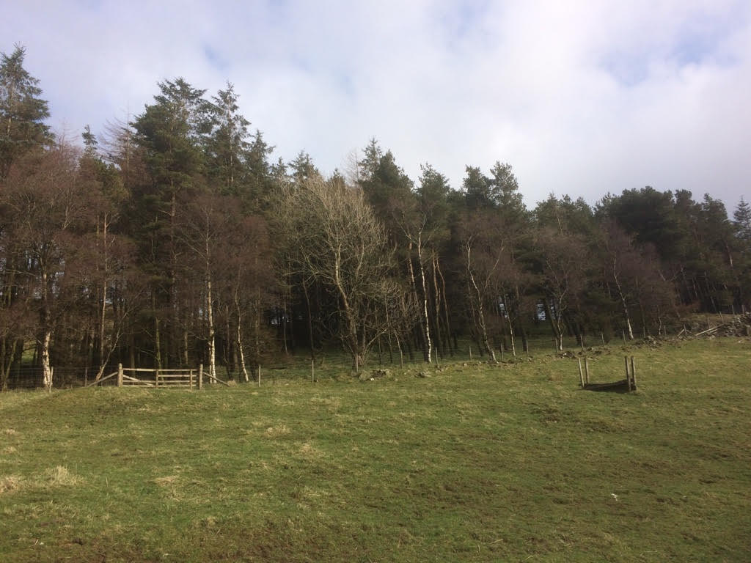
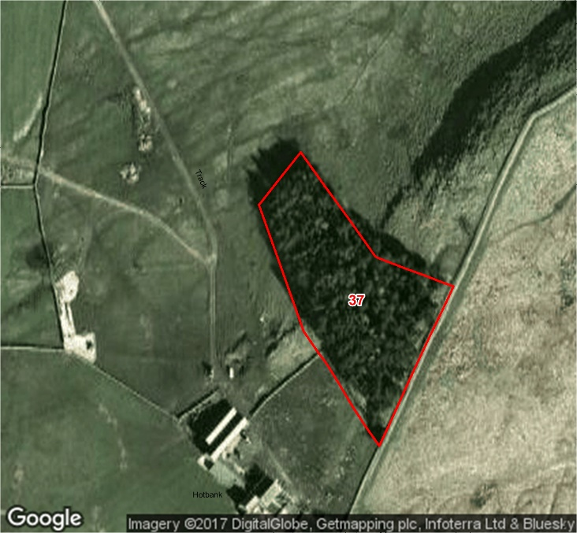
Compartment: 37 Species: Scots Pine, Sitka Spruce and Birch Hectares: 0.62
Designations: SSSI Intervention: None
Issues: None
Description: A mature mixed woodland with an even structure.
Aims: To manage for visual amenity, health and safety, and biodiversity.
17

Slide 23
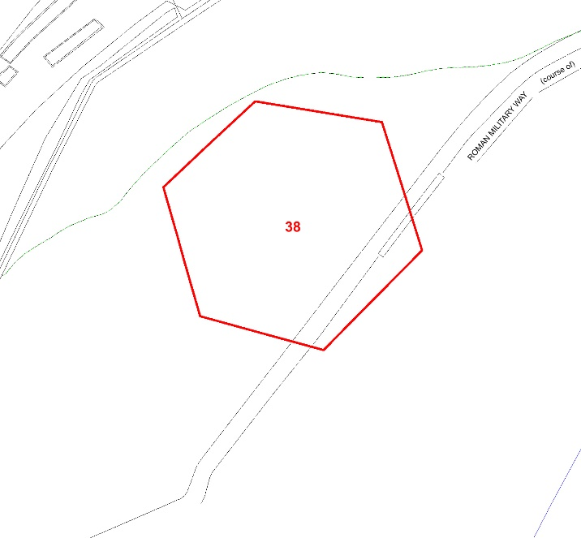
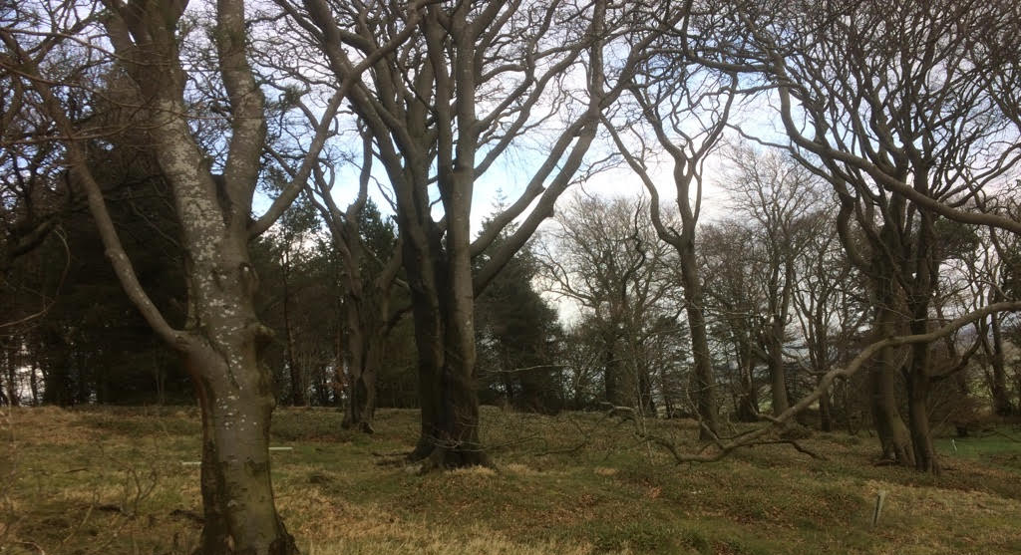
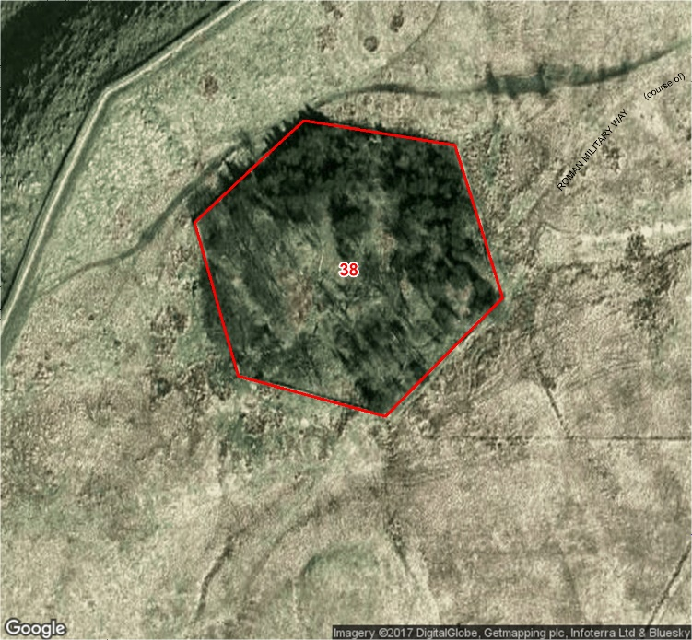
Compartment: 38 Species: Scots Pine, Beech and Sitka Spruce Hectares: 0.63
Designations: SSSI, SAM Intervention: None
Issues: None
Description: A mature mixed woodland with an even structure.
Aims: To manage for visual amenity, health and safety, and biodiversity.
18

Slide 24
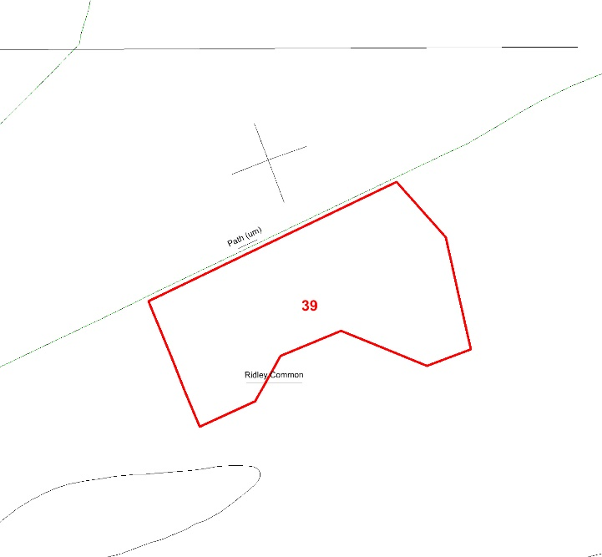
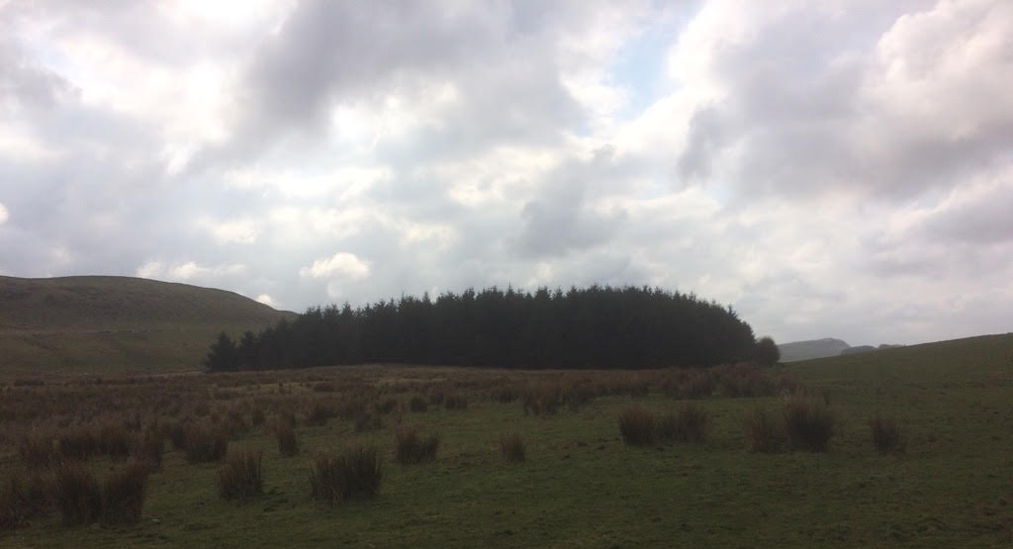
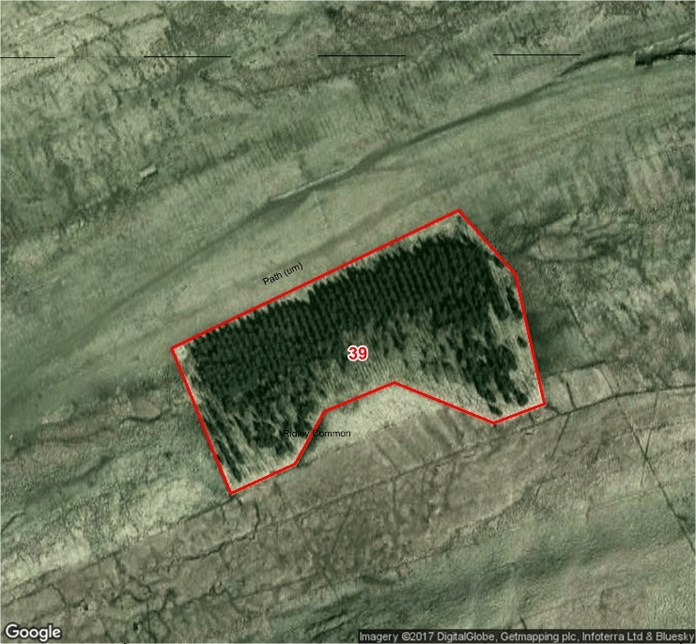
Compartment: 39 Species: Sitka Spruce and Hybrid Larch with Scots Pine and Sycamore Hectares: 2.4
Designations: SSSI, SAC Intervention: None
Issues: None
Description: A mature mixed woodland with an even structure.
Aims: To manage for visual amenity, health and safety, and biodiversity.
19

Slide 25
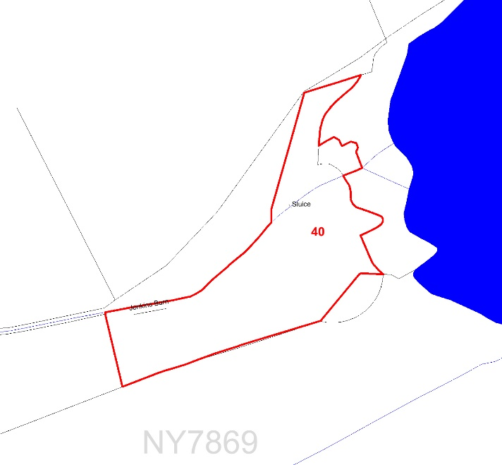
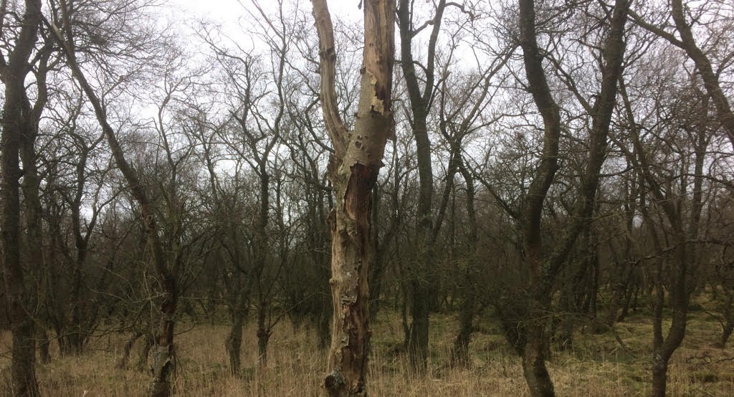
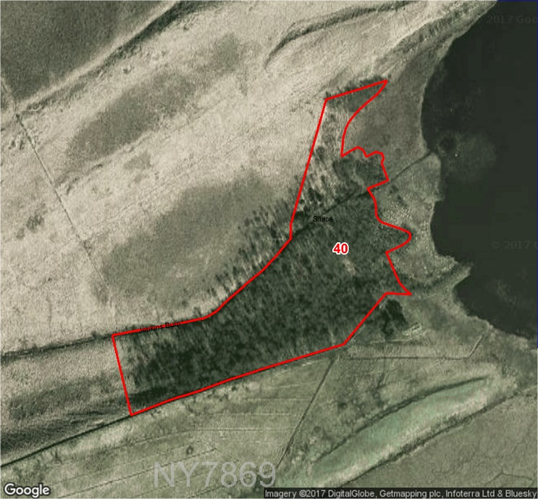
Compartment: 40 Species: Birch and alder with Scots Pine Hectares: 2.3
Designations: SSSI, SAC Intervention: None
Issues: None
Description: A mature mixed wet woodland with an even structure.
Aims: To manage for visual amenity, health and safety, and biodiversity.
20

Slide 26
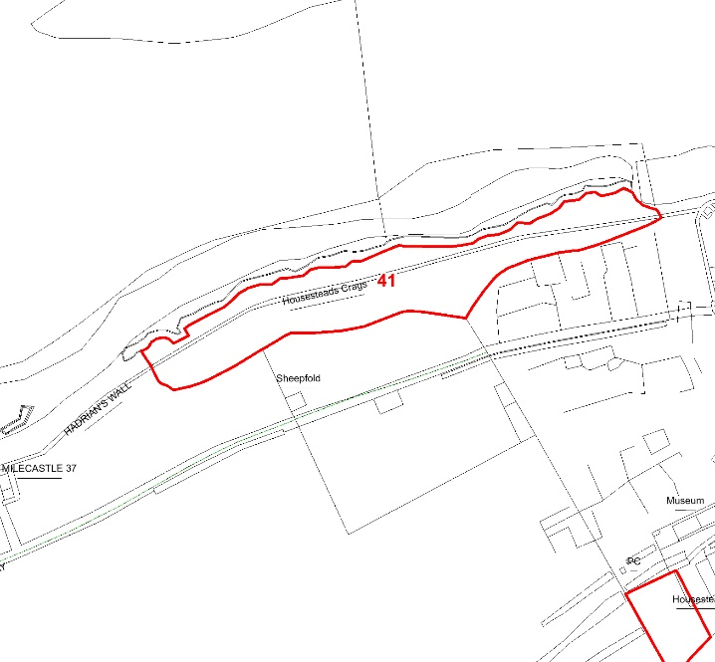
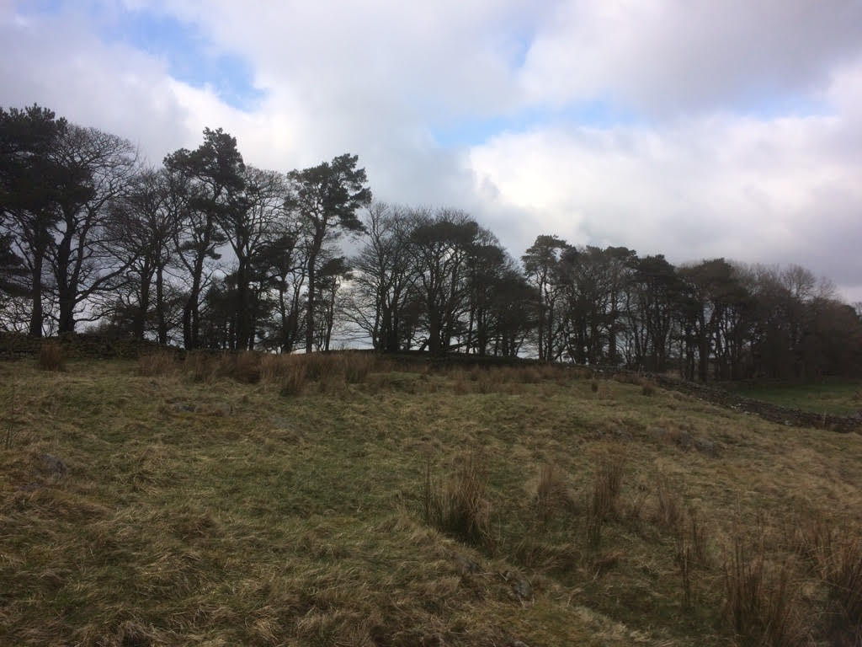
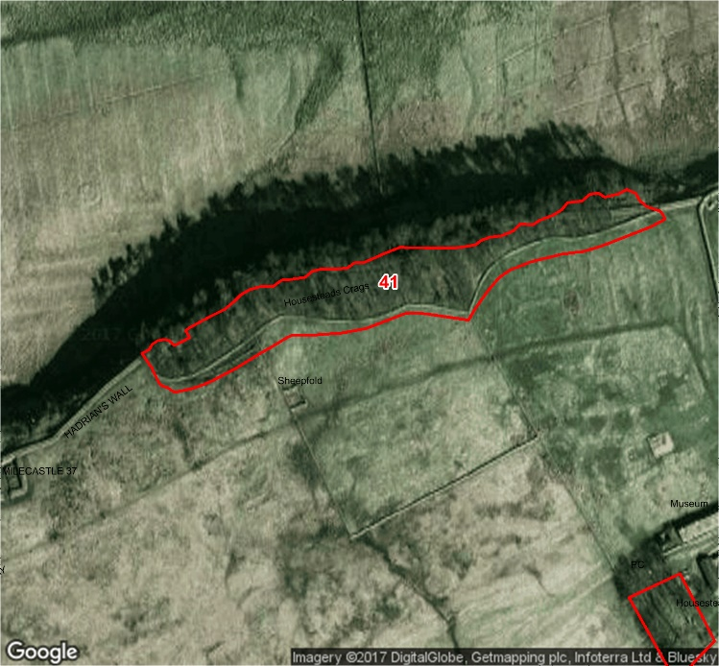
Compartment: 41 Species: Scots Pine, Sycamore and Hybrid Larch Hectares: 0.8
Designations: SSSI, SAM Intervention: None
Issues: None
Description: A mature mixed woodland with an even structure.
Aims: To manage for visual amenity, health and safety, and biodiversity.
21

Slide 27
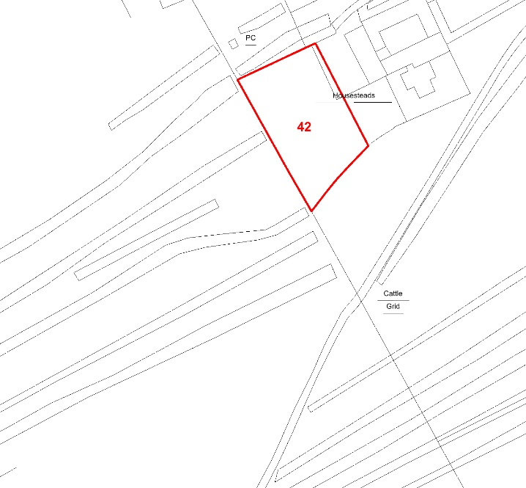
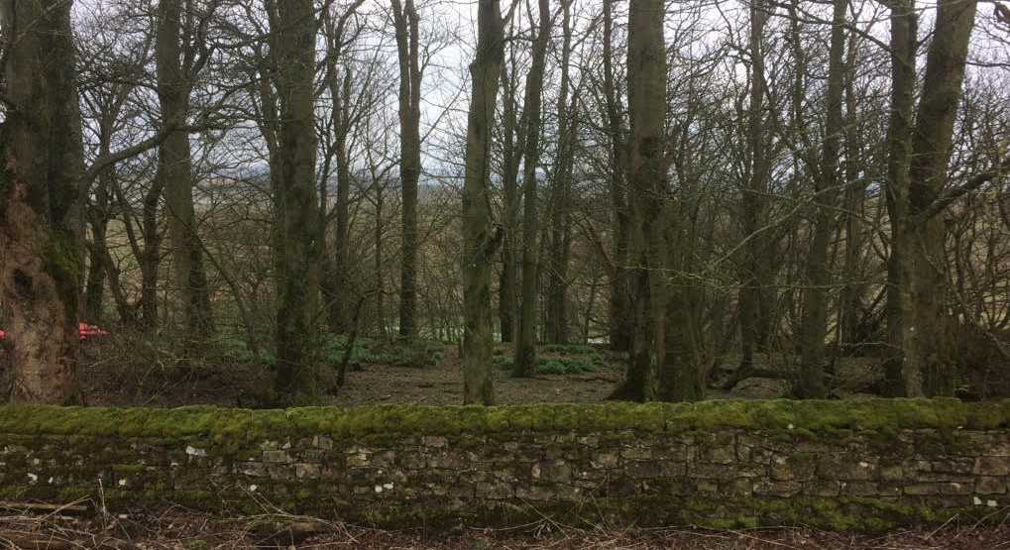
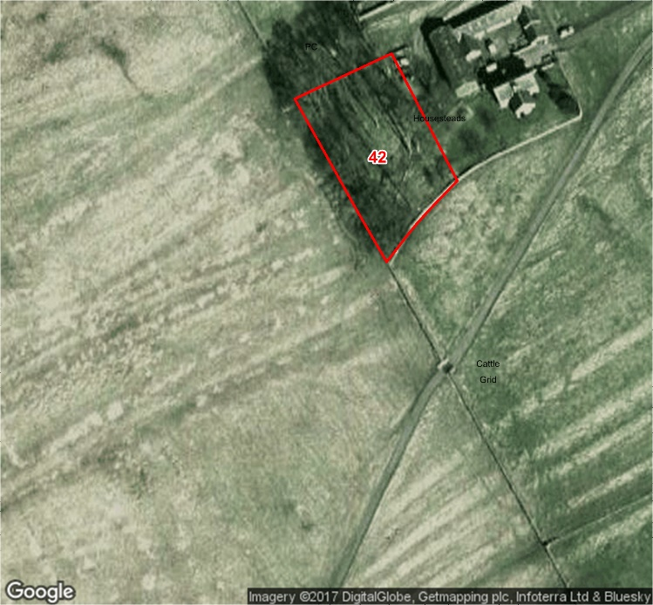
Compartment: 42 Species: Sycamore Hectares: 0.13
Designations: SSSI, SAM Intervention: None
Issues: None
Description: A mature broadleaved woodland with an even structure.
Aims: To manage for visual amenity, health and safety, and biodiversity.
22

Slide 28
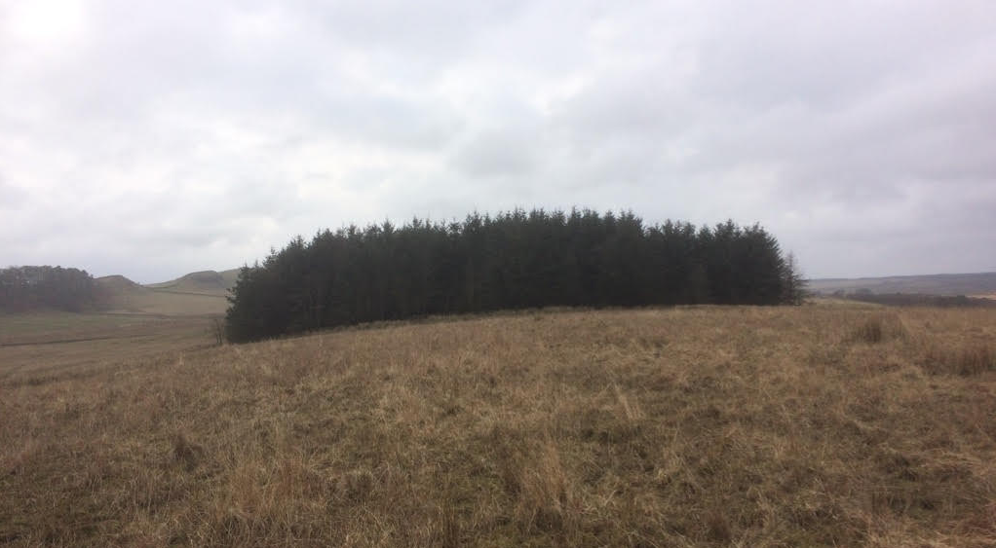
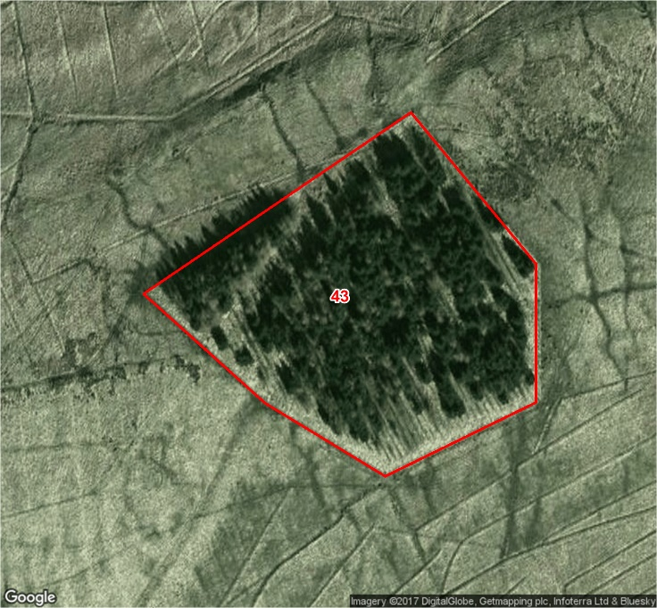
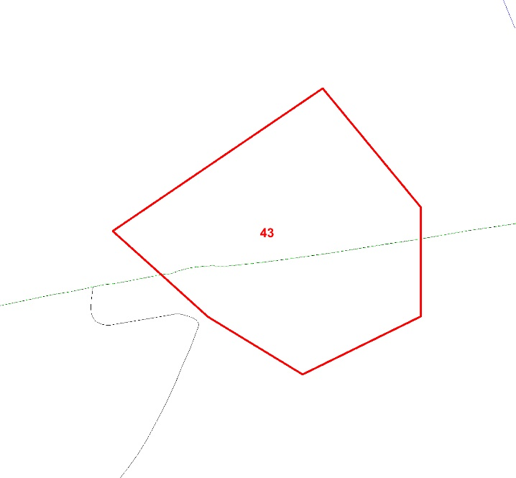
Compartment: 43 Species: Norway Spruce and Hybrid Larch Hectares: 1.13
Designations: SSSI, SAC Intervention: None
Issues: None
Description: A conifer woodland with an even structure.
Aims: To manage for visual amenity, health and safety, and biodiversity.
23

Slide 29
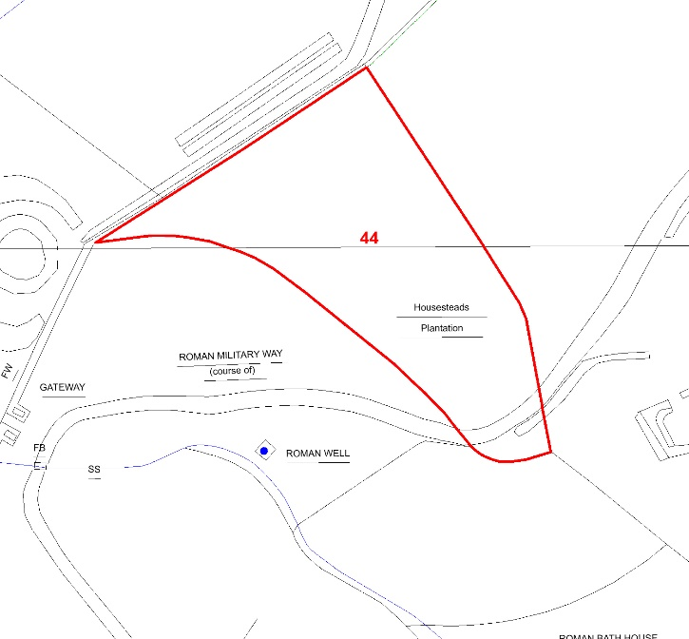
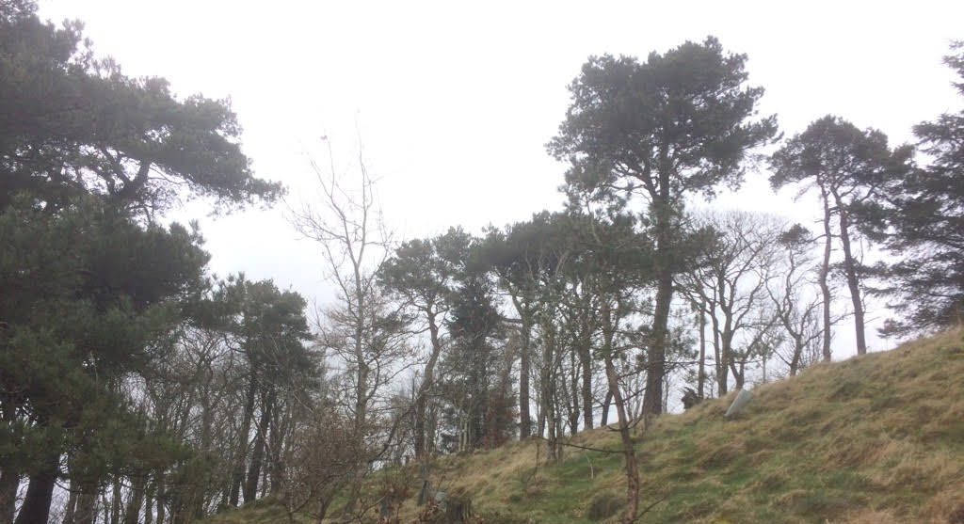
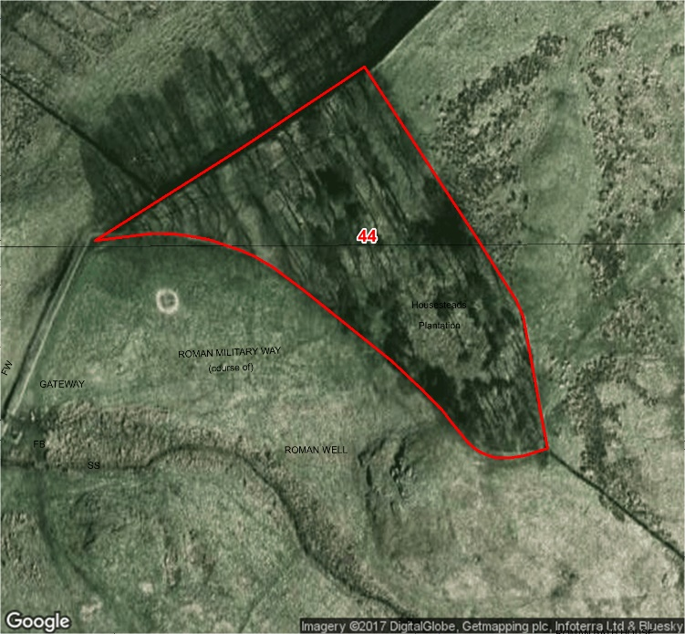
Compartment: 44 Species: Scots Pine and Sycamore Hectares: 0.57
Designations: SSSI, SAM Intervention: None
Issues: None
Description: A mature mixed woodland with an even structure.
Aims: To manage for visual amenity, health and safety, and biodiversity.
24

Slide 30
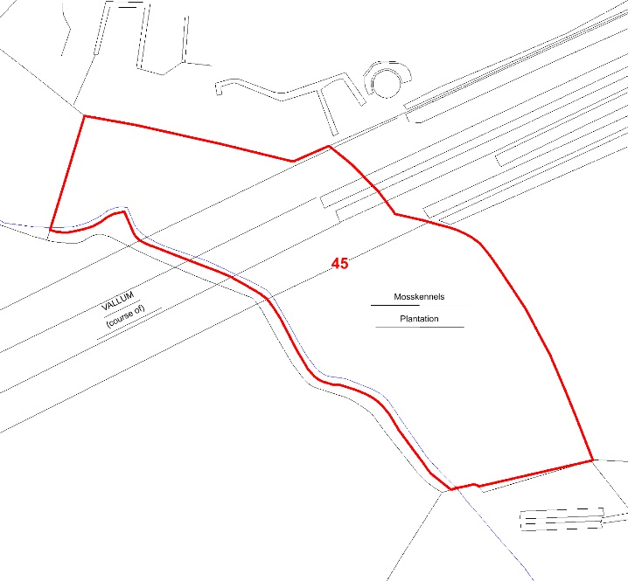
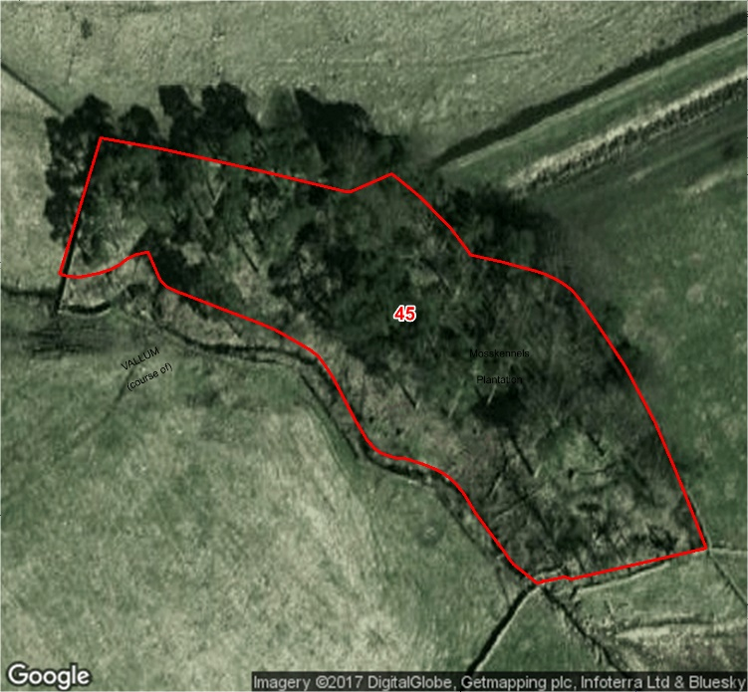
Compartment: 45 Species: Scots Pine, Sycamore, Beech and Elm Hectares: 0.64
Designations: SSSI, SAM Intervention: None
Issues: None
Description: A mature mixed woodland with an even structure.
Aims: To manage for visual amenity, health and safety, and biodiversity.
25

Slide 31
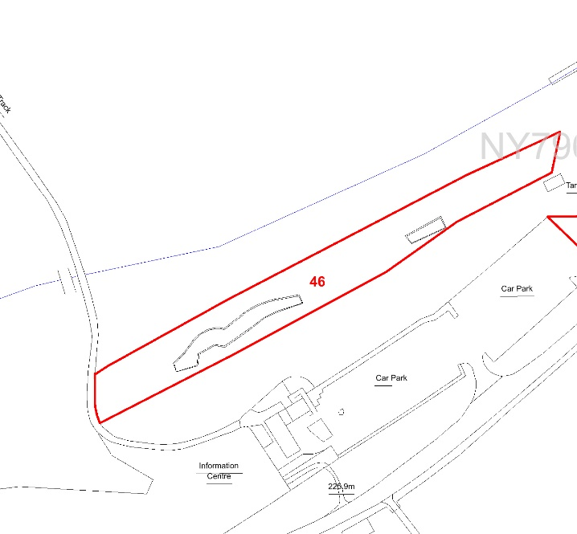
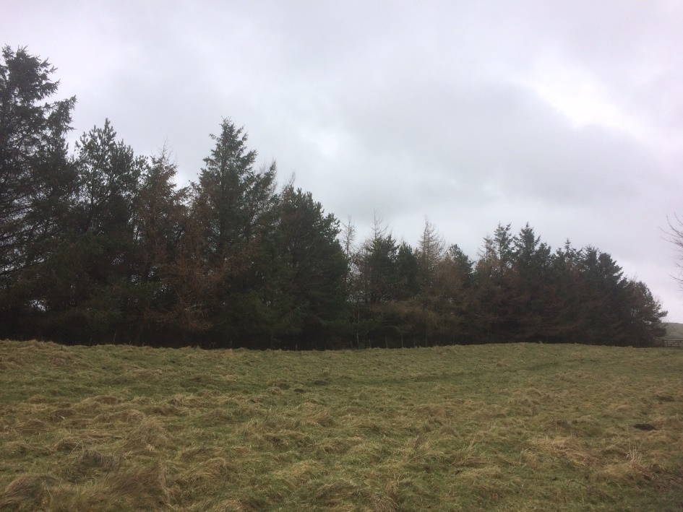
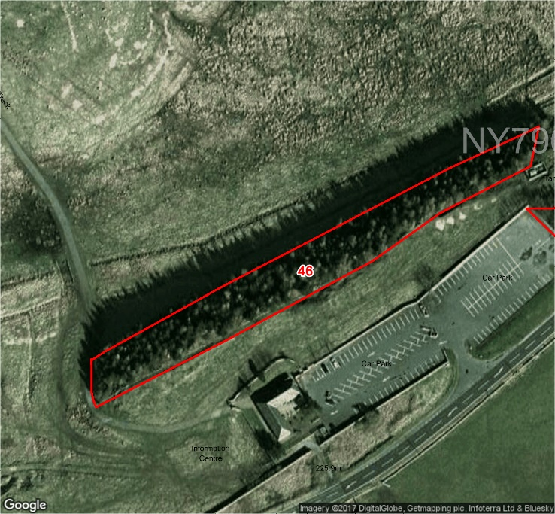
Compartment: 46 Species: Scots Pine, Sitka Spruce, Hybrid Larch and Sycamore Hectares: 0.43
Designations: SSSI, SAM Intervention: Fell Sitka Spruce and Hybrid Larch to no more than 30% of the stand
Issues: None Work Period: January 2018 – January 2020
Description: A mature mixed woodland with an even structure.
Aims: To manage for visual amenity, health and safety, and biodiversity.
26

Slide 32
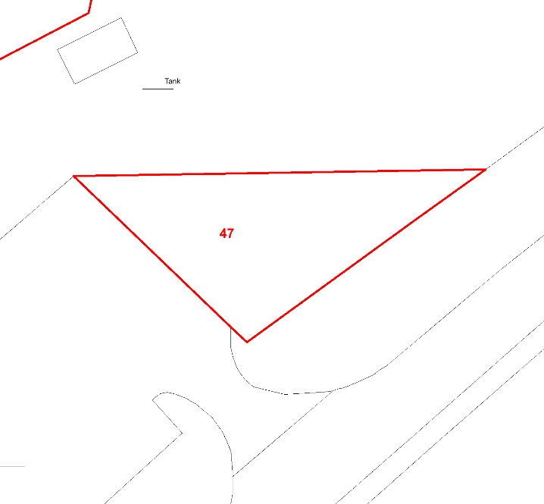
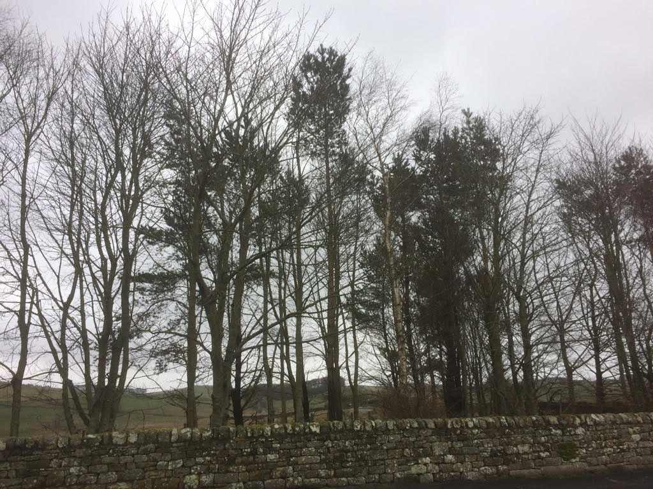
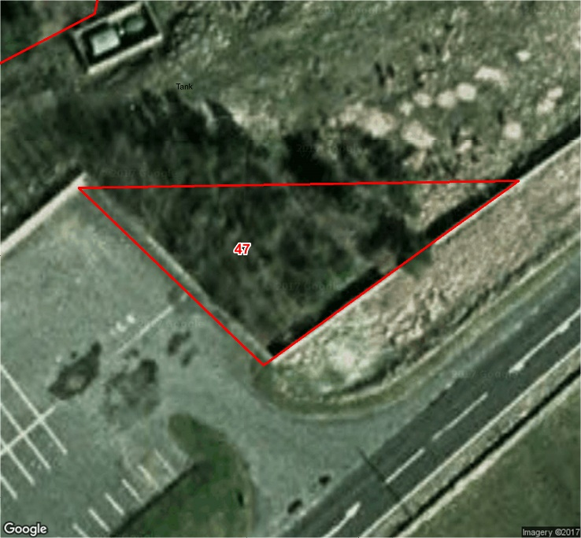
Compartment: 47 Species: Sycamore and Scots Pine Hectares: 0.05
Designations: SSSI, SAM Intervention: None
Issues: None
Description: A mature mixed woodland with an even structure.
Aims: To manage for visual amenity, health and safety, and biodiversity.
27

Slide 33
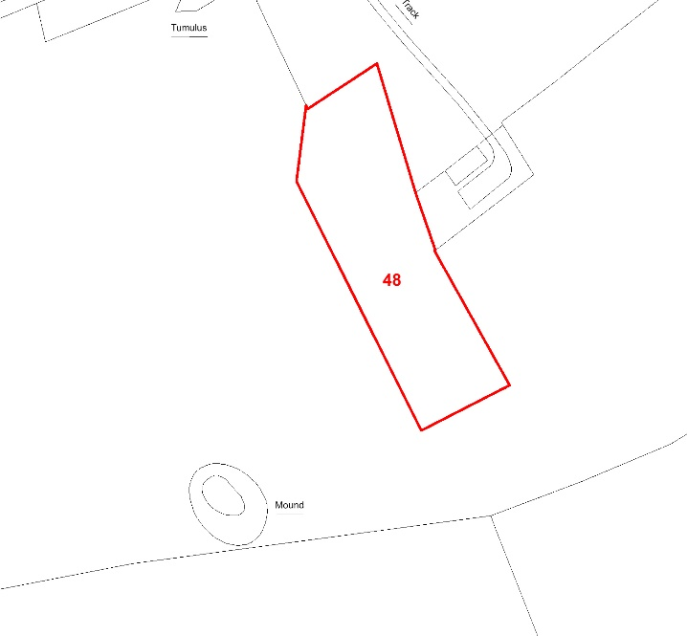
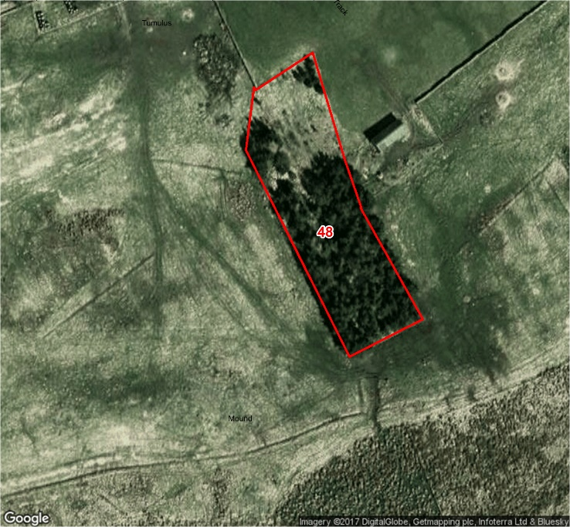
Compartment: 48 Species: Scots Pine, Poplar, Beech, Birch and Ash Hectares: 0.4
Designations: SSSI Intervention: None
Issues: None
Description: A young mixed woodland with an even structure.
Aims: To manage for visual amenity, health and safety, and biodiversity.
28

