Slide 1
Bellister
Woodland Management Plan January 2018-2028

Slide 2
Contents
 | Page |  |  | Page
Section 1: Introduction | 1 |  | Section 4: Compartment Summaries
 |  |  | 19 | 12
Section 2: Our aims and Objectives | 2 to 5 |  | 20 | 13
 |  |  | 21 | 14
Section 3: Maps |  |  | 22 | 15
Compartments and Tree Species | 7 |  | 23a | 16
Work Programme | 8 |  | 23b | 17
Statutory Designations | 9 |  | 24 | 18
Ancient Woodlands and Biodiversity | 10 |  | 25a | 19
Issues | 11 |  | 25b | 20
 |  |  | 26 | 21
 |  |  | 27 | 22
 |  |  | 28 | 23
 |  |  | 29 | 24
 |  |  | 30 | 25
 |  |  | 31 | 26

Slide 3
The aim of this plan is to provide a ten year programme of woodland management that will meet the aims and objectives of the National Trust at Bellister in Northumberland. The detail of the plan focusses on tree thinning and felling works at the site. Detail relating to the access and built structures at the site form the content of other plans.
Background to the Woodlands at Bellister
These woodland form part of the National Trust Hadrian's Wall and Tyne Valley Group of properties. The woodlands covered in this plan include compartments 19-31. The remaining compartments can be seen in the plans for Allen Banks and Staward Gorge and the plan for Hadrian’s Wall woodlands.
In total there are 13 woodland compartments covering 41 hectares.
Bellister Estate forms part of the South Tyne Valley. Altitude 120 – 215m above sea level. Solid geology is overlain with bolder clay. The area is covered by a number of soils including brown earth and surface water gleys. Steep cliff woodland in places with gentle to moderate slope elsewhere, ground slightly uneven to rough and ground bearing capacity good to poor being greatly altered during winter months as well as abnormal rainfall at other times of the year.
The estate is primarily an agricultural estate, farmed under three separate tenancies and a survival of a type of estate that was once common in the border country. The estate lies within South Tyne Valley and is surrounded by undulating hills. The woodland area behind Bellister Castle, an ancient woodland site, contains remains of a Victorian landscape planting and although less formal now does provide a backdrop to the castle setting. Specimen trees from this planting should be retained wherever possible. This area of woodland is a very prominent landscape feature from the A69 by-pass. There are 14 woodland compartments totalling 41 hectares
Much of the woodland appears to have been felled during the 1940’s and has subsequently re-established by natural regeneration although formally mixed plantation were grown. Some planting has also taken place in the past to screen Haltwhistle as well as in more recent times the A69 Haltwhistle by-pass. Although a wood may be currently ungrased the species composition of the ground flora in places suggests grasing in the past.
The woodlands are a mixture of pasture woodland and enclosed woodland, with the emphasis being on nature conservation and public recreation. The woodlands are small, spread out with the quality of timber generally poor, but with an available resource for woodfuel production.
1

Slide 4
Bellister Castle
Section 2: Our Aims and Objectives

Slide 5
What we want to do | Why we want to do it? | How can we achieve it?
Maximise the value of our woodlands for biodiversity through restoration of Ancient Woodland sites and to conduct management throughout our woodlands that creates a diverse age structure and sustainable, dynamic forest ecosystems. The work we do will aim to protect and enhance biodiversity in all woodlands and open habitats. | Britain’s woodland biodiversity is in trouble. Reports show that 60 per cent of our woodland species have decreased and 34 percent have decreased strongly over recent decades. Species decline is attributed to a lack of structural diversity in our woodlands with low management intervention and increased deer numbers resulting in uniform and aging woodlands. We want to do what we can to reverse this trend and help save Britain’s natural heritage. We’ve identified those species listed as being of high conservation importance, these are listed below: Bats: Myotis, pipistrelle, brown long eared and noctual. Birds: Kingfisher, barn owl, wood warbler, spotted flycatcher, yellowhammer, pied flycatcher Mammals: Red squirrel, otter, badger. Reptiles: Adder, common lizard Invertebrates: Large heath butterfly, soldier beetle spp, ground beetle spp Amphibians: Frogs, toads, and newts | Phased removal of invasive species from ASNW and PAWS sites including cutting and spraying of rhododendron. Continue removal of conifer via a programme of selective felling, thinning and clearfell. Where access permits phased, economic, silvicultural operations; the conifer stands will be selectively thinned prior to final felling (conifer removal) at economic maturity or they will be gradual transitioned towards a system of continuous cover forestry. Alternatively, where severe access constraints make thinning operations uneconomic either, selective/clear felling i.e. of conifer stems in the stand or waste felling over many years will be carried out. Both methods will facilitate subsequent regeneration and recolonisation of native broadleaved species. Use a combination of natural regeneration and enrichment planting with native species to regenerate or restock sites to favour red squirrel and dormouse habitat. Evaluate the current nature conservation value of the woodlands through stakeholder communications and survey work. Monitor priority species and habitats to help assess improvement and gain a better understanding of current position. Control non-native invasive species including rhododendron and grey squirrel. Manage and control deer populations where possible and appropriate. Encourage the development of greater structural and species diversity through supplementary tree planting where natural regeneration is not apparent or of the desired species. Increase dead wood volumes by ring barking selected trees away from areas of high public access. Identify and conserve veteran trees. Avoid felling large/veteran trees for safety reasons unless absolutely necessary. Protect wildlife and ancient woodland features by marking them on the ground during operations and including them in operational constraints maps. Ensure regeneration is protected from adjacent livestock farming through fence maintenance and when restocking, consider provenance and species in relation to climate change
2

Slide 6
What we want to do | Why we want to do it? | How can we achieve it?
To improve access for management and enhance and encourage safe and sympathetic public access, extending opportunities for education, recreation and participation where this does not conflict with the other objectives | The quality of experience for our visitors is of high importance. This plan aims to maintain the woodlands' wild feel and to ensure that our woodlands can be enjoyed by generations to come. | Assess the current access situation and map where access can be improved/created. Establish a program of access improvement/ creation. Develop opportunities for the local community of Tyne Valley to get involved in the site through the volunteer programme. Improve access throughout the sites to facilitate management programmes and enable people to enjoy and get more from their visit. Use the programme of woodland management as a tool to engage visitors and educate them about the importance of conservation and what our sites can offer. Create access which facilitates woodland management and compliments the existing public access infrastructure.
Reduce our carbon footprint | The Earth’s temperature is warming a result of human activities. Global Warming is already having a terrible impact upon the lives of people and nature across the globe. If the global rise in temperature can be kept below 2 degrees Celsius, the negative effects of climate change can be minimised, this however will require a change in all of our carbon outputs. We therefore wish to minimise carbon outputs and sequester as much carbon as possible through natural processes. | To conduct woodland management which promotes the growth of new trees and rapid growth through tree species selection for replanting and silvicultural systems such as coppicing. To undertake silvicultural practices which minimise soil erosion and promote soil formation. Work which allows more light to the woodland floor will facilitate this process.
Improve the capacity of our woodlands for resource protection and flood resilience, slowing the flow of water across our land to improve water quality coming off our land and play a part in protecting downstream communities at risk of flooding | Flooding is becoming an increasing risk to both urban and rural communities. We wish to play our part in the mitigation of the impacts of these storm events. | Undertake management works which increase the structural diversity of the woodland stand and increase the density and diversity of ground flora. Use brash arisings to create small leaky dams in tributaries and feeder streams to slow the flow of water in storm events where appropriate. Undertake best practice during operations to protect soils using brash mats and avoid watercourses.
3

Slide 7
What we want to do | Why we want to do it? | How can we achieve it?
Contribute to the local economy | We want our land to contribute to the quality of life for local people. One of the ways we seek to achieve this is by contributing to the local economy. | Where possible and appropriate, trees will be harvested when they achieve their optimal economic potential Apply for appropriate woodland/countryside grant schemes and regional funding to achieve stated objectives Where possible generate timber income through harvesting programmes to help fund the ecological restoration process and wider woodland improvement programmes. Work with regional contractors to develop a contractor base adapted to woodlands with access issues.
Ensure the woodland habitats are resilient to climate change and plant diseases | Climate change presents an unprecedented threat to our woodland ecosystems. By creating woodlands diverse in structure and species we will increase the overall resilience of these ecosystems. | Increase structural and species diversity where ever possible through harvesting to allow natural regeneration where possible. Remove species known to increase the likelihood of disease transmission e.g Rhododendron Seek opportunities to increase habitat connectivity Survey HWTVG to identify the potential for habitat creation.
To manage health and safety at the site in line with the ‘Tree Safety Management in the National Trust’ procedure Sep 2015 | There are risks of injury to staff, volunteers and the public from falling trees and branches. There are also risks of damage to buildings, property and vehicles. The Trust has a statutory and common law duty to assess and manage these risks. The duty is established in criminal law under the Health and Safety at Work Act, and in civil law under the Occupier’s Liability Act. The Trust must take all precautions as far as is reasonably practicable to avoid risks to the safety of members of the public, staff and volunteers. Therefore there is a need to inspect trees in and near public places and adjacent to buildings and working areas, to assess whether they represent a risk to life and/or property, and to take remedial action as appropriate. | By following National Trust Health and Safety procedures.
4

Slide 8
What we want to do | Why we want to do it? | How can we achieve it?
Conserve the historic and cultural landscape in ways that enhance the Spirit of Place | We recognise our responsibility towards the protection of our historic environment and seek to maintain and enhance it for ongoing enjoyment and education. This will conserve the historic and cultural landscape in ways that enhance the Spirit of Place | Using the Site and Monuments register record the condition of the archaeological features across HWTVG. When carrying out woodland work ensure that the historic environment is protected in line with guidance from Historic England. Working with the NT archaeologist discuss the further research recommendations from historic environment report (where applicable) and the potential to achieve them. The historic environment report highlights a certain number of management concerns and recommendations address these as part of the management of the sites. Maintain and protect designed woodland landscape elements across the site.
5

Slide 9
Compartment 20
Section 3: Site Maps
Compartment 1d

Slide 10
7

Slide 11
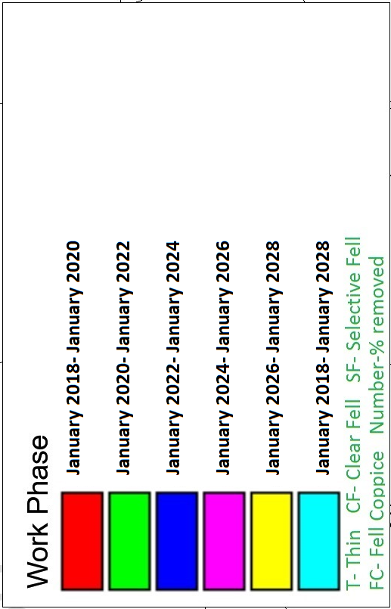
8

Slide 12
9

Slide 13
10

Slide 14
11

Slide 15
Section 4: Compartment Summaries
Compartment 25b:
Credit - Sarah Bennett

Slide 16
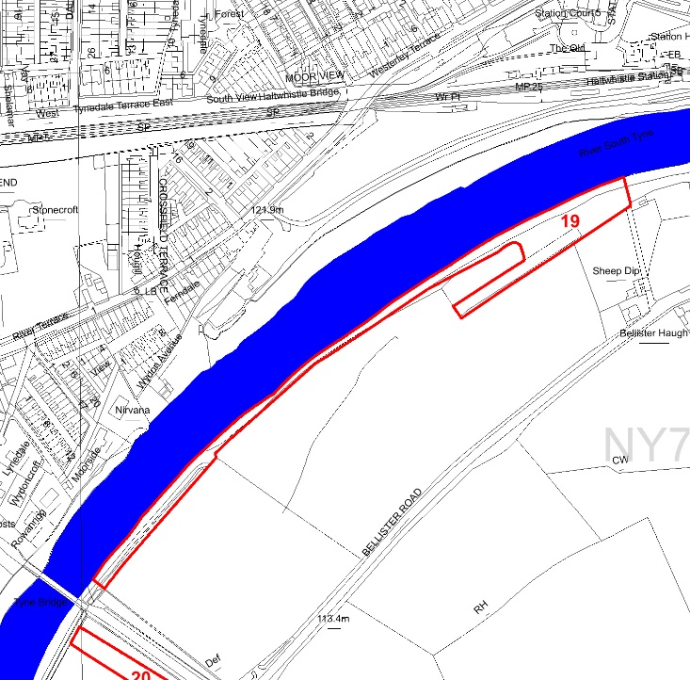
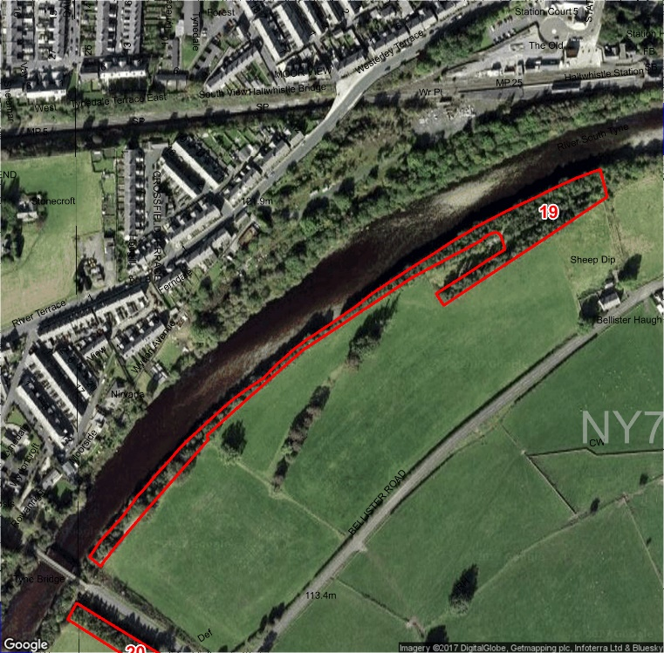
Compartment: 19 Species: Alder and Scots Pine with Sycamore and Ash Hectares: 0.82
Designations: None Issues: None Intervention: None
Description: A mature woodland with mixed native and non-native species and varied age structure.
Aims: To manage for visual amenity, health and safety, and biodiversity.
12

Slide 17
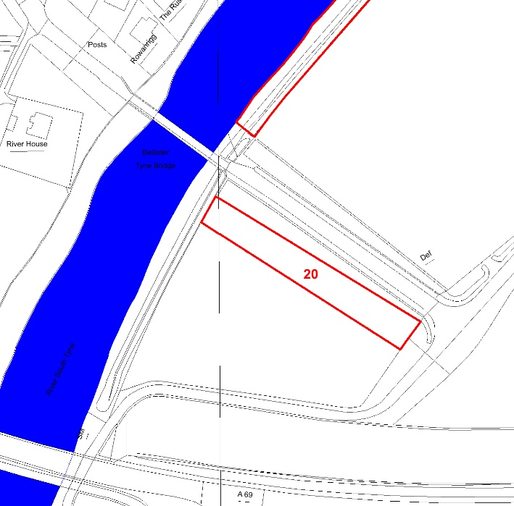
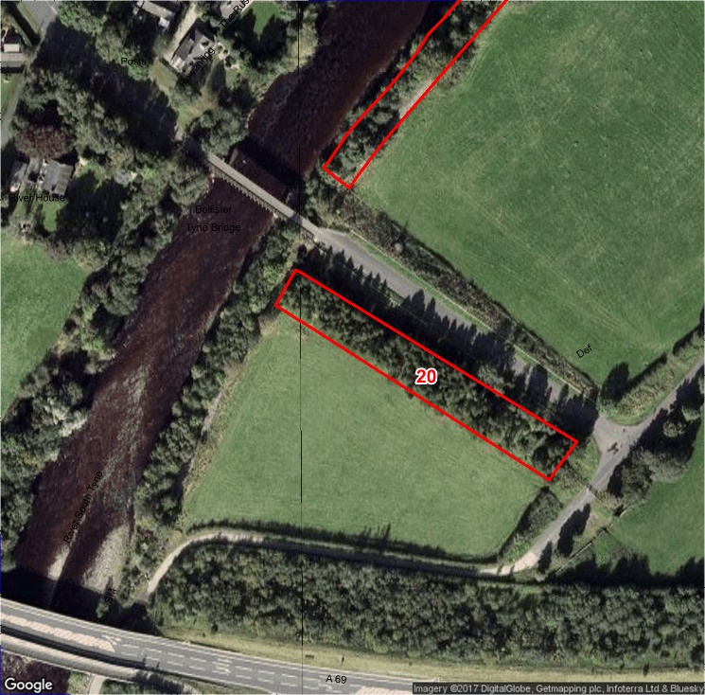
Compartment: 20 Species: Alder, Rowan, Scots Pine and Birch Hectares: 0.22
Designations: None Intervention: Invasive species control
Issues: Himalayan Balsam
Description: A new woodland with mixed native specie.
Aims: To manage for visual amenity, health and safety, and biodiversity.
13

Slide 18
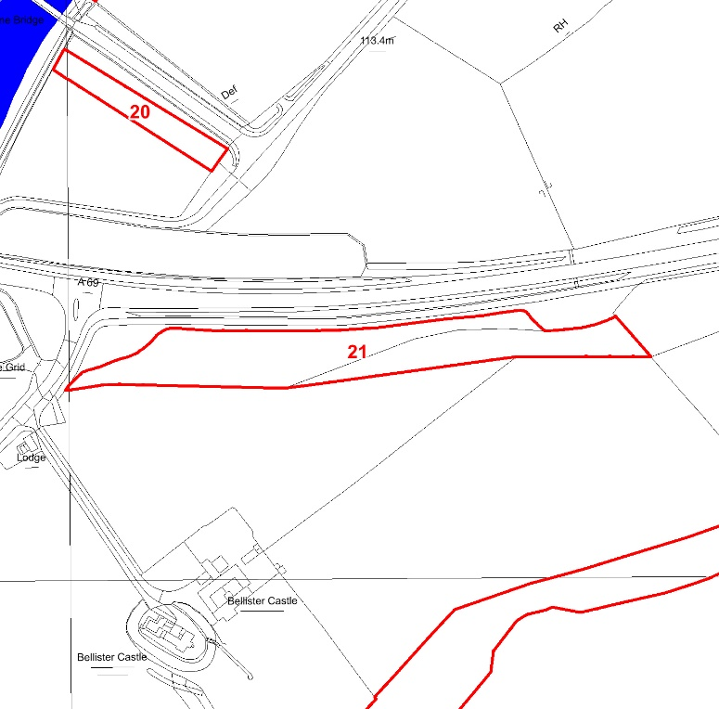
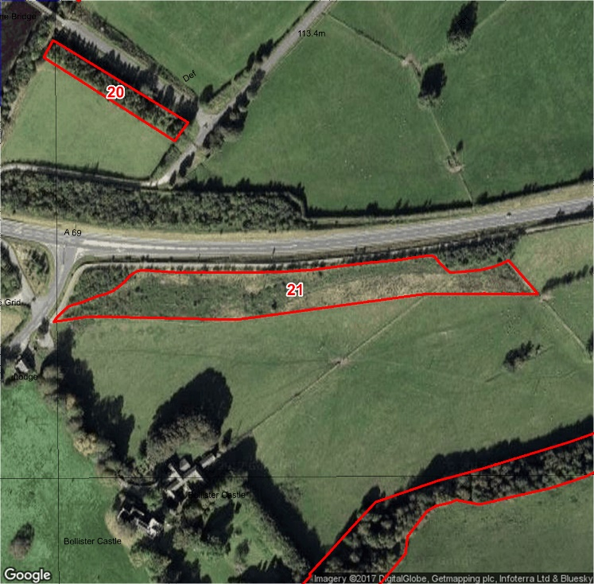
Compartment: 21 Species: Willow, Alder, Scots Pine, Sessile Oak and Ash Hectares: 1.01
Designations: None
Intervention: None
Issues: None
Description: A young mixed woodland with varied age structure.
Aims: To manage for visual amenity, health and safety, and biodiversity.
14

Slide 19
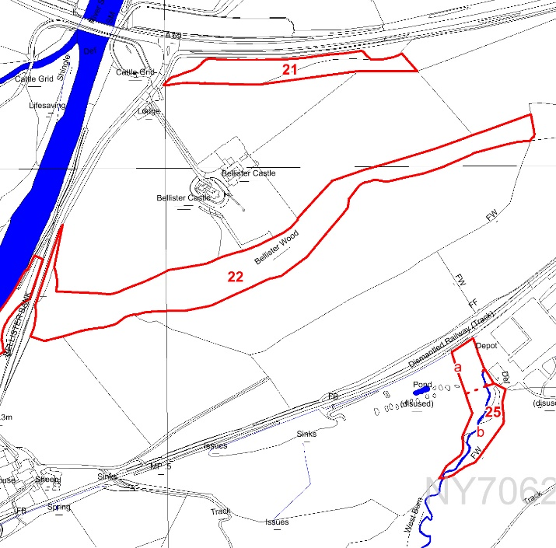
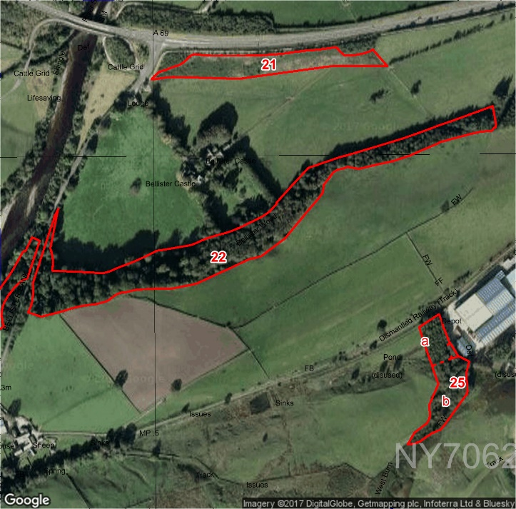
Compartment: 22 Species:Birch and Sessile Oak with Beech, Sycamore, Sitka Spruce and Japanese Larch Hectares: 2.1
Designations: ASNW Intervention: Fell Beech, Sitka Spruce and Japanese Larch to no more than 30% of the stand
Restock with Aspen and Birch. Invasive species control
Work Period: January 2022- January 2024 Issues: Himalayan Balsam
Description: A mature woodland with mixed native and non-native species and uniform age structure.
Aims: To remove non-native species and increase structural diversity.
15

Slide 20
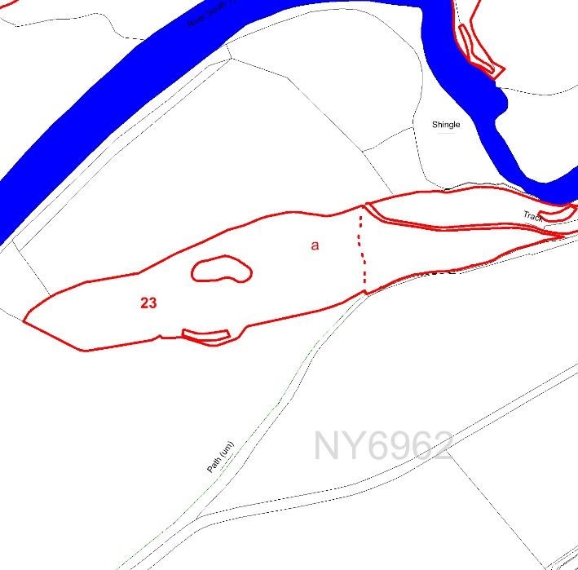
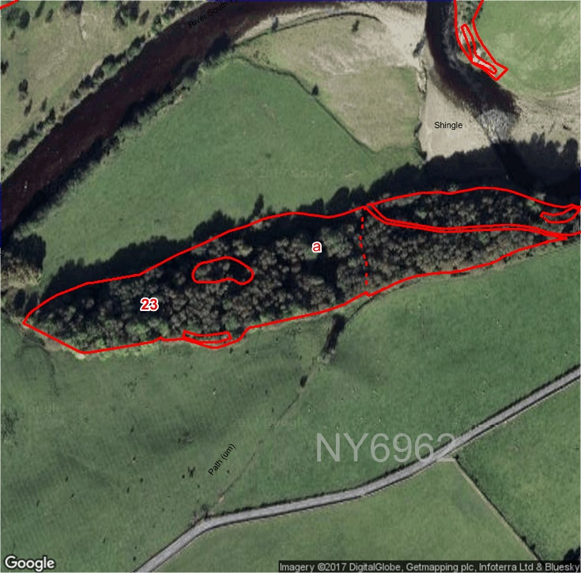
Compartment: 23a Species: Birch and Sycamore Hectares: 1.48
Designations: ASNW
Intervention: Coppice 50% of the stand replant some sessile oak.
Work Period: January 2018- January 2028 Issues: None
Description: A mature broadleaved woodland with a uniform structure
Aims: To increase natural regeneration of native species and improve structural diversity.
16

Slide 21
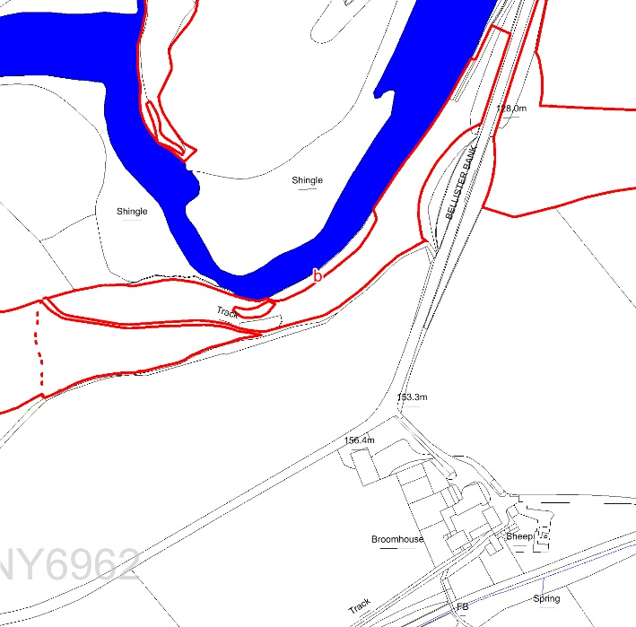
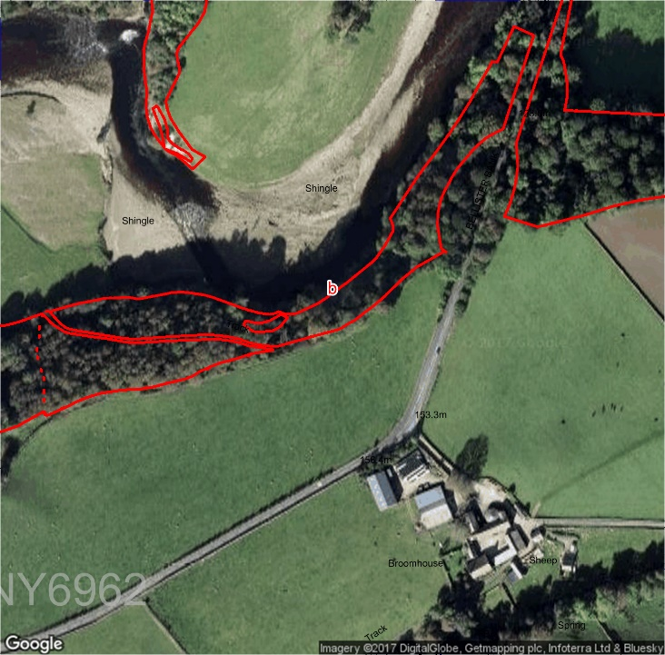
Compartment: 23b Species: Ash, Sycamore and Hazel Hectares: 1.4
Designations: ASNW
Intervention: None
Issues: Land Slips
Description: A mature, predominantly native woodland
Aims: To manage for visual amenity, health and safety, and biodiversity.
17

Slide 22
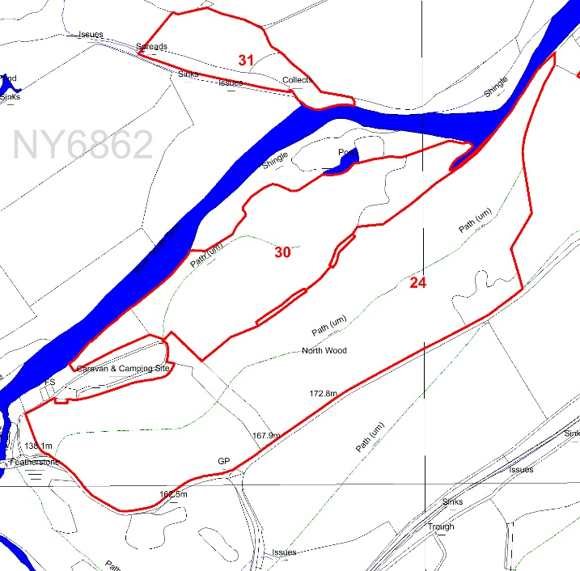
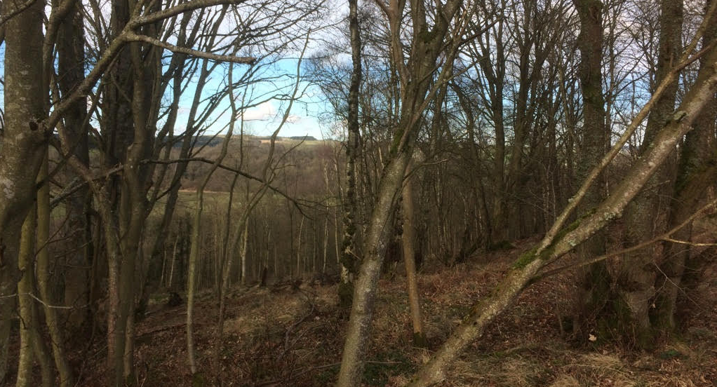
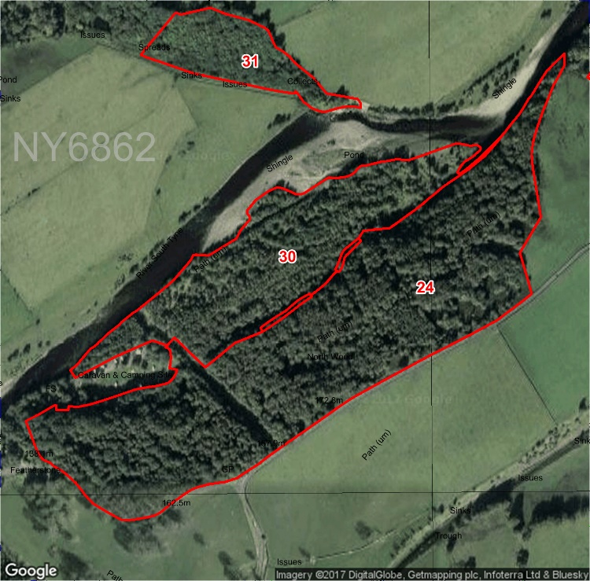
Compartment: 24 Species: Birch and Sycamore Hectares: 2.84
Designations: SSSI, SAC, ASNW Intervention: Coppice 50% of the stand and replant some sessile oak
Work Period: January 2018- January 2028 Issues: None
Description: A mature woodland with native and non-native broadleaved tree species and a varied age structure.
Aims: To diversify structure and encourage natural regeneration of native species.
18

Slide 23
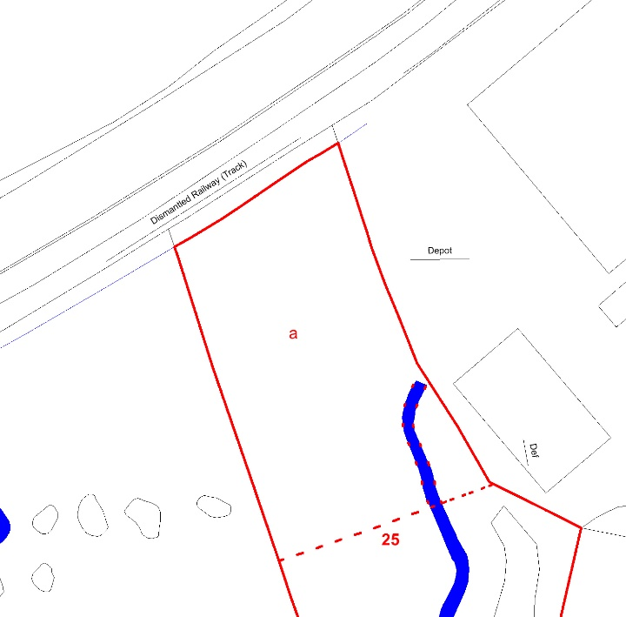
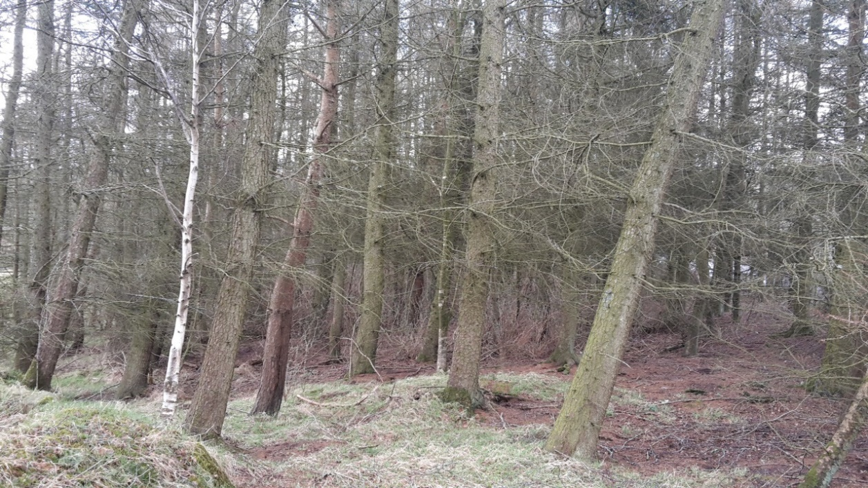
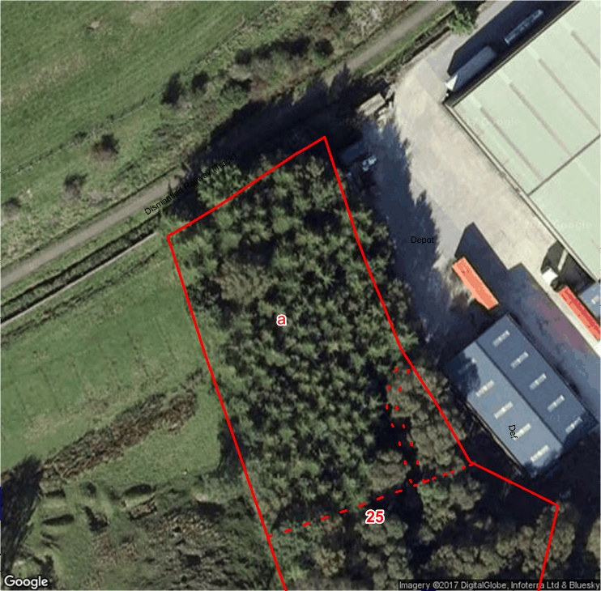
Compartment: 25a Species: Hybrid Larch and Scots Pine Hectares: 0.28
Designations: None Intervention: Clearfell and restock with Aspen, Scots Pine and Birch
Issues: None
Description: A conifer woodland with a uniform age structure.
Aims: To create a native woodland which will quickly screen buildings.
19

Slide 24
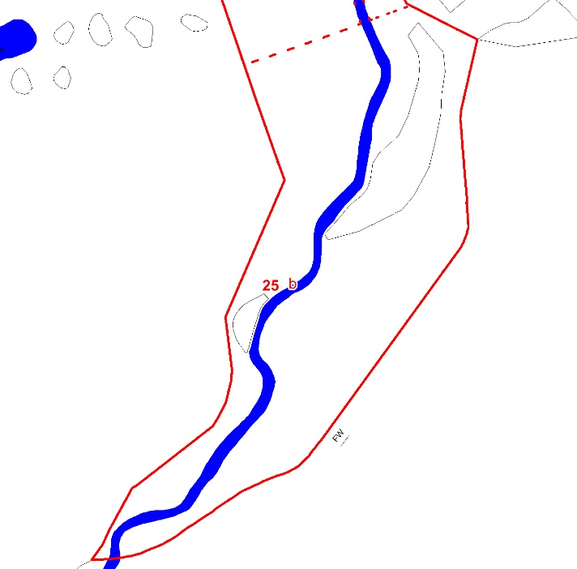
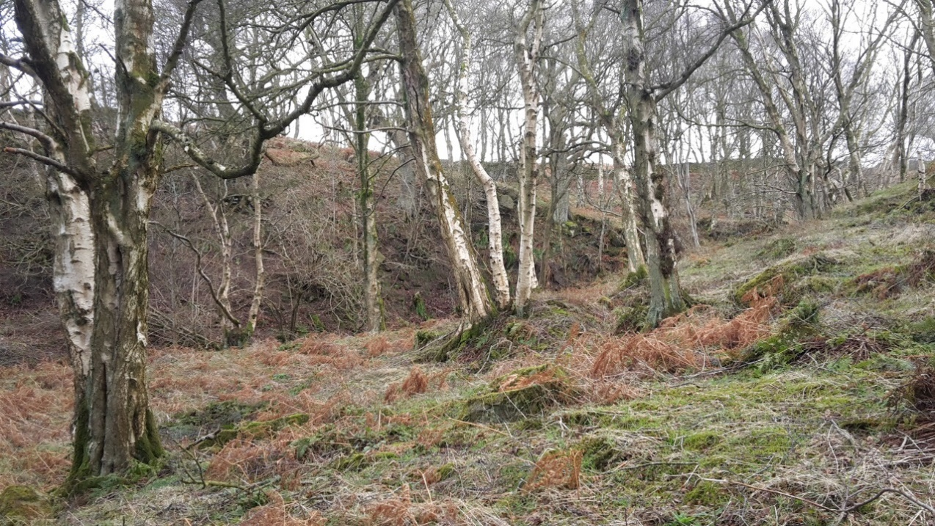
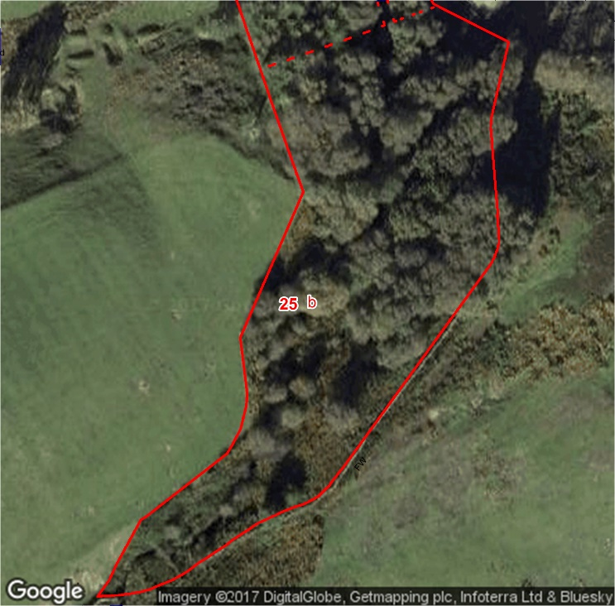
Compartment: 25b Species: Birch and Sessile Oak Hectares: 0.60
Designations: None Intervention: None
Issues: None
Description: A mature native woodland with a varied age structure.
Aims: To manage for visual amenity, health and safety, and biodiversity.
20

Slide 25
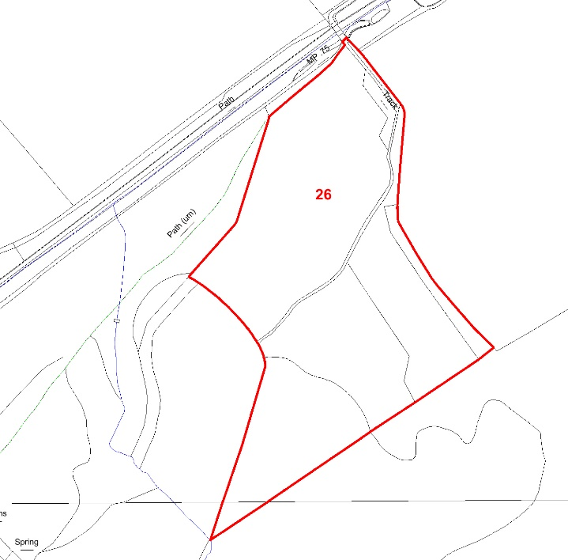
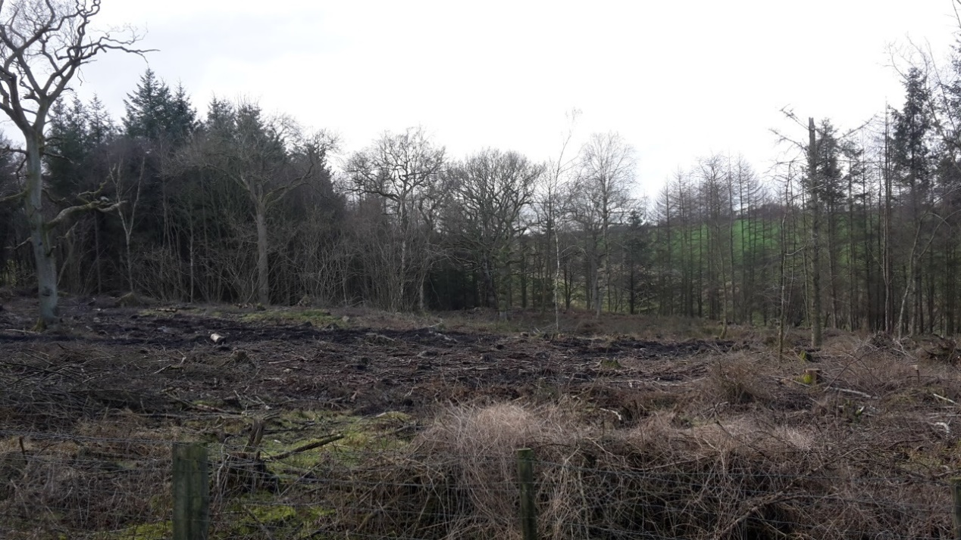
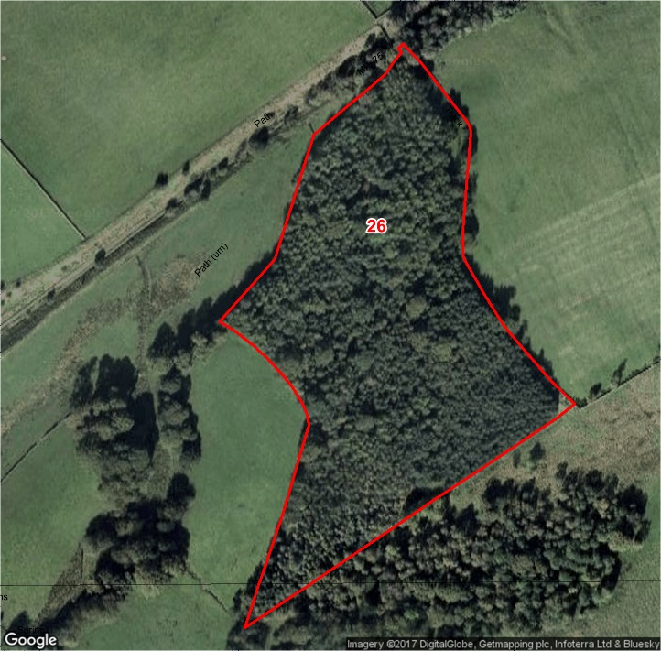
Compartment: 26 Species: Norway Spruce and Pedunculate Oak Hectares: 4.9
Designations: ASNW Intervention: Fell Norway Spruce to no more than 20% of the stand
Work Period: January 2020- January 2022 Issues: Wind blow
Description: A mature woodland with mixed native and non-native broadleaved species and a varied age structure.
Aims: To restore to native woodland
21

Slide 26
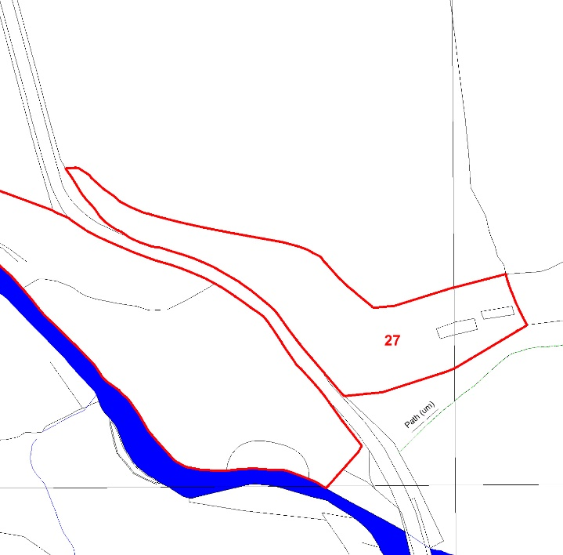
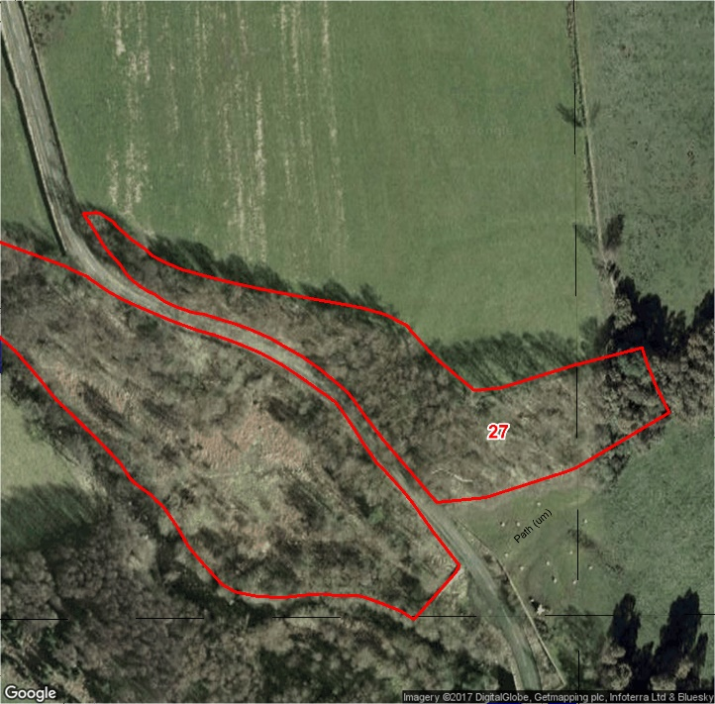
Compartment: 27 Species: Birch with Ash and Sycamore Hectares: 0.6
Designations: ASNW Intervention: None Issues: None
Description: A mature woodland with mixed native and non-native broadleaved species and a varied age structure.
Aims: To manage for visual amenity, health and safety, and biodiversity.
22

Slide 27
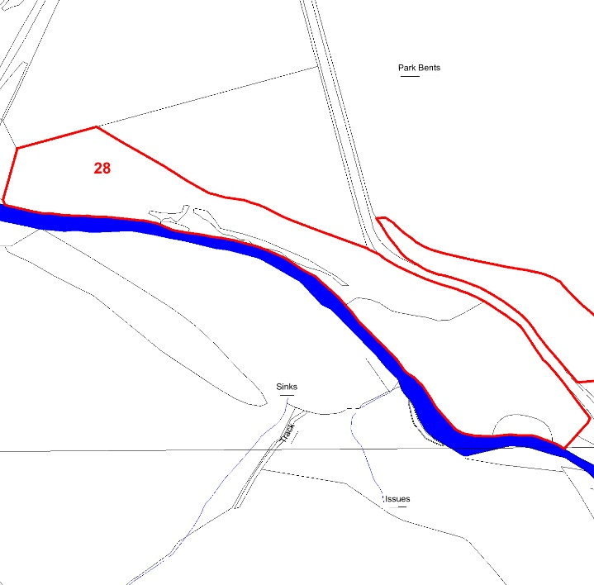
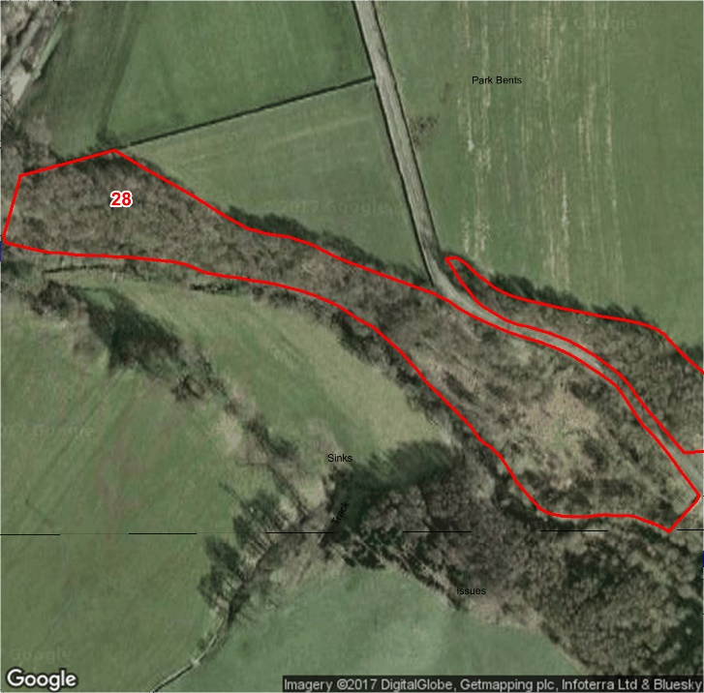
Compartment: 28 Species: Birch and Willow Hectares: 1.78
Designations: ASNW Intervention: Invasive species control
Issues: Rhododendron
Description: A mature woodland with mixed native species and a varied age structure.
Aims: To manage for visual amenity, health and safety, and biodiversity.
23

Slide 28
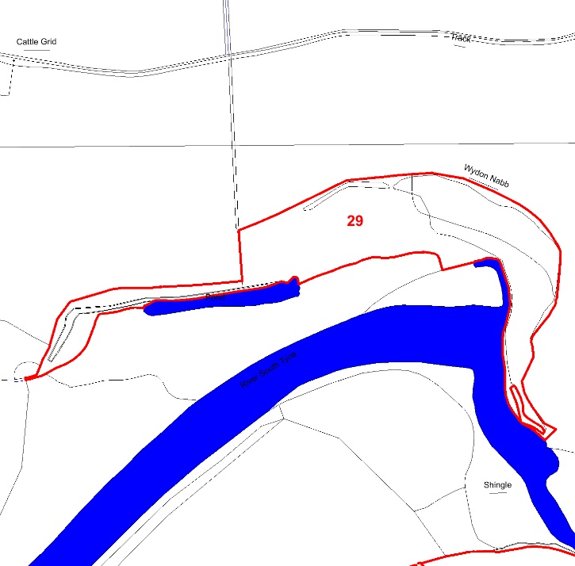
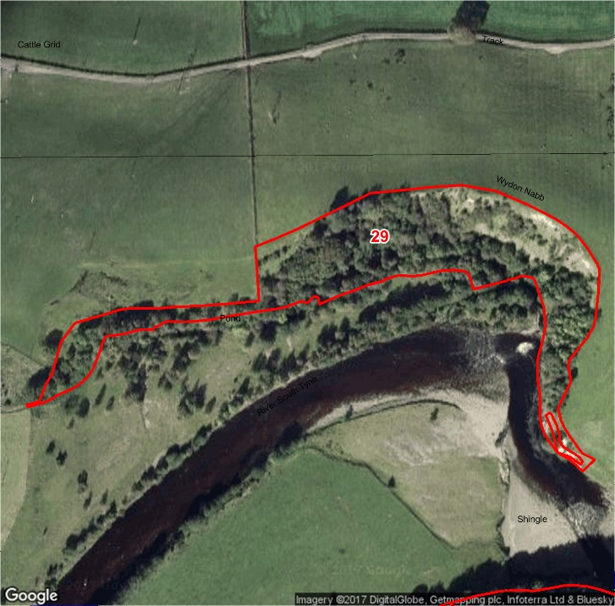
Compartment: 29 Species: Sessile Oak, Sycamore and Alder Hectares: 1.9
Designations: SSSI, SAC Intervention: None
Issues: Land Slips
Description: A mature woodland with mixed native and non-native species and a uniform age structure
Aims: To manage for visual amenity, health and safety, and biodiversity.
24

Slide 29
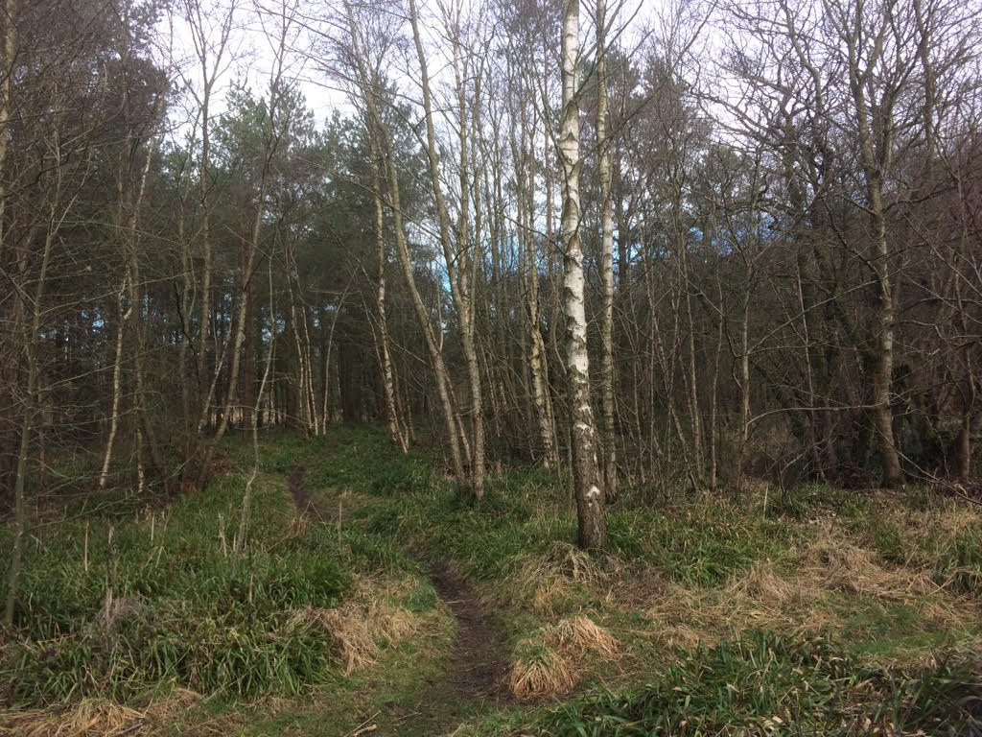
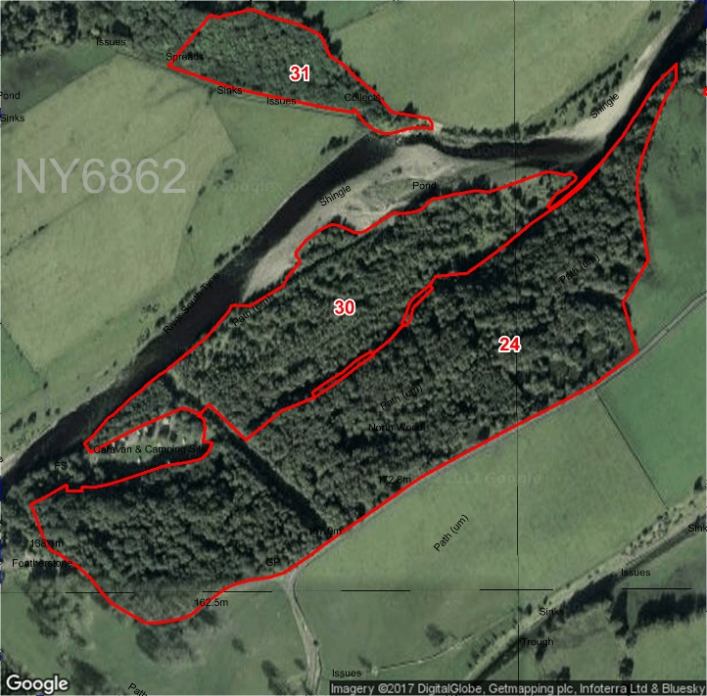
Compartment: 30 Species: Birch with Scots Pine, Sycamore, Alder and Willow Hectares: 5.9
Designations: SSSI, SAC Intervention: 30% Thin
Work Period: January 2020- January 2022 Issues: None
Description: A mature woodland with mixed native and non-native species and a varied age structure
Aims: To diversify structure and encourage natural regeneration of native species.
25

Slide 30
Compartment: 31 Species: Ash with Alder Hectares:1.9
Designations: ASNW Intervention: None Issues: Land slip
Description: A mature native woodland.
Aims: To manage for visual amenity, health and safety, and biodiversity.
26

