Slide 1
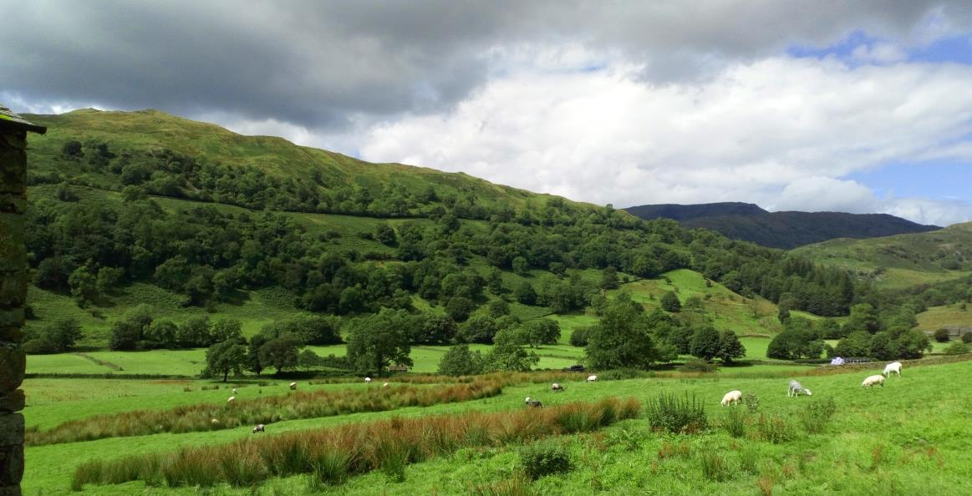
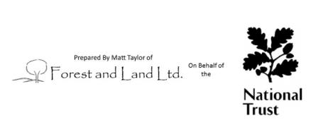
Central & East Lakes: Windermere valleys
Woodland Management Plan 2018-2028

Slide 2
The aim of this plan is to summarise the ten year programme of woodland management planned for National Trust woodlands across the Windermere valleys (Windermere, Ambleside and Troutbeck) within the Central and East Lakes property. The plan details woodlands within the NT land-holding and any planned forestry operations, including thinning & felling, infrastructure works, and improved monitoring. This particular document summarises the full Woodland Management Plan submitted to the Forestry Commission, aiming to highlight key details for each particular woodland and copse.
Background to the woodlands in the Windermere valleys property
The National Trust's holding with the Windermere, Troutbeck and Ambleside Property covers a twelve farms (and other additional land rented to farm businesses), occasional larger woodlands, and numerous small woodland blocks. The majority of the property sits on sandstone and mudstone, with a narrow band of Coniston limestone running from below Ambleside towards above Troutbeck and more volcanic Langdale bedrock to the north of this; elevation ranges from 40m a.s.l. at Bowness towards 300m a.s.l. or more at the upper reaches of the Troutbeck Valley, giving a ride range of soil and climatic conditions influencing woodland types and species compositions.
The woodland holdings total approximately 137 ha, including the large ancient semi-natural woodland of Skelghyll/Dovenest near Ambleside, the mixture of ASNW blocks within NT and other ownership to the north of Windermere, and the mixture of woodland and wood-pasture forming a continuous belt of tree-lined habitat on the western slopes of the upper Troutbeck valley. Elsewhere, P1980s-1990s farm shelterbelts form small copses within a predominantly grazed landscape, riparian woodlands along the lower slope of Troutbeck River are partly within NT owner-ship, and ghyll-side woodland fencing and supplementary planting is most notable on the slopes of Wansfell. A few isolated blocks of conifers still exist, as well as mixed conifers in the occasional broadleaf woodlands.
Larger woodlands are predominantly managed “in-hand” by the National Trust, whilst many of the smaller shelterbelts or ghyll-side exclosures remain within tenancies associated with National Trust farms. Forestry operations are organised and delivered by the National Trust’s forestry team or occasionally by contractors, in addition to broader ‘trees outside woodlands’ management as well as regular tree safety management depending on the level of usage of areas adjacent to trees. Spurred in part by the National Trust’s Land, Outdoors and Nature strategy, increasing levels of scrub and tree planting are improving the connectivity between the woodland compartments identified within this plan, such as areas of riparian planting in the upper reaches of Troutbeck Park Farm, orchard restoration at High Lickbarrow, and individual trees in cages across various farms in the area.
More details on each compartment and sub-compartment, as well as information on the soils and geology in each particular area, are included in the full woodland management plan submitted to the Forestry Commission.

Slide 3
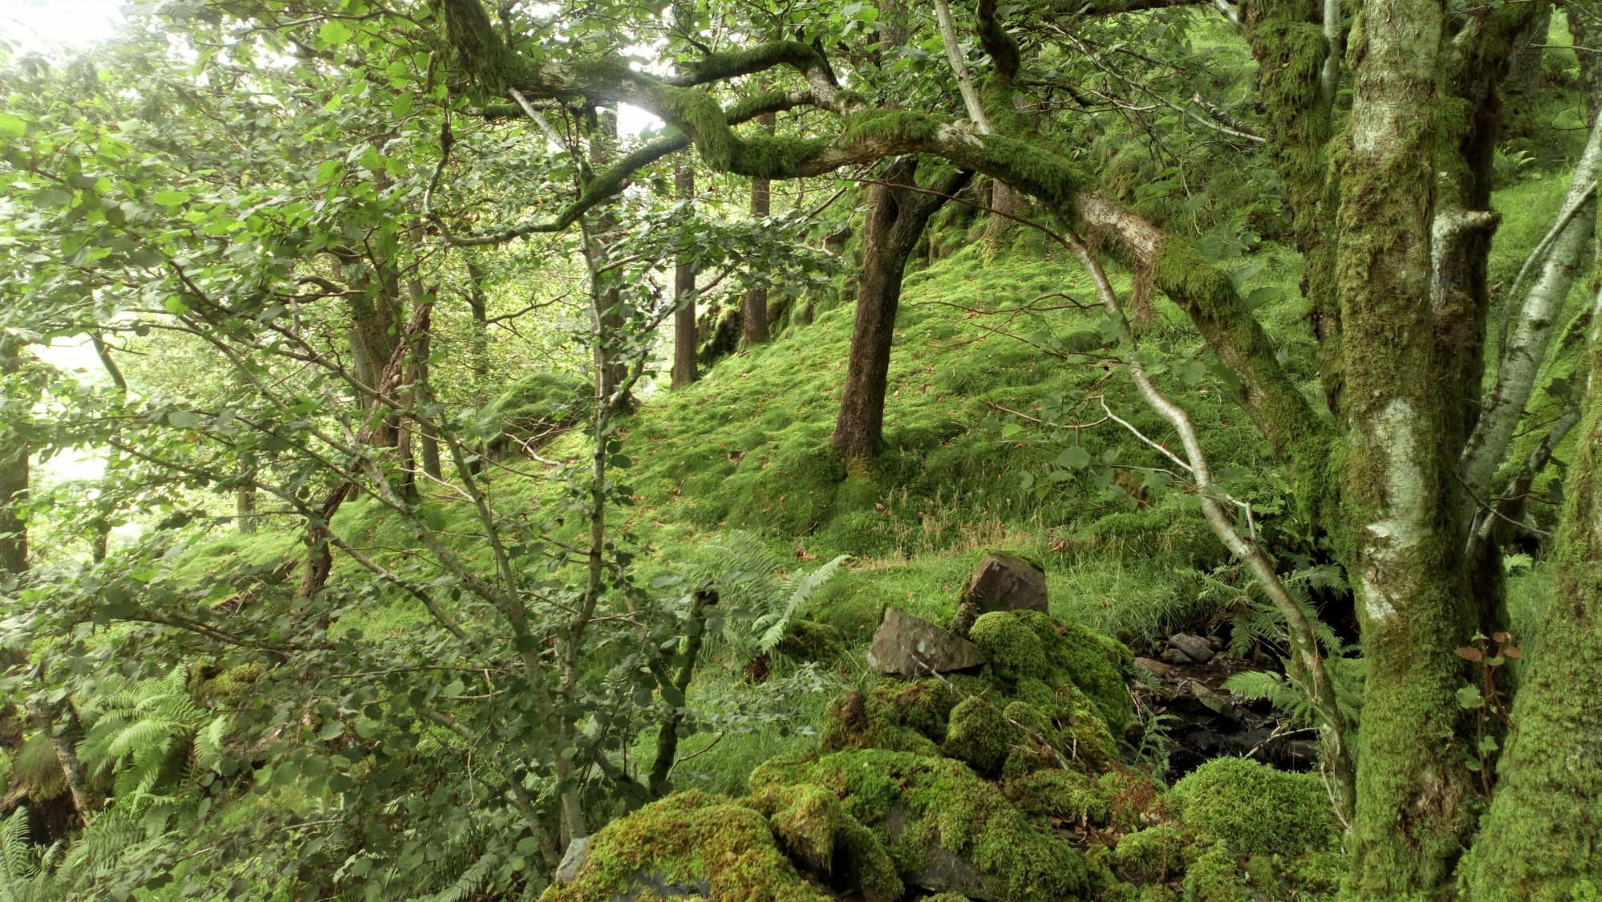
Section 2: Our Aims and Objectives

Slide 4
What we want to do | Why we want to do it? | How can we achieve it?
Maintain the current level of woodland in the National Trust Windermere property, and expand woodlands and the treed landscape where opportunities arise. | Woodland cover within the UK is poor compared to the wider European average, and the UK Government Forestry Policy details targets to expand woodland cover in the UK. The NT holds both larger woodland blocks within Windermere, Ambleside and Troutbeck, thus contributing towards existing woodland cover, as well as smaller shelterbelts and copses that can incorporate tree cover into a predominantly agricultural landscape. It is imperative that this existing tree cover is not eroded and instead expands through sensitive, collaborative schemes. This will help to provide the environmental, social and economic benefits of trees and woodlands, including the wide range of ecosystem services that complement and contrast with the ecosystem services provided by adjacent land uses. | Clear-felling of woodlands and forests will be avoided except for where small stands of trees offer no other alternatives for more sensitive woodland management; in these cases, stands will be replanted to ensure overall woodland area is maintained. Larger woodlands will be managed using “continuous cover approaches” to maintain woodland cover, through thinning or the felling of small groups of trees within woods. Opportunities for scrub and woodland planting will continue to be explored on National Trust land through partnership working with our tenant farmers, particularly exploring the potential for farm shelterbelts that can increase woodland cover and provide benefits for livestock farming businesses, as well as the options for increasing agroforestry schemes through wood pasture.
Manage and expand the woodland to improve natural resource protection, particularly focusing on water and soil quality. | Storm Desmond in 2015 demonstrated the impacts of flooding on both communities and the land. Trees and woods can help to protect water and soil through binding soils, slowing the flow of water, and improving water quality. We wish to play our part in the mitigation of the impacts of these storm events and of soil erosion. | Maintain and enhance woodlands adjacent to watercourses, and consider ‘riparian’ planting as a particular objective when considering tree planting opportunities. Continue to plant ‘trees outside woods’ in partnership with our tenant farmers .

Slide 5
What we want to do | Why we want to do it? | How can we achieve it?
Protect and enhance existing woodland biodiversity and habitat values | Biodiversity declines generally in the UK are well recognised and documented (e.g. the 2016 State of Nature report), and woodland biodiversity is included within this trend. At the same time, the National Trust is pursuing a strategic aim of ‘Land, Outdoors and Nature’, with ambitious nature conservation targets on our land-holding. Woodlands within this management plan include important upland sessile oakwood habitats, considered ‘temperate rainforests’ and potentially hosting a diversity of flora and fauna. | Woodland management operations generally prioritise habitat improvement; this is predominantly to diversify the age structure of woodlands, many of which are even-aged as a result of historic coppice management which, when it ceased, left many trees of a similar age to grow on and form what is now a closed-canopy woodland. This management favoured oak over other species, resulting in woodlands having a much higher proportion of oak trees than would naturally be expected. This simplification of the woodland structure and species diversity will have contributed to a loss of habitat for a variety of wildlife. As such, woodland operations aim to create gaps for young trees of various species to regenerate in, as well as creating more deadwood (a vital component of woodland ecosystems) and maintain some open areas (such as rides and glades) that contrast to areas under tree cover.
Improve the resilience of woodlands to climate change and pests and diseases. | The Earth’s temperature is warming a result of human activities, and climate change is widely recognised as a significant threat to woodlands as much as other ecosystems. This coincides and will interact with increasing spread of tree pests and diseases. | The woodland management described above will make woodlands more resilient, with different age structures and species present, which will spread risk to a greater degree and lessen the impact of any particular change in condition through having trees of different ages and species with different requirements, tolerances to climatic changes, and resistance to different pests and diseases. Similarly, we will assess the impact of deer in our woodlands and implement various forms of deer management techniques as necessary to reduce detrimental impacts and enable young trees and woodland flowers to grow.
Increase public and stakeholder engagement with woodlands | The National Trust fundamentally aims to look after special places for ever, for everyone. Our woodlands should be able to be enjoyed by everyone – local communities and visitors alike. Our woodland management will be more widely supported if we work in partnership with stakeholders and communities, explaining our reasoning and listening to opinions, thoughts and concerns. | The woods will continue to have a range of public, permissive and informal tracks where possible, enabling people to access and enjoy the woodlands informally. Significant viewpoints, such as Post Knott and Jenkin’s Crag, will be maintained through careful woodland management works. Our woodland plans will be shared with local community groups, as well as informal woodland users to ensure that our reasoning is understood and concerns alleviated. We will continue to work with local volunteers when managing these woods, as well as building links with groups such as local universities. Where possible, woods will also be educational spaces, such as the woods around the Footprint building in Windermere.

Slide 6
What we want to do | Why we want to do it? | How can we achieve it?
Protect cultural and historic features in our woodlands | We recognise the international importance of the Lake District as recognised in World Heritage Status and our responsibility towards protecting the Cultural and Historic Landscape. As part of this woodlands contain many signs of previous management of intrinsic cultural value. This can be structures such as charcoal pitsteads that reflect previous coppice management, or significant specimen trees that demonstrate previous planting during the fashions for creating designed landscapes., such as that found at Skelghyll Woods (AM1-3) | Understanding the Outstanding Universal Values (OUVs) for the property and how woodland management can impact upon them. Archaeological features are mapped within NT systems and these are identified prior to any operations to allow adequate protection. Woodland management will maintain significant specimen trees and, in some woods, is re-instating some coppice management to maintain this cultural link to previous management.
Provide a range of forest products | Woodland management operations are primarily focussed on improving woodland structure and health for habitat improvement; however, there is scope for the sensitive production and extraction of timber, firewood and “non-timber forest products”. These products can be sustainably produced and locally used to reduce the carbon footprint and use of materials sourced more widely. | Extract some woody material from thinnings and group-felling where extraction will not be detrimental to the woodland soil health, using more sensitive means if necessary. Use more National Trust timber on our land, utilising our sawmill capabilities at Coniston, to reduce the carbon footprint and environmental impact of buying externally-sourced products. Likewise, some firewood and timber will be sold to local sawmills and firewood processors. Explore the options surrounding “non-timber forest products”, including venison arising from any deer management.
Improve woodland monitoring | It is vital to collect information on whether woodland management works are resulting in the desired changes, as well as undertaking greater levels of surveying and monitoring to better understand the state of our woodlands and any identified needs or areas for improvement. | Monitoring of the woodland structures and tree species mixtures will be formalised in a program of forest mensuration for key larger ancient woodlands. Surveys on significant features, such as deadwood or particular groups of plants/animals, will continue where we know that woods are important for these species, to help inform any management decisions that are required.
Manage all woodlands in accordance with UKFS, UKWAS and statutory requirements | The UK Forestry Standard (UKFS) define and guide sustainable forest management, and the UK Woodland Assurance Scheme (UKWAS) sets benchmarks for forest management to be certified as sustainable. The National Trust should be managing its woodlands in accordance with these, as best industry practice. Legal obligations through statutory requirements are also non-negotiable. | The UKFS and UKWAS combined guide woodland management decision-making and the practical implementation of forestry operations. Audits of the National Trust against UKWAS requirements ensure that areas for improvement and identified and enacted. All forestry operations are undertaken with Operational Site Assessments which identify statutory requirements and ensure that they are adhered to.

Slide 7
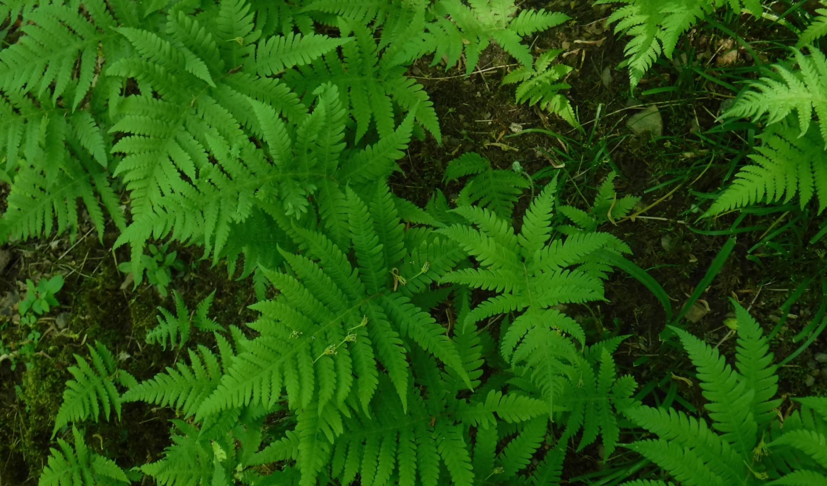
Section 3: Woodland locations

Slide 8
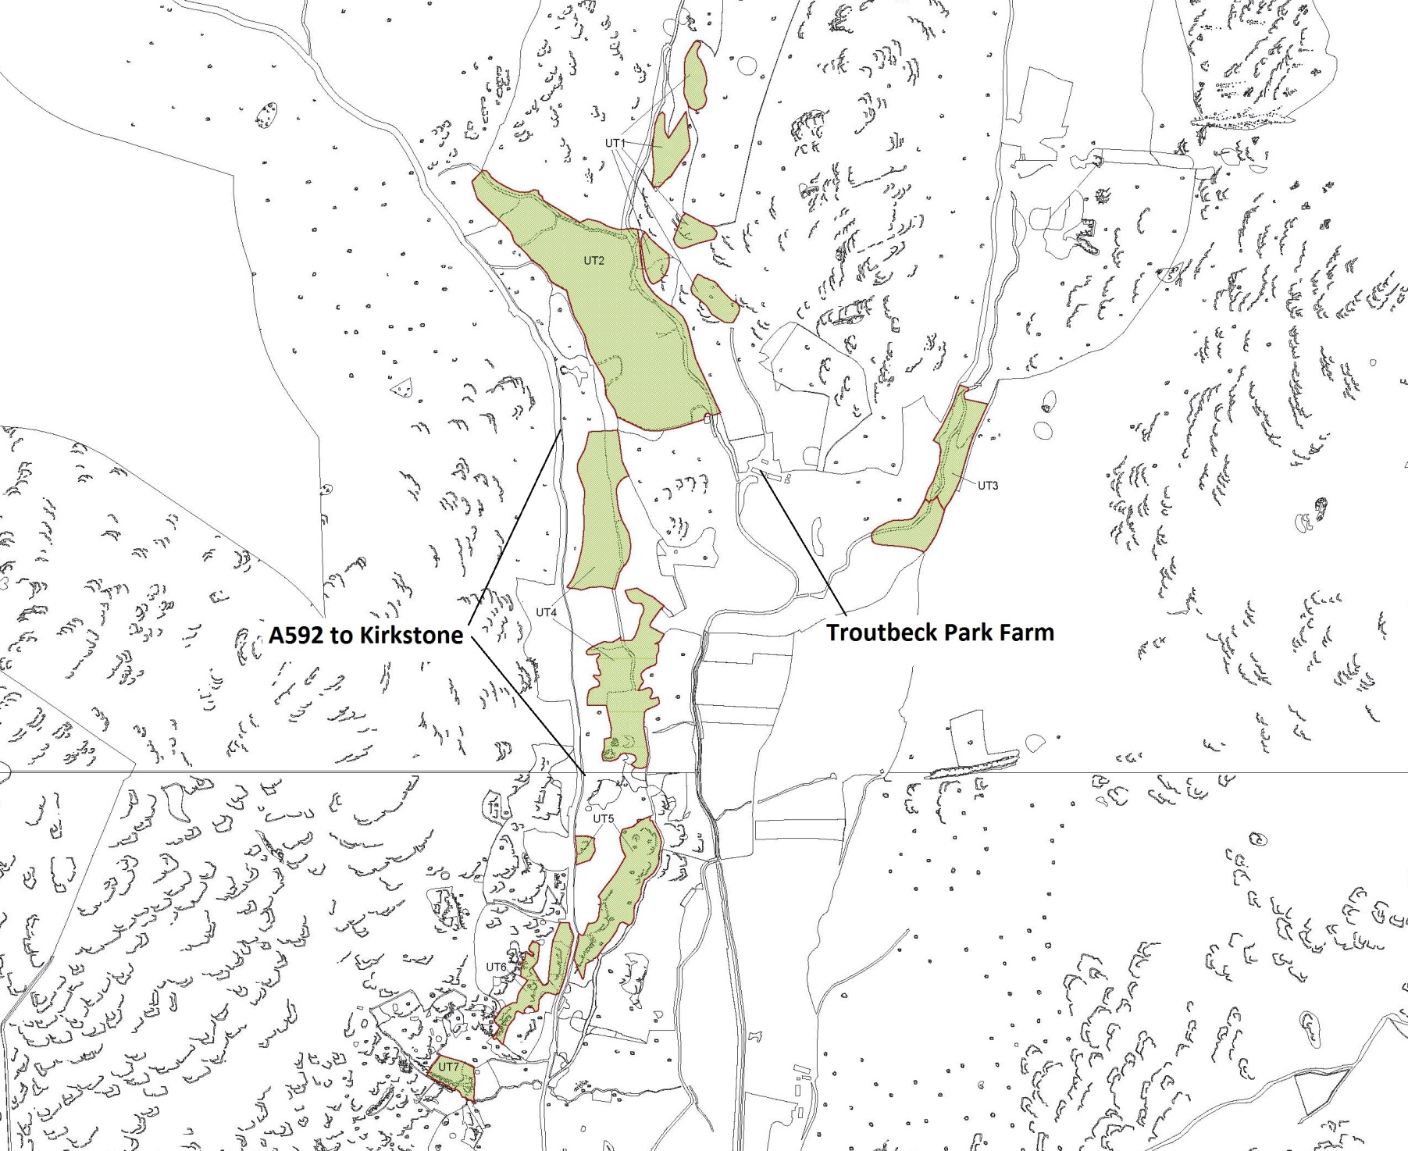
Upper Troutbeck
woodlands

Slide 9
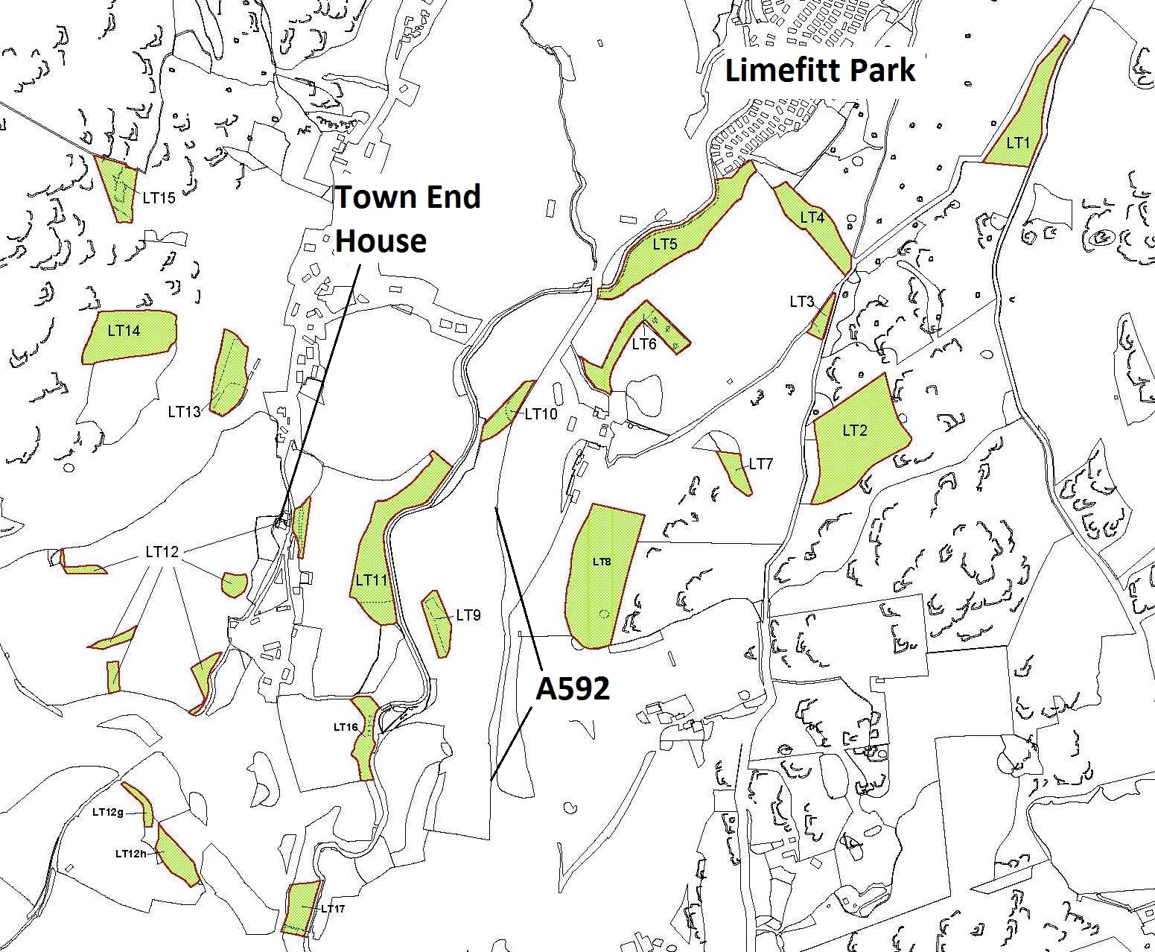
Lower Troutbeck
woodlands

Slide 10
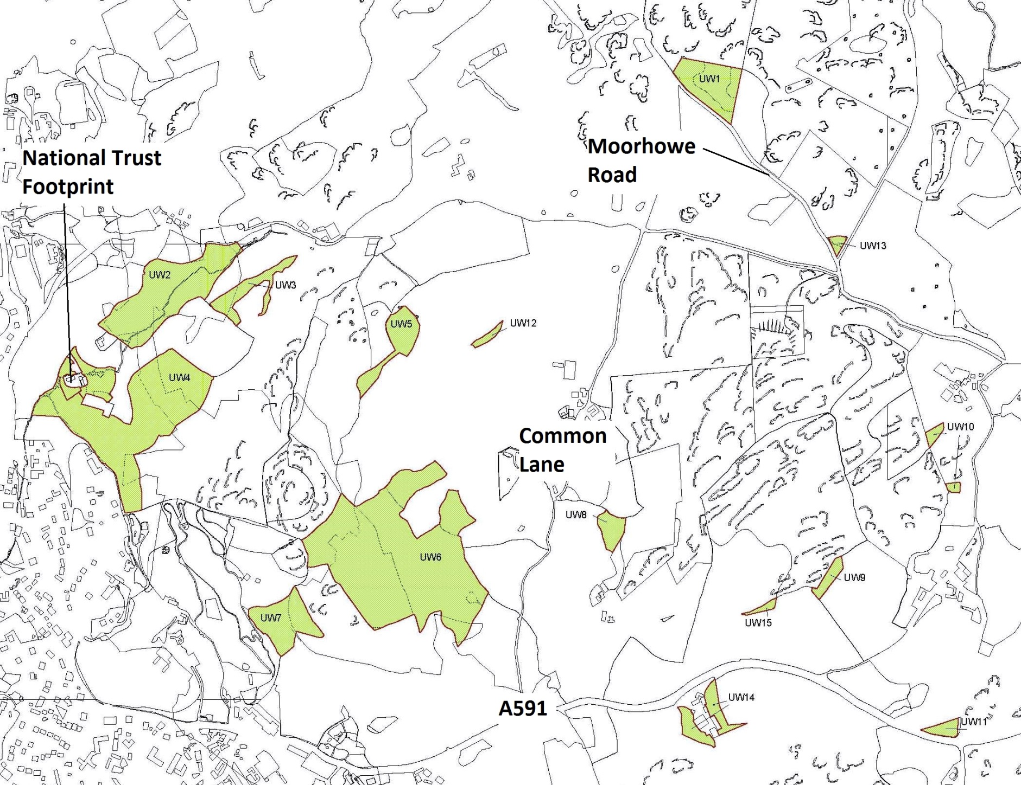
Upper Windermere woodlands

Slide 11
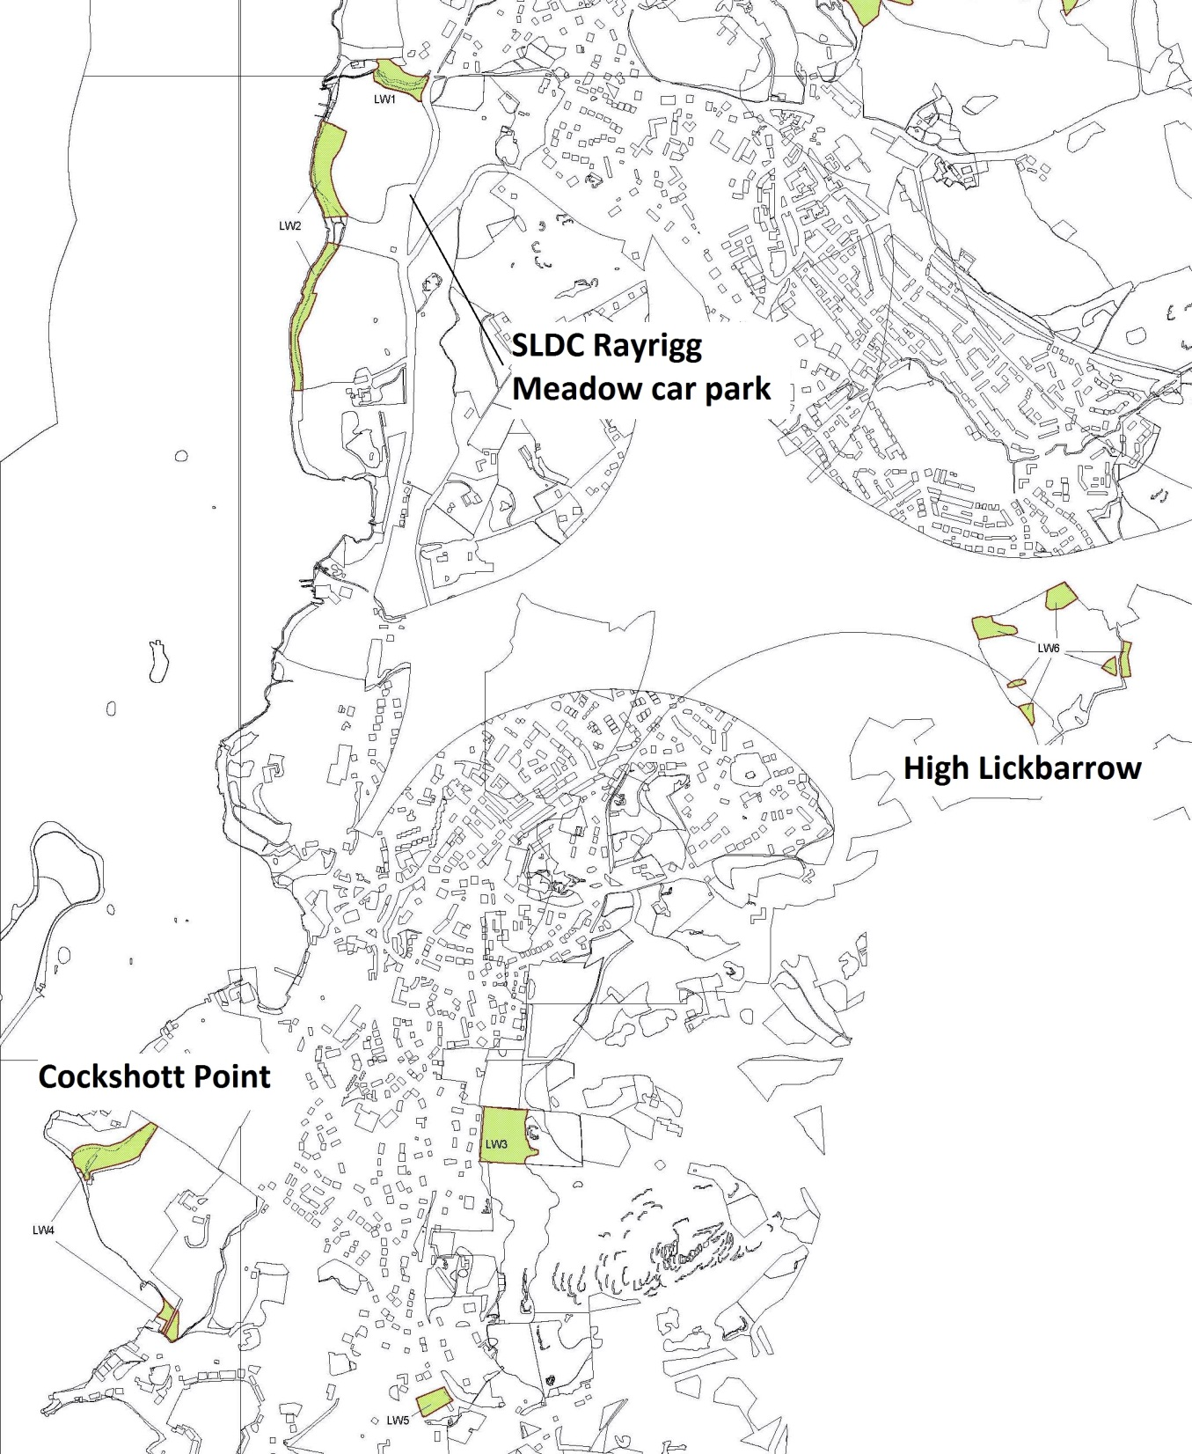
Lower Windermere woodlands

Slide 12
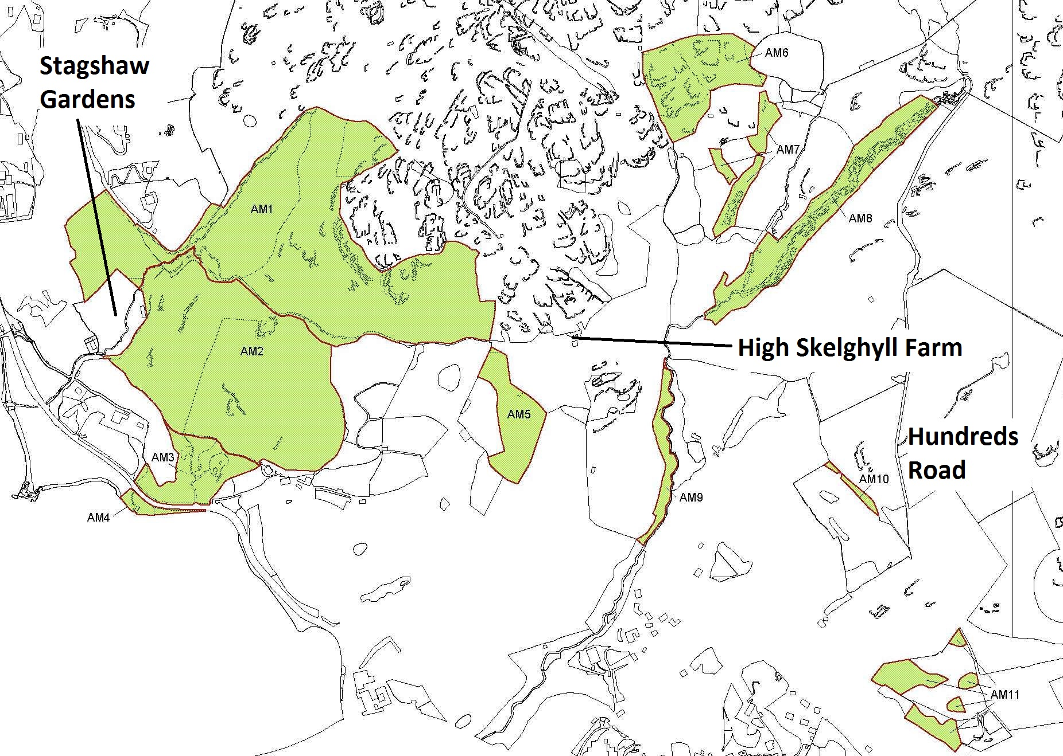
Ambleside woodlands

Slide 13
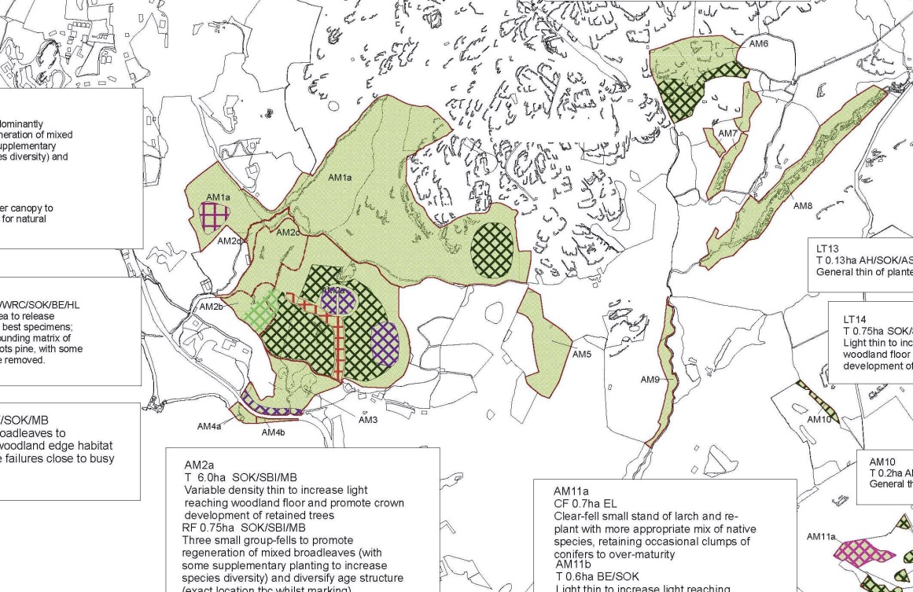
Further maps available to view/download:
Overview of compartments
Sub-compartments and species
Designations affecting woodlands
Significant features
Felling proposals
Other works proposals
Monitoring proposals

Slide 14
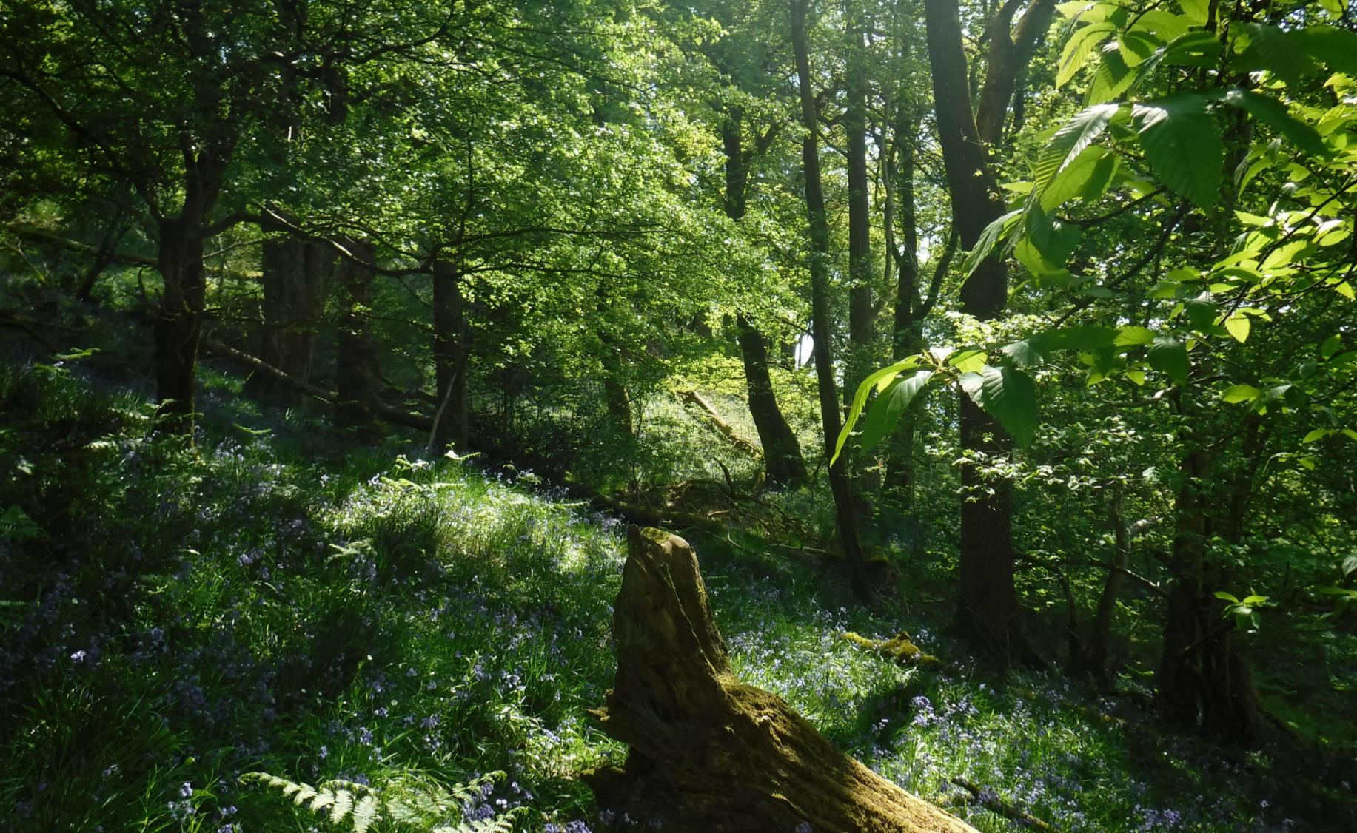
Section 4: Compartment Summaries

Slide 15
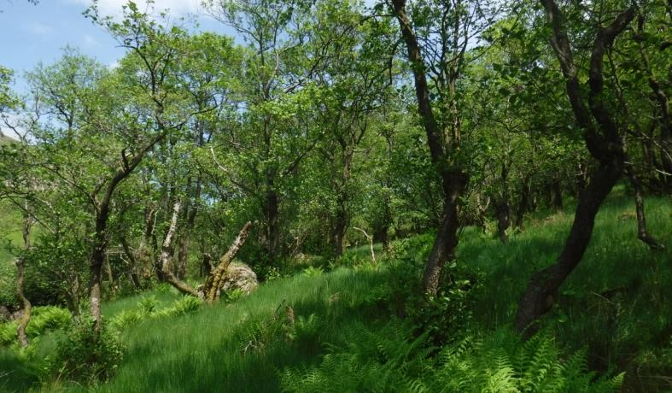
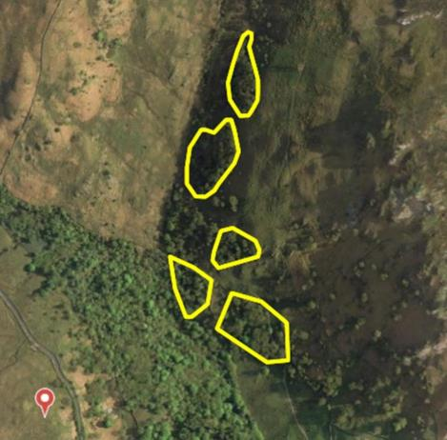
Compartment: Upper Troutbeck (UT) 1 - Settlement Wood
Species: Common alder, occasional other broadleaves e.g. holly, ash and sycamore
Hectares: 3.25ha in five discrete blocks
Designations: Lake District National Park (LDNP), World Heritage Site (WHS), Site of Special Scientific Interest (SSSI), Ancient Semi-Natural Woodland (ASNW)
Description: Remnant blocks of historically-coppiced alder woodland, with the occasional other species (e.g. ash, holly) present. Grazed by low numbers of cattle within Troutbeck Park Farm.
Issues: Even-aged structure with limited diversity of tree sizes; significant deer browsing and trespass sheep grazing; blocks isolated from each other
Aims: Blocks will join and expand under low grazing pressure, and structural diversity will be improved
Significant works: Identify and implement methods to prevent sheep ingress and manage deer to a more sustainable level; coppice two coupes to begin diversifying the age structure; create new pollards on the edge of blocks, where tree form is appropriate, to begin veteran tree development and continue the cultural heritage of pollarding; work with tenant farmer to explore options to join blocks with planting or natural regeneration

Slide 16
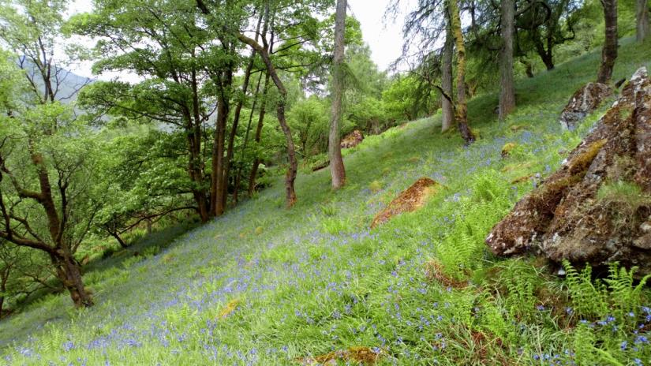
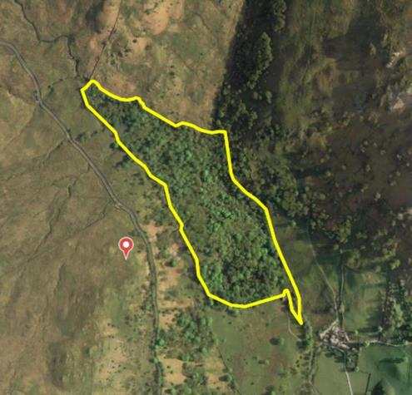
Compartment: UT2 - Hird Wood
Species: Common alder, ash and hazel with other broadleaves (UT2a); larch and Sitka spruce with broadleaves (UT2b)
Hectares: 12.9ha Designations: LDNP, WHS, ASNW
Description: A predominantly wet-woodland northwest of Troutbeck Park Farm, historically coppiced, with two significant ghylls to the north and east with lush flora. Some conifer planting to the south has established larch and spruce alongside the broadleaf species.
Issues: Even-aged structure with limited diversity of tree sizes; significant deer browsing and trespass sheep grazing hindering tree regeneration.
Aims: Improve the woodland structural diversity, and ensure long-term viability through enabling young trees to regenerate
Significant works: Thinning and two small group fells amongst conifers in UT2b (currently under application for Felling license 010/24328/2018), to establish young broadleaf trees; coppice one alder coupe in UT2a to create structural diversity; deer fence one area to the north-west of UT2a to encourage a patch of tree regeneration; widen and manage informal path to the east as a ride, maintaining linear open space for light-demanding woodland flowers and associated wildlife in contrast to the generally more shaded woodland matrix.

Slide 17
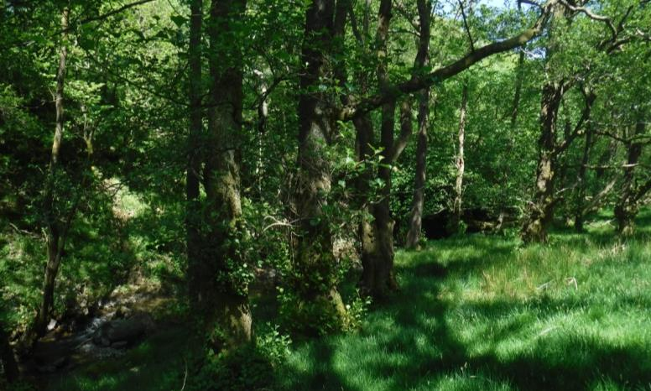
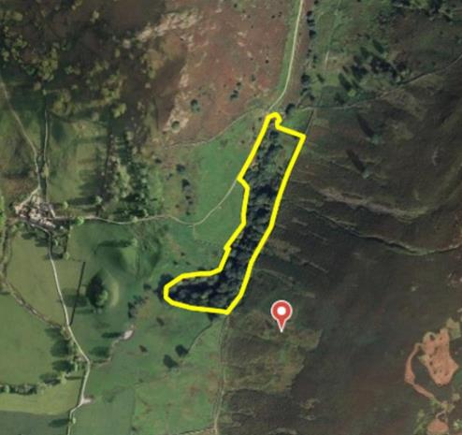
Compartment: UT3 – Hag Ghyll
Species: Common alder, ash and hazel with other broadleaves, including areas of sessile oak
Hectares: 1.2ha Designations: LDNP and WHS
Description: A relatively wet-woodland lining a lush ghyll, sloping steeply in places and with good levels of deadwood; some supplementary planting has been undertaken in two areas, one to the north-east more recently.
Issues: Significant deer browsing and occasional ingress sheep grazing preventing tree regeneration
Aims: Ensure long-term viability of the woodland through enabling young trees to regenerate; maintain riparian woodland for habitat and water quality protection
Significant works: Temporarily deer fence the most recent planting to protect trees from red deer browsing, allowing a patch of younger trees to successfully establish

Slide 18
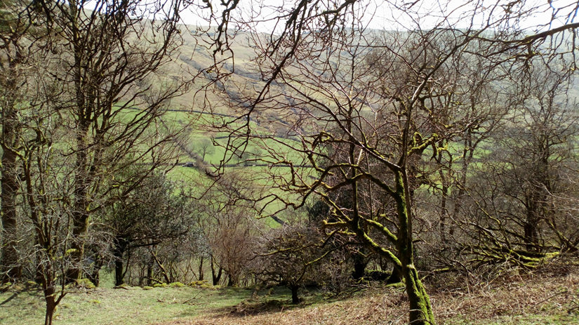
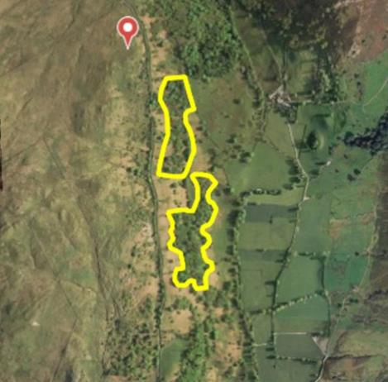
Compartment: UT4 – Kingate
Species: Common alder, ash, hazel, sessile oak with other broadleaves and occasional larch
Hectares: 6.9ha across two sub-compartments Designations: LDNP, WHS and partly ASNW
Description: UT4a (north) is predominantly wet-woodland similar to UT2; UT4b (south) has a greater proportion of oaks and occasional larch on freer-draining soils. These are more wooded blocks that in practice are difficult to delineate from the wider Kingate wood pasture, part of Troutbeck Park Farm.
Issues: Even-aged structure with limited diversity of tree sizes; significant deer browsing and trespass sheep grazing prevent tree regeneration
Aims: Ensure long-term viability through enabling young trees to regenerate, blurring the boundaries between ‘woodland’ and the surrounding wood pasture
Significant works: Lightly thin one closed-canopy stand of oak and larch to increase light to woodland floor and encourage trees of best form and health, including some standing deadwood creation; attempt some tree planting or small deer exclosures in canopy gaps to enable young trees to establish; work with tenant farmer to explore methods of stock-proofing the entire woodland/wood-pasture against ingress sheep grazing.

Slide 19
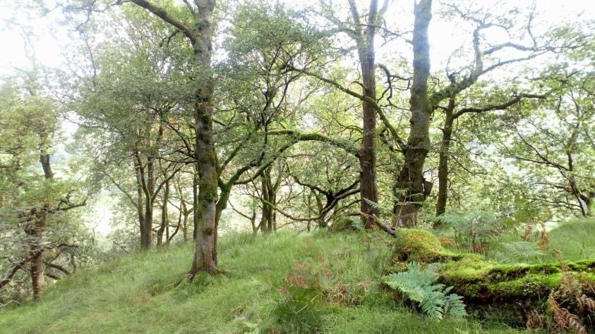
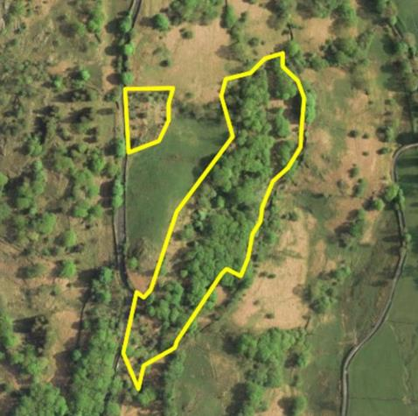
Compartment: UT5 – Home Crag
Species: Sessile oak, ash and rowan with other broadleaves
Hectares: 3.0ha in total, sited within a broader wood-pasture matrix in Troutbeck Park Farm
Designations: LDNP, WHS, and ASNW (UT5a)
Description: UT5a is a larger sub-compartment formed predominantly of a block of upland acidic oakwood, with some supplementary tree planting following storm damage in the 1980s and 90s. UT5b is a younger corner planting of a mix of broadleaves adjacent to the A592.
Issues: Even-aged structure with limited diversity of tree sizes; significant deer browsing and ingress sheep grazing prevent tree regeneration; some old tree tubes remain on site (to be removed as part of work programme)
Aims: Ensure long-term viability through enabling young trees to regenerate, blurring the boundaries between ‘woodland’ and the surrounding wood pasture
Significant works: Lightly thin stand of oak in UT5a to increase light to woodland floor and encourage trees of best form and health, including some standing deadwood creation; work with tenant farmer to explore methods of stock-proofing the entire woodland/wood-pasture against ingress sheep grazing.

Slide 20
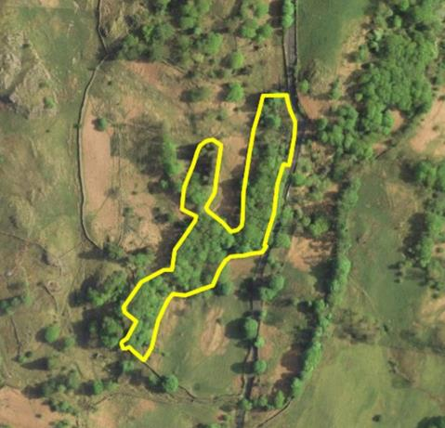
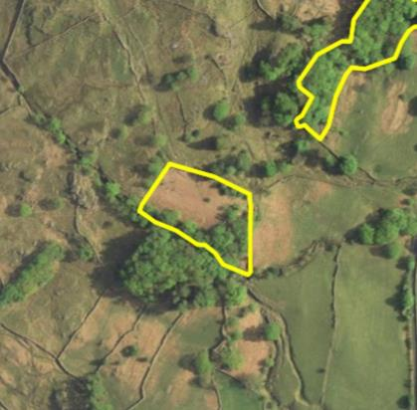
Compartment: UT6 – Chimney Crag
Species: Sessile oak with other broadleaves; one stand of Norway spruce
Hectares: 1.45ha in total Designations: LDNP & WHS; ASNW (UT6a)
Description: UT6a is predominantly a block of upland acidic oakwood, situated on crags above the A592; UT6b is a small stand of Norway spruce, and UT6c is a small planting of mixed broadleaves next to the A592. Boundaries are mostly blurred with wider wood pasture, within Stonethwaite Farm.
Issues: Even-aged structure with limited diversity of tree sizes; significant deer browsing and ingress sheep grazing prevent tree regeneration
Aims: Ensure long-term viability through enabling young trees to regenerate, blurring the boundaries between ‘woodland’ and the surrounding wood pasture
Significant works: Lightly thin stand of oak in UT6a to increase light to woodland floor and encourage trees of best form and health, including some standing deadwood creation; create new pollards from selected young trees with the appropriate form in UT6c
Compartment: UT7 – Brockbarrow Wood
Species: Sessile oak with other broadleaves
Hectares: 0.65ha Designations: LDNP and WHS
Description: A patch of remnant upland oakwood on crags, with occasional hazel around bracken-dominated open space; one small stand of larch is situated to the south along Brockbarrow ghyll.
Issues: Significant deer browsing and historic sheep grazing have confined tree cover to the more inaccessible crag end and prevented tree regeneration
Aims: Encourage remnant woodland/tree cover to expand out from crag ends and fill in the compartment
Significant works: Deer fence bracken bed adjacent to existing tree cover, enabling the remnant tree cover to expand through natural regeneration

Slide 21
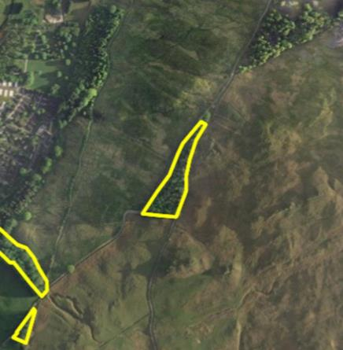
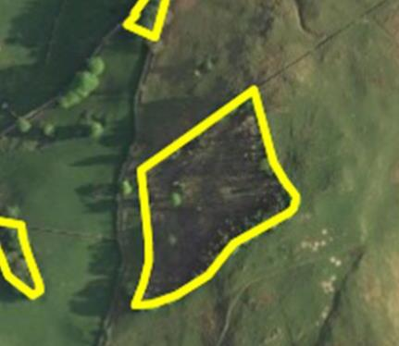
Compartment: Lower Troutbeck (LT) 1 – Coronation Planting
Species: Scots pine, sycamore, beech and Sitka spruce, with occasional other broadleaves
Hectares: 1.0ha Designations: LDNP & WHS
Description: A triangular plantation of mixed conifers and broadleaves, situated between bridleways and isolated from other nearby forests; the canopy is generally closed.
Issues: Poor boundaries leading to ingress sheep grazing and a lack of light on woodland floor; artificially straight boundaries contrast sharply with the surrounding open land when viewed from afar
Aims: Develop the forest into a stand of well-formed trees, with more light on the forest floor and a more natural appearance from afar, providing habitat and shelter on an otherwise open hillside.
Significant works: Lightly thin stand to increase light to woodland floor and encourage trees of best form and health; cut two scallops along edges to break up artificially straight edges; cut one small open glade within forest; carry out boundary repairs to exclude ingress sheep.
Compartment: LT2 – Whiteside Plantation
Species: Scots pine, rowan, sessile oak, ash, sycamore, silver birch and other broadleaves
Hectares: 2ha
Designations: LDNP & WHS
Description: A former conifer plantation, clear-felled and now regenerating with natural and planted trees which are predominantly broadleaved; mature Scots pine and broadleaves were retained, especially on rocky knoll to the southeast of the wood, providing a diversity of age classes
Issues: Sitka spruce regeneration; occasional ingress sheep grazing; old tree tubes remain on site (to be removed as part of work programme)
Aims: Continue to allow predominantly broadleaf woodland of variable tree density to regenerate and provide habitat and amenity value
Significant works: Occasionally respace young trees to favour native species

Slide 22
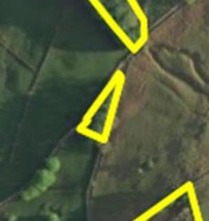
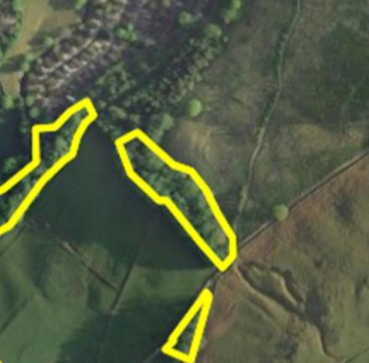
Compartment: LT3 – Un-named larch plantation
Species: European larch with occasional boundary broadleaves
Hectares: 0.15ha Designations: LDNP & WHS
Description: A small triangular plantation of mature larch, situated on the junction between Garburn and Longmire bridleways
Issues: No boundaries lead to ingress sheep grazing; isolation from other woodlands; too small for Continuous Cover Forestry approaches to restructuring the species and age structure
Aims: Convert to a more natural, mixed copse with greater amenity and biodiversity value than the current stand
Significant works: Clear-fell and re-plant with mixed native species, including shrubby species at edges; stock-fence as part of re-planting to exclude sheep
Compartment: LT4 – Hard Ghyll
Species: Sycamore, ash, Norway maple, hazel and oak
Hectares: 0.7ha Designations: LDNP & WHS
Description: A narrow riparian woodland of mixed broadleaves, generally forming a closed-canopy and falling steeply with the watercourse, which has good levels of fallen deadwood and lower plant flora
Issues: Poor boundaries allow ingress sheep grazing; lack of light on woodland floor also hinders tree regeneration
Aims: Increase light to the woodland floor and create dappled shade along watercourse to benefit woodland flora and stream habitat; enable tree regeneration through excluding stock
Significant works: Lightly thin trees to increase light to woodland floor and encourage trees of best form and health, including some standing deadwood creation; carry out boundary repairs

Slide 23
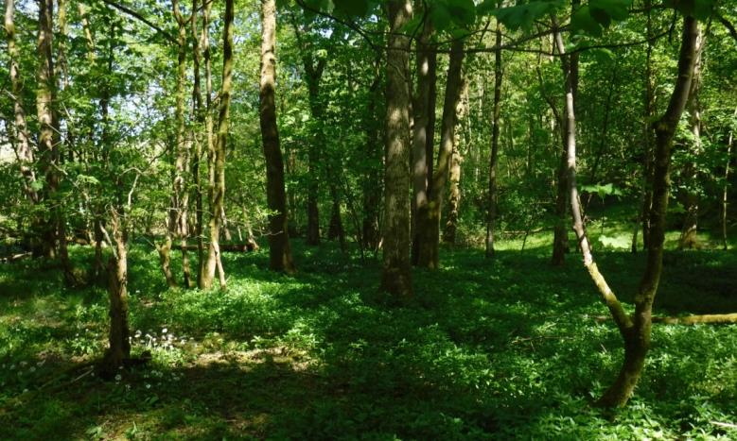
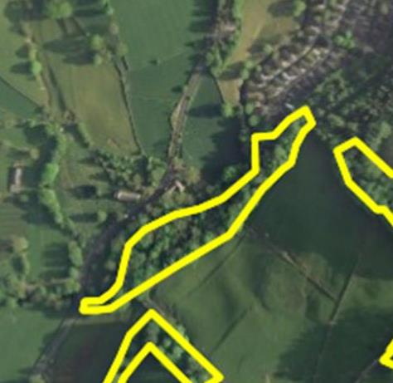
Compartment: LT5 – Jennyscar Woods
Species: Sycamore and ash, common alder, beech and sessile oak, and other mixed broadleaves
Hectares: 1.3ha
Designations: LDNP & WHS
Description: Riparian woodland along Trout Beck, with a good mixture of broadleaf species and contributing to a wider strip of riparian woodland in various parcels of ownership running along this river. Additionally, the wood is highly visible from the A592 as it passes Troutbeck Church
Aims: Generally maintain healthy woodland cover along river for habitat and resource protection

Slide 24
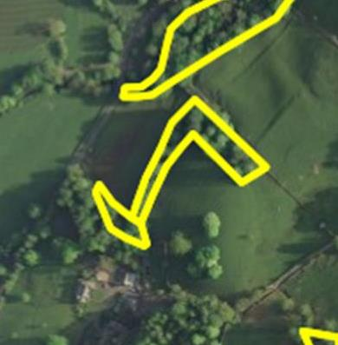
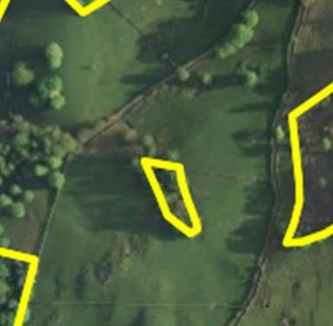
Compartment: LT6 – Howe Farm shelterbelt
Species: Mixed broadleaves, including beech, sessile oak, sycamore and lime
Hectares: 0.7ha in total Designations: LDNP & WHS
Description: Three sub-compartments of linear copses surrounding and dividing fields in Howe Farm tenancy and close to Garburn bridleway. Sub-compartment 6a lines a small watercourse; sub-compartments 6b and 6c are notable for large, mature trees, some of which are highly visible from the A592.
Issues: Occasional ingress sheep grazing, though generally at low levels
Aims: Generally maintain tree cover for a variety of amenity, habitat and shelter purposes
Compartment: LT7 – Ghyll Wood
Species: Larch, alder, oak and ash, and occasional other broadleaves
Hectares: 0.2ha
Designations: LDNP & WHS
Description: A small patch of relatively open woodland lining a watercourse close to Garburn bridleway, with occasional older trees on boundaries, providing particularly water quality protection as well as habitat values
Issues: Poor boundaries allow significant ingress sheep grazing, preventing tree regeneration
Aims: Ensure long-term viability of stream-side vegetation through enabling young trees to regenerate
Significant works: Boundary repairs to exclude sheep

Slide 25
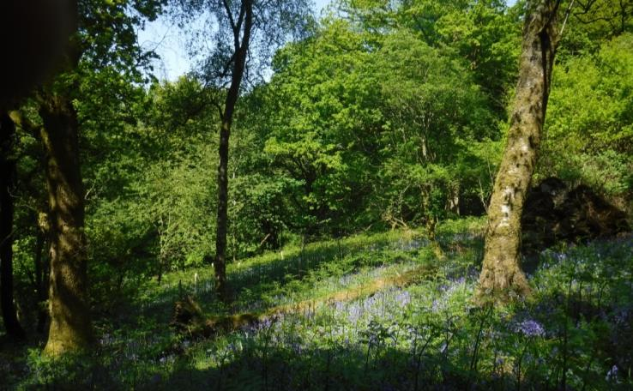
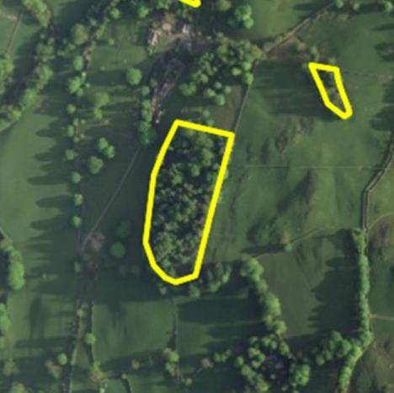
Compartment: LT8 – Castle Neb Wood
Species: Mixed broadleaves including sessile oak, beech, sycamore, ash and birch; some larch and Scots pine
Hectares: 2.2ha Designations: LDNP, WHS & ASNW; in part Plantation on Ancient Woodland Site (PAWS)
Description: Roughly rectangular woodland of varying structure, with stands of old trees, more open space to the southeast, a stand of young planted broadleaves where a conifer crop was previously clear-felled, and an existing remnant stand of larch to the southwest
Issues: Isolation from other woodlands; relatively closed canopy and subsequent shading; deer browsing hinders tree regeneration
Aims: Maintain the existing variability in age classes through enabling tree regeneration in future; allow more light to woodland floor, partly by reducing the dominance of beech and sycamore, to allow regeneration of more typical, light-demanding oakwood species
Significant works: Thin beech/sycamore to the north, larch to the southeast, and planted trees to the west, to increase light to woodland floor and encourage trees of best form and health; work with tenants of surrounding farmland to explore options for improving woodland access

Slide 26
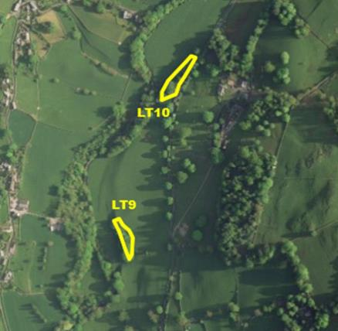
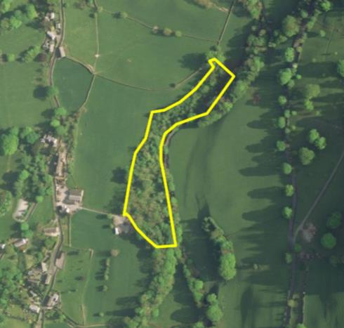
Compartment: LT9 & LT10 – Howe Farm shelterbelts
Species: Mixed broadleaves including sessile oak, ash, hazel and sycamore; some larch and Scots pine
Hectares: 0.2ha & 0.3ha respectively Designations: LDNP & WHS
Description: Two small shelterbelts planted around pre-existing boundary trees in the 1980s for amenity/landscape purposes; both are surrounded by and divide fields in the Howe Farm tenancy
Issues: Planted trees now closing canopy; some shading of pre-existing older boundary trees with potential to become veteran trees
Aims: Enable well-formed boundary trees to develop and provide habitat, amenity value, and shelter for livestock, integrated into the farmed landscape
Significant works: Thin younger, planted trees to promote trees of best form and health, including ‘halo-thinning’ around older hedgerow trees to reduce shading
Compartment: LT11 – Scar Wood
Species: Ash, sycamore, and mixed broadleaves including sessile oak, birch, hazel and hawthorn
Hectares: 1.4ha Designations: LDNP & WHS
Description: Linear riparian wood lining Trout Beck, which to the south consists of more mature ash and sycamore dominating, and to the north is as a separate sub-compartment planted with mixed broadleaves. Contributes to a wider strip of riparian woodland in various parcels of ownership running along this river.
Issues: Relatively closed canopy and subsequent shading; deer browsing; historic agricultural waste; old tree tubes remain on site (to be removed as part of work programme)
Aims: Maintain a riparian woodland of mixed age classes and species composition for resource protection and habitat value
Significant works: Lightly thin both sub-compartments to increase light to woodland floor and create dappled shade along watercourse, as well as encouraging trees of best form and health; construct small deer exclosures in canopy gaps

Slide 27
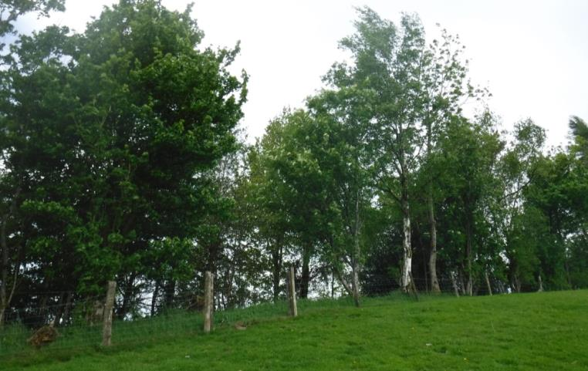
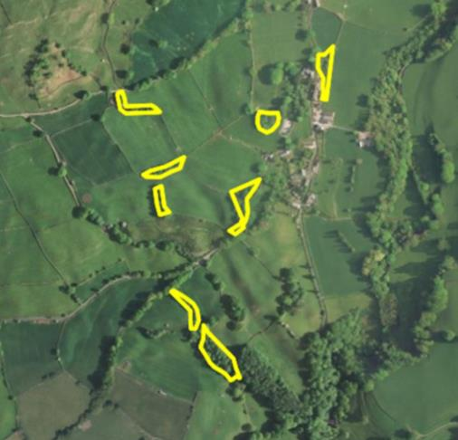
Compartment: LT12 – Croft Wood/Town End Farm shelterbelts
Species: Mixed broadleaves and conifers, including ash, sessile oak, beech, hazel, hawthorn, Scots pine and larch
Hectares: 1.23ha in total, divided into 8 sub-compartments
Designations: LDNP & WHS; two sub-compartments sit partly within Troutbeck Conservation Area
Description: Various small farm shelterbelts, planted in the 1980s and, in two particular sub-compartments south of Holbeck Lane, planted around pre-existing boundary/hedgerow trees.
Issues: Planted trees starting to close canopy and, in two sub-compartments, overtop older hedgerow trees; ash dieback is noticeable
Aims: Enable well-formed boundary trees to develop and provide habitat, amenity value, and shelter for livestock
Significant works: General first thin to promote trees of best form and health, including ‘halo-thinning’ around older hedgerow trees to reduce shading

Slide 28
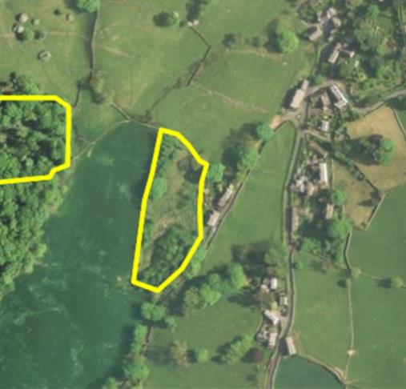
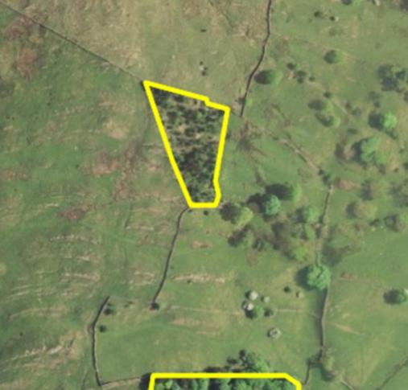
Compartment: LT13 – Robin Lane Close
Species: Mixed broadleaves, including sessile oak, ash and sycamore
Hectares: 0.65ha Designations: LDNP & WHS
Description: A 1980s mixed broadleaf planting sitting behind cottages on Robin Lane. The planted patches are bisected by a power-line, providing open ground, and some pre-existing older trees sit especially to the west of the land parcel.
Issues: Planted trees starting to close canopy; some fly-tipping
Aims: Enable well-formed landscape trees to develop and provide habitat, amenity value, and shelter for livestock
Significant works: Thin younger, planted trees to promote trees of best form and health, including ‘halo-thinning’ around older trees to reduce shading
Compartment: LT15 – Mackreth/Hundreds Wood
Species: Mixed broadleaves and conifers, including common alder, Scots pine and larch
Hectares: 0.5ha Designations: LDNP & WHS
Description: Small, isolated planting on the higher slopes above Troutbeck village, consisting of a mixture of conifers and broadleaves and surrounded by open land; the trees are relatively well-spaced, in part due to the site’s significant exposure.
Issues: Poor boundaries and subsequent ingress sheep grazing hinder tree regeneration
Aims: Generally maintain a stand of mixed species tree cover for habitat and amenity value, with well-formed trees
Significant works: Boundary repairs to make the copse stock-proof

Slide 29
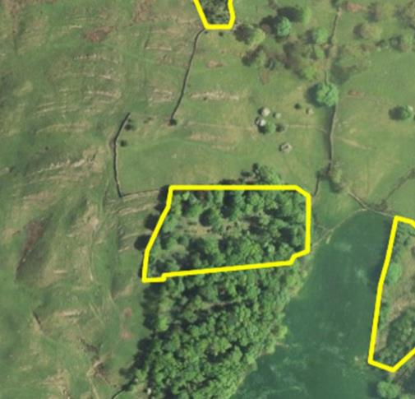
Compartment: LT14 – Hag Wood
Species: Sessile oak, mixed broadleaves and yew
Hectares: 1.2ha Designations: LDNP, WHS & ASNW
Description: Approximately half of a larger woodland block (the other half in private ownership), mostly a typical upland acidic oakwood with a small clump of yew to the top corner. Some areas planted with conifers previously were removed and re-planted with mixed broadleaves.
Issues: Deer browsing hinders tree regeneration and the development of ground flora; old tree tubes remain on site (to be removed as part of work programme)
Aims: Maintain ancient semi-natural woodland of predominantly upland oakwood character, but with more varied age classes and species diversity, and ensure long-term viability through enabling young trees to regenerate
Significant works: Lightly thin to increase light to woodland floor and encourage trees of best form and health, including some standing deadwood creation; construct small deer exclosures in canopy gaps

Slide 30
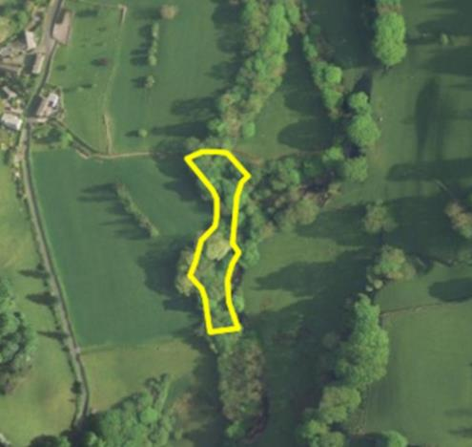
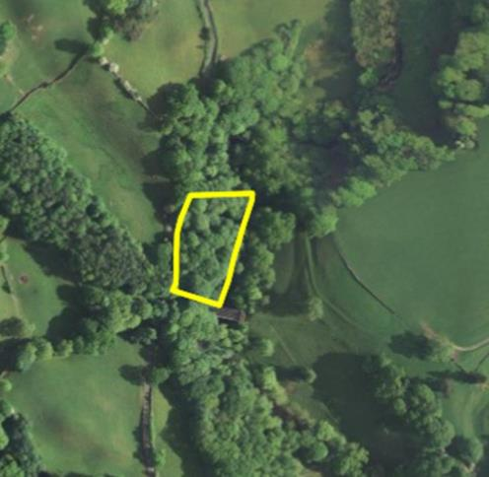
Compartment: LT16 – Un-named riparian woodland
Species: Ash, sycamore, and mixed broadleaves
Hectares: 0.35ha Designations: LDNP & WHS
Description: A linear parcel of riparian wood lining Trout Beck, predominantly consisting of mature ash and sycamore with other broadleaves (including small-leaved lime). Contributes to a wider strip of riparian woodland in various parcels of ownership running along this river, and has previously been noted for a rich ground flora.
Issues: Limited at present
Aims: Maintain a riparian woodland of mixed age class and species for resource protection and habitat value.
Compartment: LT17 – Benslop Wood
Species: Ash, sycamore, sessile oak and mixed broadleaves
Hectares: 0.45ha Designations: LDNP, WHS & ASNW
Description: Steeply-sloping parcel of a larger riparian wood lining Trout Beck, predominantly consisting of mature oak, ash and sycamore with other broadleaves including wych elm. As an ancient woodland, it has a well-developed ground flora and good levels of deadwood. Contributes to a wider strip of riparian woodland in various parcels of ownership running along this river.
Issues: Limited at present
Aims: Maintain a riparian woodland of mixed age class and species for resource protection and habitat value.

Slide 31
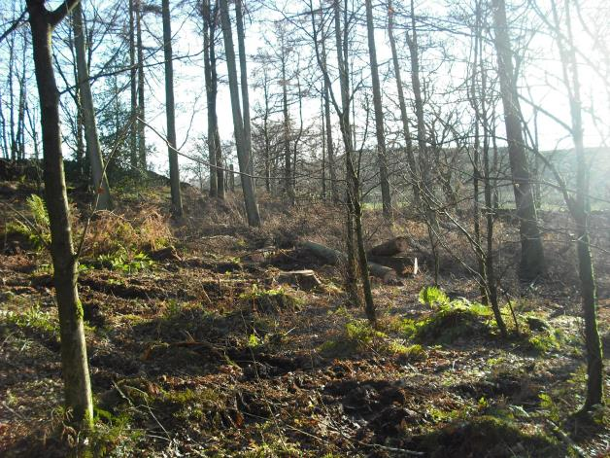
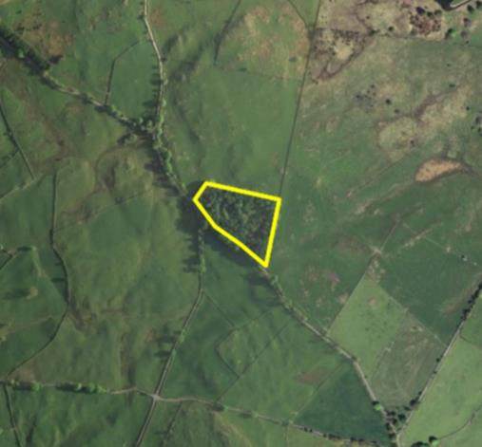
Compartment: Upper Windermere (UW) 1 – Bishop Plantation
Species: Mixed broadleaves, including sessile oak, rowan, sycamore, beech and hazel, and hybrid larch
Hectares: 1.7ha Designations: LDNP & WHS
Description: Small, rectangular plantation off Moorhowe Road with three relatively distinct patches: the middle was cleared in the 1980s following storms and replanted with mixed broadleaves, the south was mostly cleared of conifers in 2017 and re-planted with broadleaves and shrubs, and the north remains dominated by original planting of beech, sycamore and larch.
Issues: Planted trees in the middle starting to close canopy; some old tree tubes remain on site (to be removed as part of work programme); fly-tipping adjacent to the roadside
Aims: Generally maintain a mixed-age, mixed-species woodland for habitat , amenity and other values
Significant works: Coppice 1980s-90s planting in centre of woodland in 2-3 coupes to improve structural diversity; check and maintain newer planting as necessary; thin remaining area of older larch and beech to allow trees of best form and health to be retained to maturity/over-maturity

Slide 32
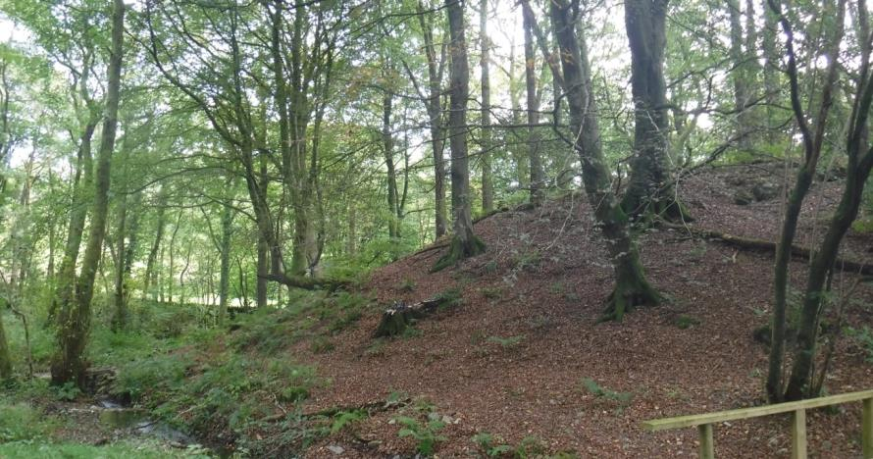
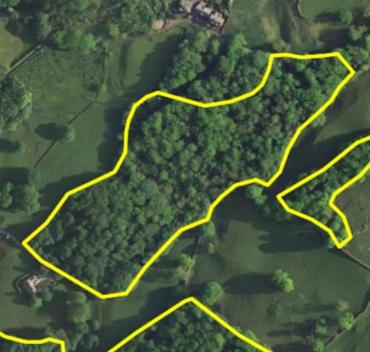
Compartment: UW2 – Low Hag Wood
Species: Sessile oak, beech, common alder, ash, sycamore and other mixed broadleaves
Hectares: 4.1ha
Designations: LDNP, WHS & (mostly) ASNW
Description: Ancient woodland within the St Catherine’s estate, predominantly lapsed coppice sessile oak with significant amounts of beech; Wynlass Beck is lined with more wet woodland of alder, sycamore and ash, with patches of bird cherry.
Issues: Even-aged structure in part of the wood, with limited diversity of tree sizes; generally closed canopy and subsequent shading hindering regeneration of light-demanding oakwood species
Aims: Maintain ancient semi-natural woodland of predominantly upland oakwood character, but with more varied age classes and species diversity, and ensure long-term viability through enabling young trees to regenerate
Significant works: Thin oak and beech to the west of the wood to increase light to woodland floor and encourage trees of best form and health; coppice one coupe of oak; thin sycamore and mixed broadleaves along beck to create dappled shade along watercourse; fell two small scallops adjacent to footpaths to create open space within woodland

Slide 33
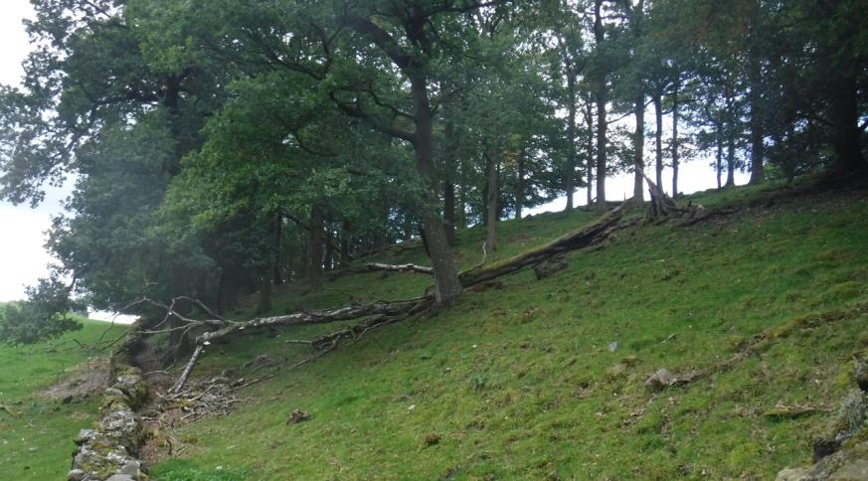
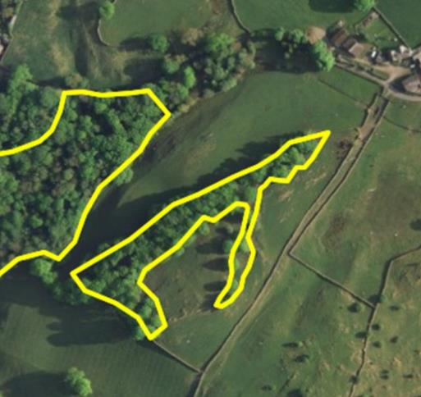
Compartment: UW3 – Un-named copse
Species: Sessile oak and occasional other broadleaves
Hectares: 0.9ha Designations: LDNP & WHS
Description: A small copse formed of closed-canopy sessile oak, which is possibly a remnant of woodland once joined to Low Hag Wood; grazed within Causeway Farm
Issues: Generally closed canopy and subsequent shading, as well as grazing, leading to lack of tree regeneration
Aims: Diversify the woodland structure towards a greater mix of tree sizes; enable well-formed boundary trees to develop and provide habitat, amenity value, and shelter for livestock
Significant works: Lightly thin stand to increase light to woodland floor and encourage trees of best form and health; work with tenant farmer to explore options for small exclosures to enable pulses of grouped tree regeneration

Slide 34
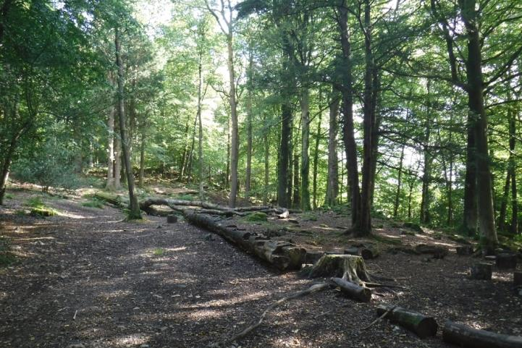
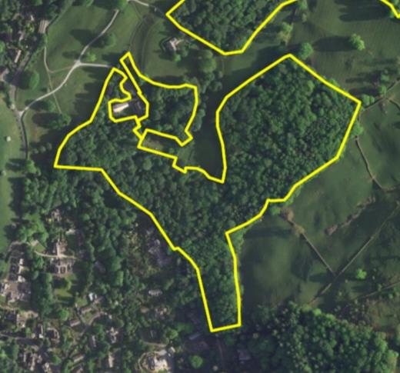
Compartment: UW4 – High Hag Wood
Species: Sessile oak, beech, and other mixed broadleaves; some Scots pine and birch
Hectares: 7.9ha Designations: LDNP, WHS & (mostly) ASNW
Description: A significant area of ancient woodland within the St Catherine’s estate, split nominally into five sub-compartments. The wood is predominantly lapsed coppice sessile oak with significant amounts of beech; other distinct areas include a more birch-dominated area to the east, younger mixed broadleaves surrounding the Footprint building, and more pure beech east of the NT Property Office. Popular with walkers and used for school and community group engagement events.
Issues: Even-aged structure with limited diversity of tree sizes; generally closed canopy and subsequent shading hindering tree regeneration
Aims: Maintain ancient semi-natural woodland of predominantly upland oakwood character, but with more varied age classes and species diversity, and ensure long-term viability through enabling young trees to regenerate
Significant works: Thin oak, beech and other broadleaves through most of the woodland to increase light to woodland floor and encourage trees of best form and health; coppice one coupe of oak to the north-east and undertake one group-fell of beech to the north-west to create groups of younger tree regeneration. Scalloping of the western woodland edge also to be undertaken under Felling License 010/206/17-18.

Slide 35
Compartment: UW5 – Common Farm Wood
Species: Ash, sessile oak, alder, willow and birch
Hectares: 1.2a Designations: LDNP & WHS
Description: Linear copse within Common Farm land. Most of the copse is a structurally diverse wet wood/carr, with good habitat value; to the north is a stand of birch, bisected by power-lines, whilst the south has been more recently planted with a mix of broadleaves to extend the tree cover into a shelterbelt.
Issues: Younger, planted trees now closing canopy
Aims: Enable well-formed boundary and farmland trees to develop and provide habitat, amenity value, and shelter for livestock; enable the structurally-diverse area of carr to persist, providing wetland habitat
Significant works: Thin younger, planted trees to promote trees of best form and health, including ‘halo-thinning’ around older, pre-existing trees to reduce shading
Compartment: UW12 – Common Farm Wood
Species: Mixed broadleaves including sessile oak, ash, wild cherry and rowan
Hectares: 0.15ha
Designations: LDNP and WHS
Description: Small, linear shelterbelt planted along field boundary and lying within Common Farm tenancy. Typical of many similar broadleaf plantings, and functioning predominantly as shelter within the agricultural landscape.
Issues: Planted trees now closing canopy; some shading of one pre-existing older boundary tree
Aims: Enable well-formed boundary trees to develop and provide habitat, amenity value, and shelter for livestock, integrated into the farmed landscape
Significant works: Thin younger, planted trees to promote trees of best form and health, including ‘halo-thinning’ around older tree to reduce shading

Slide 36
Compartment: UW6 – Common Wood
Species: Sessile oak, birch, and other mixed broadleaves
Hectares: 12.1ha Designations: LDNP, WHS & (mostly) ASNW
Description: Ancient woodland within the Crosthwaite estate predominantly lapsed coppice sessile oak with other typical upland acidic oakwood species (rowan, birch, hazel and holly). Some smaller areas have previously been under conifer cover, which was felled and deer-fenced prior to re-planting and regenerating with broadleaves. Along small watercourses are more typical wet-woodland species such as alder and ash. Some previous group fells have been replanted in the 1980s/1990 to create clumps of younger trees.
Issues: Generally even-aged structure with limited diversity of tree sizes; predominantly closed canopy and subsequent shading, along with deer browsing, hindering tree regeneration; some old tree tubes remain on site (to be removed as part of work programme)
Aims: Maintain ancient semi-natural woodland of predominantly upland oakwood character, but with more varied age classes and species diversity, and ensure long-term viability through enabling young trees to regenerate
Significant works: Thinning and small group-fells through the south of the wood under Felling License 010-150-16-17; coppicing two coupes five years apart to the west and thin along a natural dip to create lighter linear space; thinning 1980s planting in a previous group fell to the northwest and thinning around another natural opening, adjacent to the footpath to the north, to enable tree regeneration

Slide 37
Compartment: UW7 – Far Common Wood
Species: Sessile oak, birch, sycamore, and other mixed broadleaves
Hectares: 1.6ha Designations: LDNP, WHS and ASNW
Description: Small parcel of ancient woodland within the Crosthwaite estate and similar to nearby Common Wood. Predominantly lapsed coppice sessile oak with other typical upland acidic oakwood species and significant areas of sycamore. A relatively steep bank to the eastern boundary has a greater mix of species and a higher stocking density of trees.
Issues: Generally even-aged structure with limited diversity of tree sizes; predominantly closed canopy and subsequent shading, along with deer browsing, hindering tree regeneration; cherry laurel encroaching from neighbouring land; poor boundaries, especially along the north
Aims: Maintain ancient semi-natural woodland of predominantly upland oakwood character, but with more varied age classes and species diversity, and ensure long-term viability through enabling young trees to regenerate
Significant works: Thin oak and other broadleaves along the western boundary to increase light to the woodland floor, and fell one group of oak to allow a patch of young trees to develop; cut back and treat any re-growth of cherry laurel; undertake boundary repairs

Slide 38
Compartment: UW8 – Grove Farm Wood
Species: Sessile oak, sycamore, ash, and other mixed broadleaves
Hectares: 0.5ha Designations: LDNP and WHS
Description: Small parcel of woodland within the Crosthwaite estate, near to Grove Farm. Predominantly characteristic of flushed, damper soils, dominated by sycamore and ash, with areas dominated by oak on thinner soils; holly forms a good understory.
Issues: Generally closed canopy and subsequent shading; deer browsing; poor boundary to the north
Aims: Maintain a woodland with varied age classes and species diversity, and ensure long-term viability through enabling young trees to regenerate; enable more light to reach the woodland floor for ground flora and tree regeneration
Significant works: Generally thin the woodland to increase light reaching the woodland floor; work with neighbouring land-owner to ensure boundary is repaired
Compartment: UW9 , UW10 and UW11 – Mislet Farm Woods
Species: Mixed broadleaves, including sycamore, oak and ash, and yew in one UW10 compartment
Hectares: UW9 0.3ha, UW10 0.2ha, UW11 0.3ha Designations: LDNP and WHS
Description: Small copses and shelterbelts within Mislet Farm land. UW9 is more linear, and is predominantly sycamore and oak with a good diversity of other mixed broadleaves and holly understory. UW10 is two discrete blocks of trees closer to the farmstead, one of which is predominantly sycamore and ash and the other containing a greater level of yew. UW11 is a corner planting adjacent to the A591, predominantly oak, ash and wild cherry. Valuable patches of tree cover for habitat and amenity value within a more open, farmed landscape.
Issues: Limited at present
Aims: Maintain older copses integrated into the farming landscape; manage UW11 to enable well-formed trees to develop and provide habitat, amenity value, and shelter for livestock
Significant works: Thin younger, planted trees in UW11 to promote trees of best form and health

Slide 39
Compartment: UW13 – Mislet Farm Wood
Species: European larch and mixed broadleaves, including sessile oak, ash, wild cherry, rowan, hawthorn and hazel
Hectares: 0.15ha
Designations: LDNP & WHS
Description: Small corner planting along Moorhowe Lane, presumably previously a stand or larch with the majority of trees removed and re-planted with broadleaves. Trees are generally establishing well and will continue to provide habitat and amenity value.
Issues: Some old tree tubes remain on site (to be removed as part of work programme)
Aims: Enable a small copse of well-formed boundary trees to develop and provide habitat, amenity value, and shelter for livestock, integrated into the farmed landscape. No significant works planned at present.
Compartment: UW14 & UW15 – Bannerigg shelterbelts
Species: Mixed broadleaves including sessile oak, ash, silver birch and common alder; orchard apples in UW14
Hectares: UW14 0.8ha, UW15 0.2ha Designations: LDNP & WHS
Description: UW14 consists of two areas of planting surrounding Bannerigg farmstead. In both cases, orchard apples are planted to the north, whilst a more standard mix of broadleaves have been planted to the south. UW15 is a line of boundary trees with new planting around existing trees, highly visible at the top of fields north of the A591.
Issues: Planted trees now closing canopy; some shading of one pre-existing older boundary tree; some old tree tubes remain on site (to be removed as part of work programme)
Aims: Enable well-formed boundary trees to develop and provide habitat, amenity value, and shelter for livestock, integrated into the farmed landscape
Significant works: Thin younger, planted trees in UW14 to promote trees of best form and health, including beginning new pollards where tree form and position allows; fence repairs

Slide 40
Compartment: Lower Windermere (LW) 1 & LW2 – Millerbeck Wood, Adelaide Hill and Rayrigg Woods
Species: Mixed broadleaves including sessile oak, beech and sycamore
Hectares: 2.5ha in total Designations: LDNP & WHS; LW2a & LW2b ASNW
Description: Three separate sub-compartments that make up ‘Millerground’, a popular stretch of woodlands leading down to and along Windermere lakeshore. Mostly sessile oak, with significant beech and sycamore and areas of shingle with more ash, wych elm and small-leaved lime. The woods are seasonally busy with both local community users and visitors. The Local Authority own a small area between LW2a and LW2b.
Issues: Occasional anti-social behaviour; significant beech regeneration and a generally closed-canopy hinders regeneration of more light demanding species.
Aims: To maintain a mixed broadleaf woodland of the oakwood-type, and maintain the significant amenity value through preventing the paths from becoming overgrown and enabling users to enjoy both the woodland habitat but also the lakeshore views
Significant works: Thin along Millerbeck in LW1 to create more dappled shade, and maintain views up the beck from the small bridge; generally thin UW2, focussing on reducing beech to increase light levels and promote regeneration of oak, birch and other light-demanding species; coppice sycamore and beech along the lakeshore in four areas in LW2b to maintain views out to the lake.

Slide 41
Compartment: LW3 – Post Knott
Species: Mixed broadleaves including sessile oak and sycamore; occasional conifers including Scots pine and larch
Hectares: 1.3ha
Designations: LDNP & WHS
Description: The more wooded slopes below the popular Post Knott viewpoint above Bowness. The woodland is predominantly sessile oak, with younger beech, sycamore and ash present alongside occasional, significant larch and Scots pine. The wood is popular with local community members and visitors enjoying the view from the top.
Issues: A generally closed-canopy is limited regeneration of more light demanding species; sightlines from the viewpoint can become blocked by trees below
Aims: To maintain a mixed broadleaf woodland of the oakwood-type, and maintain key sightlines from the viewpoint
Significant works: General thin of areas of the woodland to reduce beech and sycamore particularly, allowing more light to the woodland floor and opening some sightlines from the Post Knott viewpoint; some continued coppicing and pollarding of young trees around the viewpoint itself.

Slide 42
Compartment: LW4 – Cockshott Woods & Ferry Nab
Species: Sessile oak and occasional other mixed broadleaves, as well as Corsican pine; more ash and alder at Ferry Nab
Hectares: 0.95ha (LW4a) & 0.3ha (LW4b) Designations: LDNP & WHS
Description: Cockshott Woods is a belt of predominantly oak, with occasional beech, sycamore and conifer, which line the eastern edge of the popular Cockshott Point just south of Bowness waterfront. Ferry Nab Woods (LW4b) line either side of the footpath leaving NT-owned land to the south of Cockshott Point, and are more wet woodland in character with alder and ash, and a significant stand of ‘Touch-me-not balsam’
Issues: Occasional anti-social behaviour; invasive species (Himalayan balsam and Japanese knotweed) at Ferry Nab
Aims: To maintain a woodland belt at Cockshott Point for habitat and amenity value; maintain a structurally-diverse stand of wet woodland and associated habitat benefits at Ferry Nab
Significant works: Lightly thin Cockshott wood to increase light reaching the woodland floor and encourage trees of best form and health; occasionally coppice patches of alder at Ferry Nab to maintain varied light levels and stand structure for wildlife.

Slide 43
Compartment: LW5 – Borderiggs Brow
Species: Mixed broadleaves, including beech, sycamore, hornbeam, oak and sweet chestnut
Hectares: 0.3ha Designations: LDNP & WHS
Description: Small copse of very varied species and age structure, situated between housing to the south of Bowness and bordered on the west by the A5074. A small path runs through the site, and a historic feature (trough) can be found on the western edge.
Issues: Some cherry laurel is invading from neighbouring gardens; the paths can become overgrown and difficult to use.
Aims: To generally maintain a mixed broadleaf woodland for habitat and amenity value.
Significant works: Small trees will be felled off the historic feature, and the southern boundary thinned (and roadside vegetation coppiced) to increase light and make the entrance here more welcoming.
Compartment: LW6 – High Lickbarrow
Species: Sessile oak and other mixed broadleaves, including alder and hazel in wetter areas of some copses
Hectares: 1.05ha Designations: LDNP & WHS
Description: Various copses of predominantly sessile oak around the wider High Lickbarrow farm south of Windermere. One copse lines Scout Beck and borders neighbouring garages to the north of the site; some are fenced off whilst others are unfenced and grazed by the Albion cattle on the farm. Copse LW6d was thinned and some alder coppiced in 2017; sycamore and ash in LW6e (south of Old Droomer Barn) were felled in 2017 and re-planted with wild fruit trees to reduce damage to the barn and retaining wall. The copses contribute to the mixed character of this farm and provide significant habitat value, as well as amenity value.
Issues: Limited at present
Aims: To generally maintain clumps of trees intimately mixed with the grazing land at High Lickbarrow
Significant works: Copses will be lightly thinned to encourage trees of the best form and health to become landscape/field trees; LW6e will be lightly thinned through the creation of standing dead trees to allow more dappled shade to reach Scout Beck.

Slide 44
Compartment: Ambleside (AM) 1 & AM2 – Skelghyll & Dovenest Woods
Species: Sessile oak, silver birch and other mixed broadleaves; various conifers, including Douglas fir, Scots pine and larch in Dovenest
Hectares: 21.2ha and 15.4ha Designations: LDNP, WHS & ASNW
Description: The two largest compartments in the ancient woodland Skelghyll Woods, near Ambleside, split nominally along the line of the bridleway. AM1, to the north, is predominantly lapsed-coppice sessile oakwood, with occasional wet flushes of ash, bird cherry and other species. AM2 is more varied, with specimen conifers around the ‘Tall Tree Trail’, larch and pine plantations above this, and more typical lapsed-coppice sessile oakwood to the east. Jenkin’s Crag provides a notable viewpoint and the woodland provides significant habitat; in addition, the specimen planting of conifers is part of the designed landscape incorporating the privately-owned Wansfell Holme below the woodland.
Issues: Even-aged structure with limited diversity of tree sizes; generally closed canopy and subsequent shading hindering regeneration of oak and other light-demanding species; deer browsing and occasional ingress sheep grazing
Aims: Maintain ancient semi-natural woodland of predominantly upland oakwood character, but with more varied age classes and species diversity, and ensure long-term viability through enabling young trees to regenerate; also maintain the designed landscape through continued occasional planting of specimen conifers within ‘Tall Trees’ area.
Significant works: One group/regeneration fell to the west of AM1 and thinning to the east of AM1 to allow groups of young trees to develop; variable-density thinning and small group fells through the oakwood (eastern) part of AM2 to diversify the even-aged structure, as well as creation of a ride and some coppice coupes for increased open space; light thinning in the Tall Trees section to show off the best conifers; improved access through resurfacing main tracks as necessary.

Slide 45
Compartment: AM3 & AM4 – Thief Fold Wood and Jenkin’s Field
Species: Mixed broadleaves, including sessile oak, sycamore, ash and alder; occasional conifers, including Douglas fir
Hectares: 2.3ha and 0.3ha Designations: LDNP & WHS; ASNW (AM3)
Description: AM3 is the southern-most portion of Skelghyll Woods, notably of different character to AM1 & AM2 through being generally wetter and scattered with more unusual broadleaf trees such as southern beech and tulip trees. Ponds and old quarries are notable. AM4, on the opposite side of the A591, is dominated to the north by significant Douglas fir, whereas the thinner strip to the south is oak, ash and hazel lining Windermere lakeshore.
Issues: Invasive species, including Rhododendron and Japanese knotweed.
Aims: Remove invasive species and maintain mixed species woodland appropriate to the site.
Significant works: Roadside coppicing in AM3 to create a more shrubby edge to the woodland; removal of Rhododendron from both sites and continued treatment of Japanese knotweed in AM3; improved access point into wider woodland using existing entrance and track in AM3.
Compartment: AM5 – High Skelghyll Wood
Species: Ash, sessile oak and other mixed broadleaves
Hectares: 2.1ha Designations: LDNP, WHS & ASNW
Description: Patch of woodland east of Skelghyll Woods and south of the bridleway from Ambleside to Troutbeck; well-spaced ash and oak dominate with some 1990s under-planting of other mixed broadleaves beginning to establish and provide a mixture of age classes
Issues: Some old tree tubes remain on site (to be removed as part of work programme)
Aims: Maintain ancient semi-natural woodland of predominantly upland oakwood character with varied age classes and species diversity, and ensure long-term viability through enabling young trees to regenerate

Slide 46
Compartment: AM6 – Sheepfolds
Species: Mixed broadleaves including ash, sessile oak, hazel, rowan, alder, and other mixed broadleaves
Hectares: 3.6ha Designations: LDNP & WHS
Description: Area of woodland and scrub woodland on the slopes of Wansfell within Town End Farm land. The southern belt consists of P1990s broadleaf planting, now closing canopy; to the north is more scattered scrub woodland developing through a bracken bed. The occasional larger tree to the southwest suggests previous woodland or wood-pasture cover.
Issues: Occasional boundary gaps allowing deer and sheep ingress; shading of older/veteran trees by younger planting
Aims: Enable mixed broadleaf woodland of well-formed trees to develop from the planted belt, and maintain deer fence as necessary to facilitate further scrub regeneration above the planted area
Significant works: General first thin of planted broadleaves to promote trees of best form and health, including halo thinning around veterans.
Compartment: AM7 – ‘Sausages’
Species: Ash, alder, rowan, hazel, elm and other mixed broadleaves
Hectares: 1.2ha Designations: LDNP & WHS
Description: Three areas of fenced-off ghyll-side, with existing riparian trees supplemented by further broadleaf planting. The ghyll-sides themselves are generally floristically rich and the range of tree sizes and species is relatively good.
Issues: Some old tree tubes remain on site (to be removed as part of work programme)
Aims: Maintain riparian vegetation to enhance the habitat and protect water quality

Slide 47
Compartment: AM8 – Skelghyll Beck
Species: Sessile oak, ash, wych elm, hazel, rowan and other mixed broadleaves
Hectares: 4.1ha Designations: LDNP, WHS & SSSI
Description: Fenced-off riparian woodland, with older sessile oak on flatter areas and ash, wych elm and other riparian species on the steeper immediate ghyll-sides. One stand of lapsed oak coppice is present towards the south of the compartment. The ghyll itself is floristically rich and the trees are generally a good mixture of sizes and species. Some supplementary planting has occurred in bracken to either edge of the compartment.
Issues: Some old tree tubes remain on site (to be removed as part of work programme)
Aims: Maintain riparian vegetation for habitat and water quality protection
Compartment: AM9 – Holbeck Ghyll
Species: Sessile oak, ash, alder, wych elm, rowan, hazel, rowan and other mixed broadleaves
Hectares: 0.85ha Designations: LDNP & WHS
Description: Unfenced riparian woodland to the west of Holbeck Ghyll, as part of High Skelghyll Farm. The canopy is generally closed, and there is limited tree regeneration due to grazing. Wetter flushes contain more ash and alder; drier, raised areas have a greater proportion of oak, and hazel forms a scattered understory.
Issues: Lack of regeneration
Aims: Maintain riparian vegetation for habitat and water quality protection; work with tenant farmer to explore options to secure the establishment of young trees

Slide 48
Compartment: AM10 – Greenthwaites
Species: Ash, alder, rowan, sessile oak, sycamore, mixed broadleaves and Scots pine
Hectares: 0.2ha Designations: LDNP & WHS
Description: Small, linear farm shelterbelt in Town End Farm land, planted in the 1980s along a field boundary and to the west of a public bridleway
Issues: Some ash dieback observed
Aims: Enable well-formed boundary trees to develop and provide habitat, amenity value, and shelter for livestock
Significant works: Thin younger, planted trees to promote trees of best form and health
Compartment: AM11 – Martin’s Wood
Species: AM11a: European larch; AM11b: beech and sessile oak; AM11c: larch, Scots pine, sessile oak, rowan, birch and other mixed broadleaves
Hectares: 1.6ha in total Designations: LDNP & WHS
Description: A mixture of sub-compartments within one land parcel in Town End Farm land, including a stand of European larch, a mixed group of mature beech and oak, and three small plantings of mixed broadleaves/conifers (some of which are around pre-existing oak trees.
Issues: Lack of tree regeneration; some shading of older oaks by planted trees in AM11c sub-compartments
Aims: Maintain mixed patches of woodland with varied species structure for habitat and resource protection
Significant works: Clear-fell larch in AM11a and re-stock with more appropriate mixture of native species (retaining the occasional conifer to over-maturity); thin AM11b to promote the trees of best form and health and allow light to encourage tree regeneration; thin AM11c plantings to promote trees of best form and health and halo thin around existing oaks.

