Slide 1
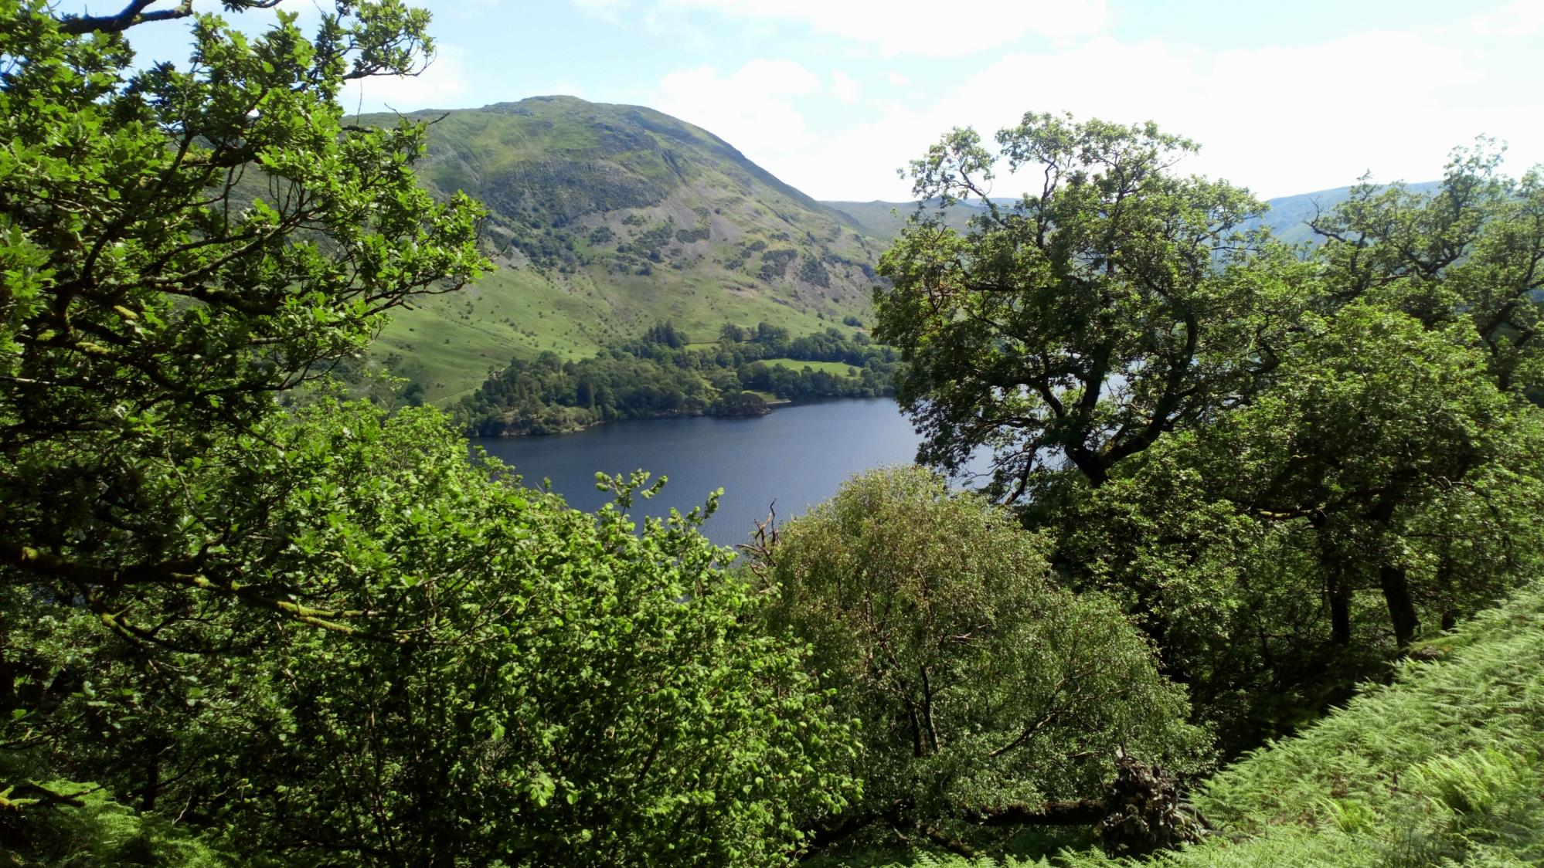
Central & East Lakes: Ullswater valley
Woodland Management Plan 2020-2030
Template design by Matt Taylor, Forest Plans

Slide 2
The aim of this plan is to summarise the-ten year programme of woodland management planned for National Trust woodlands across the Ullswater valley within the Central and East Lakes property. The plan details woodlands within the NT land-holding and any planned forestry operations, including thinning & felling, infrastructure works, and improved monitoring. This particular document summarises the full Woodland Management Plan submitted to the Forestry Commission, aiming to highlight key details for each particular woodland compartment.
Background to the woodlands in the Ullswater valleys property
The National Trust's holding with the Ullswater covers four farm tenancies (and other additional land rented to farm businesses), with significant areas of wood pasture and old deer parks, some large and extensive natural woodlands alongside occasional conifer plantation, and numerous small woodland blocks. The majority of the property sits on igneous rock, or further north sandstone and mudstone, mostly associated with the Borrowdale Volcanic Group; elevation ranges from 150m a.s.l. at lakeshore compartments up to 450m a.s.l. or more at the upper reaches of some Glencoyne woodland compartments, giving a ride range of soil and climatic conditions influencing woodland types and species compositions.
The woodland holdings total approximately 490 ha, including the large ancient semi-natural woodlands of Low Wood, Glencoyne Wood and Gowbarrow woodlands, the mixture of ancient semi-natural woodland blocks within wood pasture around Hartsop Hall, Glencoyne and Gowbarrow, the large larch plantation at Seldom Seen, and small woodland blocks scattered around Blowick and Side Farm. Occasional P1980s-1990s plantings are now developing woodland conditions and create more densely tree’d blocks within more wood-pasture or open landscapes. The woodland compartments of Aira Force contribute significantly to this designed landscape and popular visitor attraction, with a mixture of natural woodland types and designed pinetum planting with specimen exotic conifers.
The majority of woodlands lie within tenancies associated with National Trust farms, especially woodlands around Hartsop associated with Hartsop Hall, and Glencoyne and Gowbarrow woodlands mostly within Glencoyne Farm tenancy. Forestry operations are organised and delivered by the National Trust’s Forestry and Ranger teams or by local contractors, in addition to broader ‘trees outside woodlands’ management as well as regular tree safety management depending on the level of usage of areas adjacent to trees. Spurred in part by the National Trust’s Land, Outdoors and Nature strategy to improve the nature value of its land, increasing levels of scrub and tree planting as well as extensive cattle-only grazing are aiming to improve the connectivity between the woodland compartments identified within this plan, such as scrub planting above Hartsop village, small tree planting exclosures at Caiston and Dovedale, and wood-pasture grazing at Glencoyne and Gowbarrow parks.
More details on each compartment and sub-compartment, as well as information on the soils and geology in each particular area, are included in the full woodland management plan submitted to the Forestry Commission.

Slide 3
Glossary of terms used
ASNW: Ancient semi-natural woodland (i.e. woodland that has been present for over 400 years and remains of relatively natural composition)
Coppicing: historic practice of cutting trees down to the stump to allow them to re-sprout, producing continual supply of wood; often done in groups (coupes) through a woodland.
Group/regeneration felling: felling a group of trees within a woodland, rather than thinning by removing individual trees, to allow a greater amount of light to reach the woodland floor which favours seedlings of light-demanding tree species like oak, rowan and birch.
LDNP: Lake District National Park
PAWS: Plantation on Ancient Woodland Site, an area of ancient woodland that has been planted (often conifers, occasionally other broadleaves) but maintains some of the ecology of ancient woodlands. Gradual removal of the artificial planted canopy is promoted, whilst avoiding where possible relatively drastic clear-felling.
Pollarding: cutting a tree back towards the top of the trunk, around 2m high, to re-sprout and provide a continual supply of wood like coppicing, but above the browse height of animals (so possible to do in areas grazed by livestock or deer). Commonly seen on ash in the Lake District farmed landscape.
SSSI: Site of Special Scientific Interest, a formal conservation designation recognising the value of an area biologically, ecologically, or geologically, designated by Natural England who will retain an interest in its management.
SAC: Special Area of Conservation, a formal conservation designation for areas of European importance for habitat or species conservation, designated by Natural England.
Thinning: removal of a low percentage of trees in a group to give more growing space to those remaining, often to promote trees of a particular species or with certain features (e.g. well-formed crowns or veteran/habitat features)
Veteran trees: trees of particular biological, cultural or aesthetic importance because of their age, size or location; often they are ancient, but sometimes younger trees with damage or past treatment may show veteran features, which include hollowing and cavities, deadwood, cracks, fungi and epiphytic plants. They are of immense value as wildlife habitat as well as often having a cultural association.
WHS: World Heritage Site

Slide 4
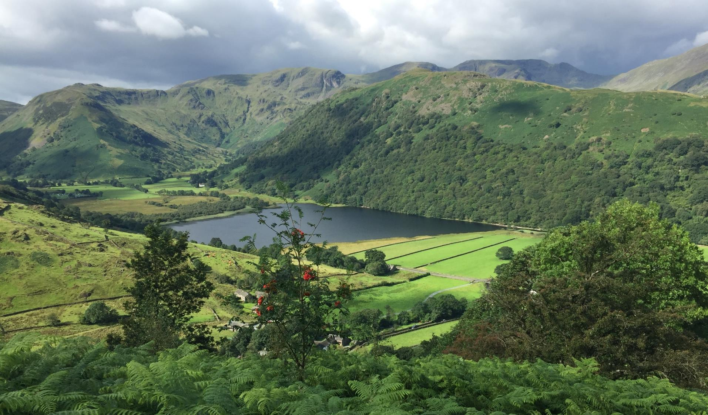
Section 2: Our Aims and Objectives

Slide 5
What we want to do | Why we want to do it? | How can we achieve it?
Maintain the current level of woodland in the National Trust Windermere property, and expand woodlands and the treed landscape where opportunities arise. | Woodland cover within the UK is poor compared to the wider European average, and the UK Government Forestry Policy details targets to expand woodland cover in the UK. The NT holds both larger woodland blocks within Ullswater, contributing towards existing woodland cover, as well as smaller shelterbelts and copses that can incorporate tree cover into a predominantly agricultural landscape. It is imperative that this existing tree cover is not eroded and instead expands through sensitive, collaborative schemes. This will help to provide the environmental, social and economic benefits of trees and woodlands, including the wide range of ecosystem services that complement and contrast with the ecosystem services provided by adjacent land uses. | Clear-felling of woodlands and forests will be avoided except for where small stands of trees offer no other alternatives for more sensitive woodland management; in these cases, stands will be replanted to ensure overall woodland area is maintained. Larger woodlands will be managed using “continuous cover approaches” to maintain woodland cover, through thinning or the felling of small groups of trees within woods. Opportunities for scrub and woodland planting will continue to be explored on National Trust land through partnership working with our tenant farmers, particularly exploring the potential for farm shelterbelts that can increase woodland cover and provide benefits for livestock farming businesses, as well as the options for increasing agroforestry schemes through wood pasture.
Manage and expand the woodland to improve natural resource protection, particularly focusing on water and soil quality. | Storm Desmond in 2015 demonstrated the impacts of flooding on both communities and the land. Trees and woods can help to protect water and soil through binding soils, slowing the flow of water, and improving water quality. We wish to play our part in the mitigation of the impacts of these storm events and of soil erosion. | Maintain and enhance woodlands adjacent to watercourses, and consider ‘riparian’ planting as a particular objective when considering tree planting opportunities. Continue to plant ‘trees outside woods’ in partnership with our tenant farmers .

Slide 6
What we want to do | Why we want to do it? | How can we achieve it?
Protect and enhance existing woodland biodiversity and habitat values | Biodiversity declines generally in the UK are well recognised and documented (e.g. the 2016 State of Nature report), and woodland biodiversity is included within this trend. At the same time, the National Trust is pursuing a strategic aim of ‘Land, Outdoors and Nature’, with ambitious nature conservation targets on our land-holding. Woodlands within this management plan include important upland oakwood habitats, considered ‘temperate rainforests’ and potentially hosting a diversity of flora and fauna, as well as ancient semi-natural wet woodlands dominated by alder, ash and wych elm. Important fauna such as red squirrels, raptors and otters, as well as significant lower plant flora such as lichens, are documented within Ullswater woodlands. | Woodland management operations prioritise habitat improvement. This is predominantly through diversifying the age structure of larger tracts of woodlands, some of which are even-aged as a result of planting or of historic coppice management which, when it ceased, left many trees of a similar age to grow on and form what is now a closed-canopy woodland. This management favoured particular species, resulting in woodlands having a much higher proportion of one species than would naturally be expected. This simplification of the woodland structure and species diversity will have contributed to a loss of habitat for a variety of wildlife. As such, woodland operations aim to create gaps for young trees of various species to regenerate in, as well as creating more deadwood (a vital component of woodland ecosystems) and maintain some open areas that contrast to areas under tree cover. Thinning woodlands with a generally closed canopy will allow more light to reach the woodland floor for wildflowers, as well as ‘free up’ trees of best form to go on to become future large, veteran trees with habitat values for a myriad of wildlife. We will continue to consider key wildlife and implement appropriate management, such as retention of some conifers for red squirrels and halo-thinning veteran trees to maintain their habitat value. We will also as standard implement protection for wildlife during forestry operations.
Improve the resilience of woodlands to climate change and pests and diseases. | The Earth’s temperature is warming a result of human activities, and climate change is widely recognised as a significant threat to woodlands as much as other ecosystems. This coincides and will interact with increasing spread of tree pests and diseases. | The woodland management described above will make woodlands more resilient, with different age structures and species present, which will spread risk to a greater degree and lessen the impact of any particular change in condition through having trees of different ages and species with different requirements, tolerances to climatic changes, and resistance to different pests and diseases. Similarly, we will assess the impact of deer in our woodlands and implement various forms of deer management techniques as necessary to reduce detrimental impacts and enable young trees and woodland flowers to grow, to create this more varied woodland structure. In areas where ash dominates, such as Dovedale and parts of Yew Crag, we will work with tenant farmers and other partners to explore options for planting a variety of ecologically-similar species.
Increase public and stakeholder engagement with woodlands | The National Trust fundamentally aims to look after special places for ever, for everyone. Our woodlands should be able to be enjoyed by everyone – local communities and visitors alike. Our woodland management will be more widely supported if we work in partnership with stakeholders and communities, explaining our reasoning and listening to opinions, thoughts and concerns. | The woods will continue to have a range of public, permissive and informal tracks where possible, enabling people to access and enjoy the woodlands informally. Significant viewpoints, such as those around Aira Force, will be maintained through careful woodland management works. Tree safety management will continue along all roads, public access areas, and residential areas at the frequencies prescribed in the National Trust’s tree safety management procedures. This plan and additional information regarding operations will be shared with local community groups and other woodland users to ensure that our reasoning is understood and concerns alleviated. We will continue to work with local volunteers when managing these woods, including the coppice woodshare group at Dobbinwood, as well as building links with groups such as local universities. Where possible, woods will also be educational spaces for local schools.

Slide 7
What we want to do | Why we want to do it? | How can we achieve it?
Protect cultural and historic features in our woodlands | We recognise the international importance of the Lake District as a World Heritage Status and our responsibility towards protecting the Cultural and Historic Landscape. As part of this woodlands contain many signs of previous management of intrinsic cultural value. This can be seen in the designed landscape of Aira Force, the significant pollards in old deer parks or wood pasture, and structures such as charcoal pitsteads that reflect previous coppice management. | Understanding the Outstanding Universal Values (OUV) of the property and how woodland management can impact upon this. Archaeological features are mapped within NT systems and these are identified prior to any operations to allow adequate protection. Woodland management will maintain significant specimen trees and, in some woods, is re-instating some coppice and/or pollard management to maintain this cultural link to previous management.
Provide a range of forest products | Woodland management operations are primarily focussed on improving woodland structure and health for habitat improvement; however, there is scope for the sensitive production and extraction of timber, firewood and “non-timber forest products”. These products can be sustainably produced and locally used to reduce the carbon footprint and use of materials sourced more widely. | Extract some woody material from thinnings and group-felling where extraction will not be detrimental to the woodland soil health, using more sensitive means if necessary. Use more National Trust timber on our land, utilising mobile sawmillers where applicable, to reduce the carbon footprint and environmental impact of buying externally-sourced products. Likewise, some firewood and timber will be sold to local sawmills and firewood processors. Explore the options surrounding “non-timber forest products”, including venison arising from any deer management.
Improve woodland monitoring | It is vital to collect information on whether woodland management works are resulting in the desired changes, as well as undertaking greater levels of surveying and monitoring to better understand the state of our woodlands and any identified needs or areas for improvement. | Monitoring of the woodland structures and tree species mixtures will be formalised in a program of forest mensuration for key larger ancient woodlands or woods with active restoration. Surveys on significant features, such as deadwood or particular groups of plants/animals, will continue where we know that woods are important for these species, to help inform any management decisions that are required.
Manage all woodlands in accordance with UKFS, UKWAS and statutory requirements | The UK Forestry Standard (UKFS) define and guide sustainable forest management, and the UK Woodland Assurance Scheme (UKWAS) sets benchmarks for forest management to be certified as sustainable. The National Trust should be managing its woodlands in accordance with these, as best industry practice. Legal obligations through statutory requirements are also non-negotiable. | The UKFS and UKWAS combined guide woodland management decision-making and the practical implementation of forestry operations. Audits of the National Trust against UKWAS requirements ensure that areas for improvement and identified and enacted. All forestry operations are undertaken with Operational Site Assessments which identify statutory requirements and ensure that they are adhered to.

Slide 8
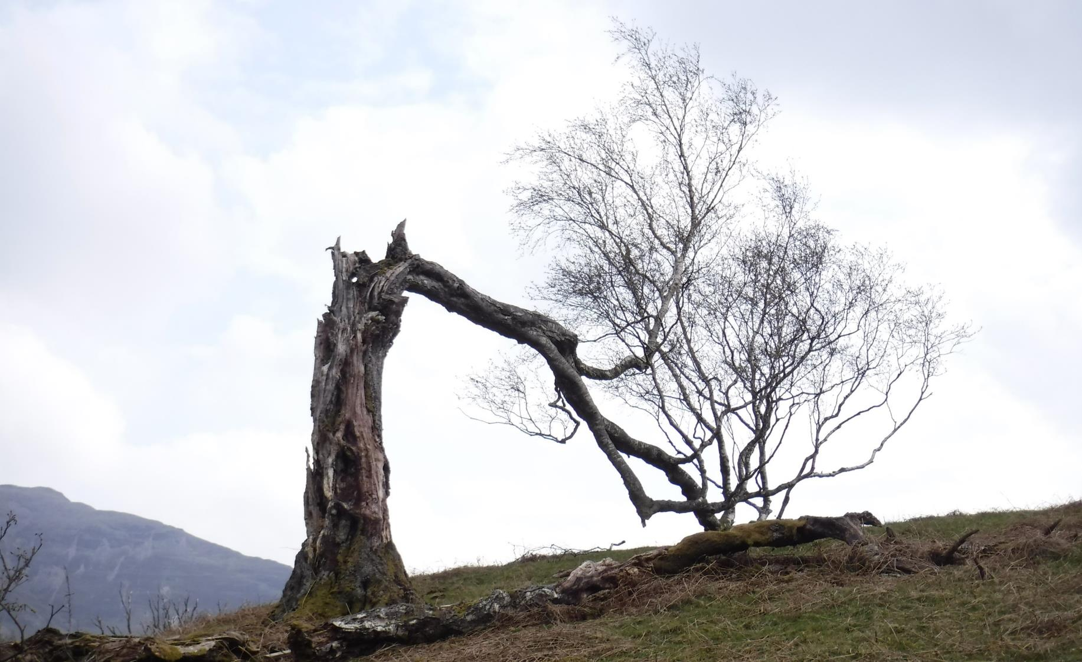
Section 3: Woodland locations

Slide 9
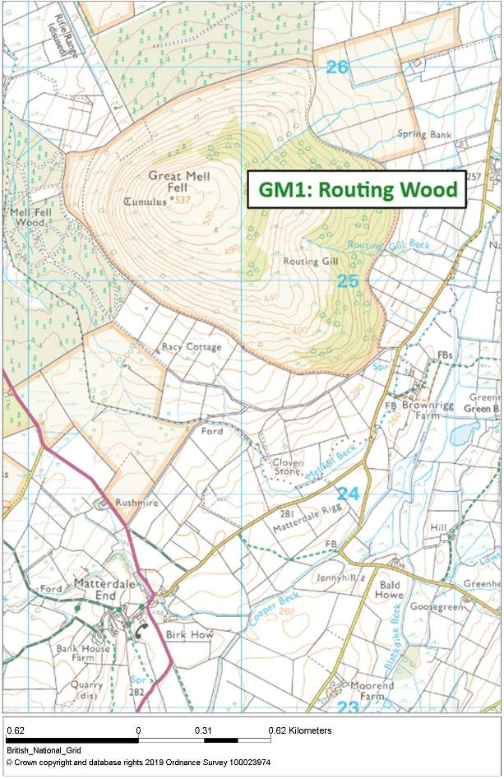
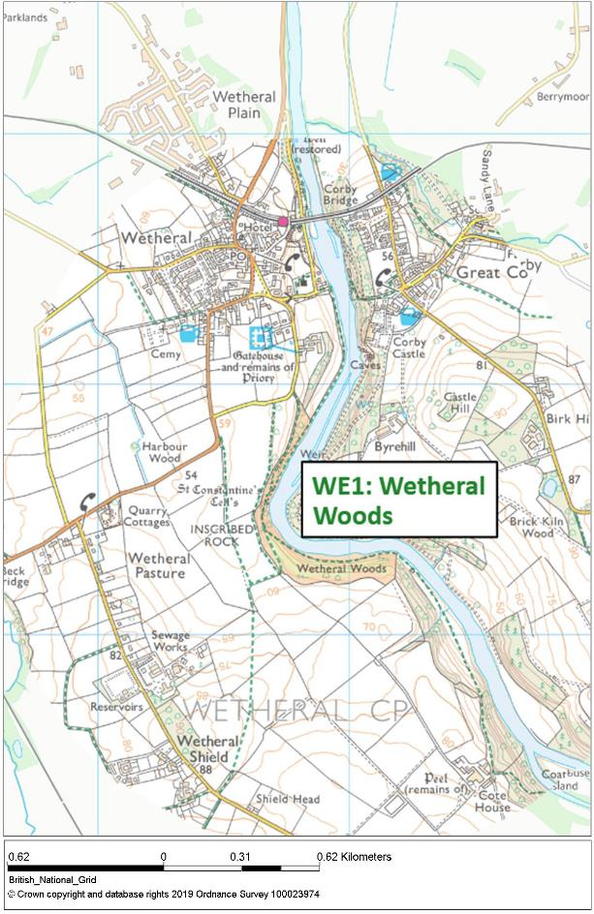
Great Mell
Fell
Wetheral Woods

Slide 10
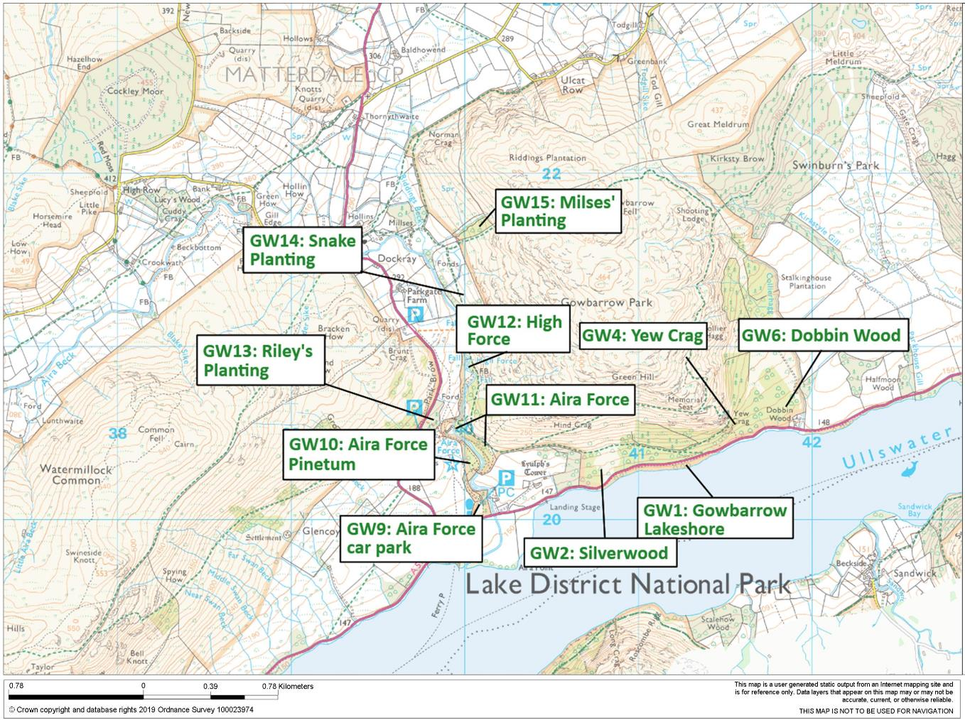
Gowbarrow woodlands

Slide 11
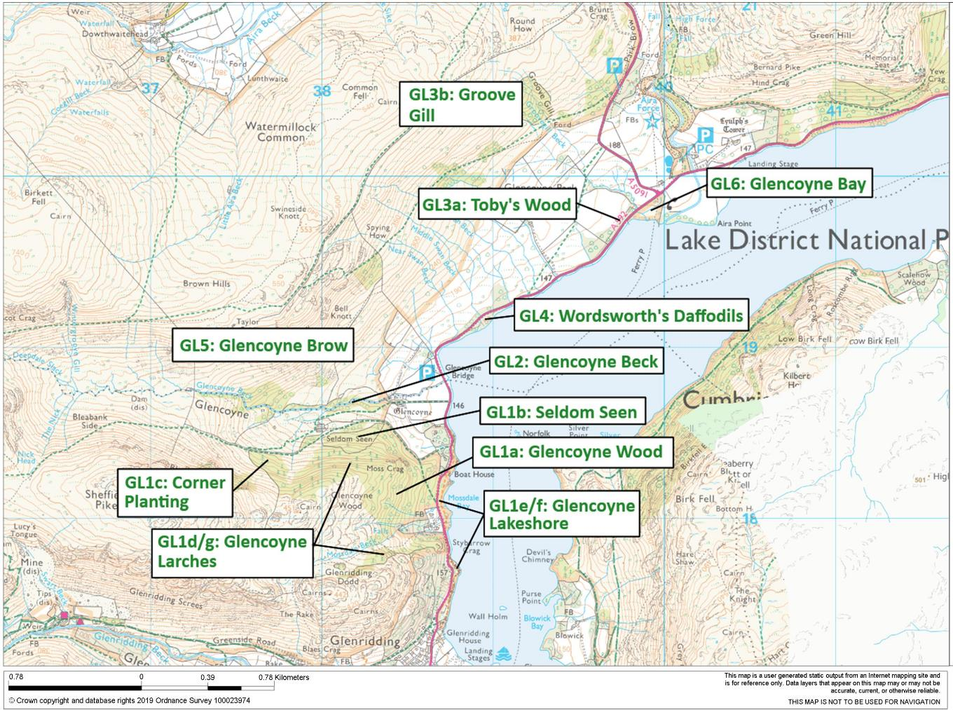
Glencoyne woodlands

Slide 12
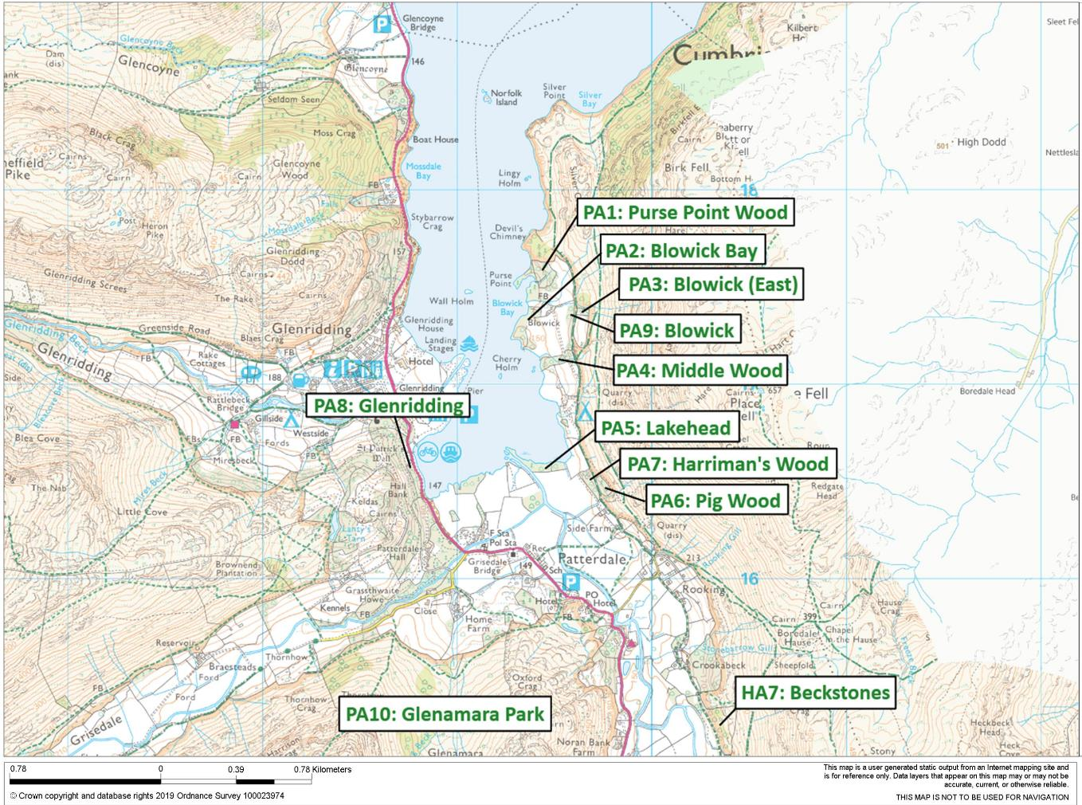
Patterdale woodlands

Slide 13
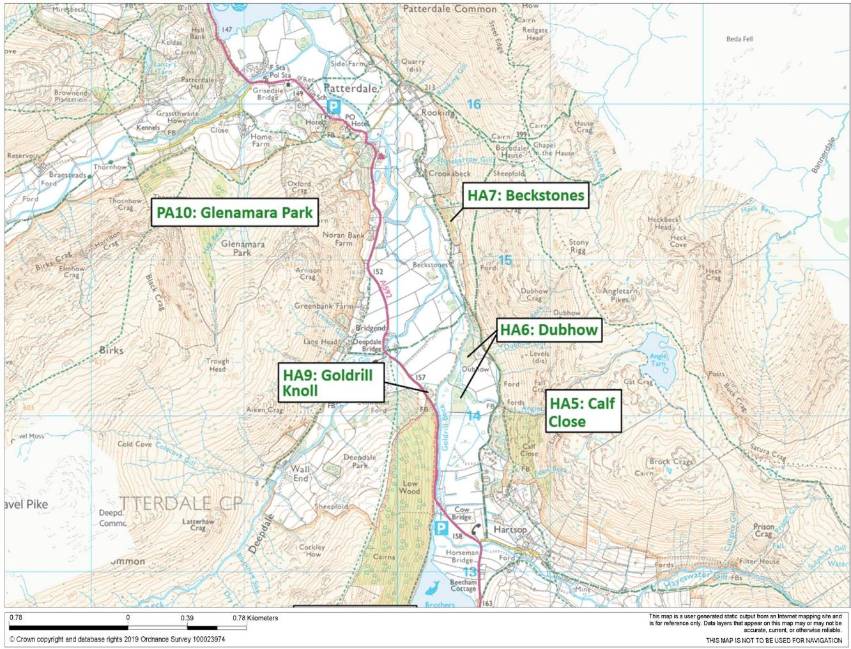
Upper Hartsop woodlands

Slide 14
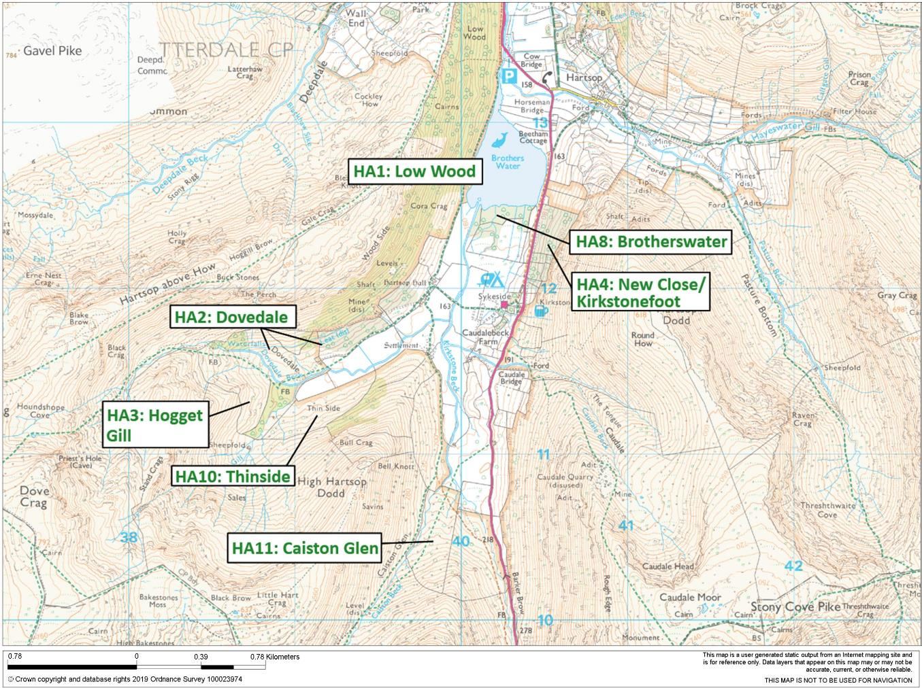
Lower Hartsop woodlands

Slide 15
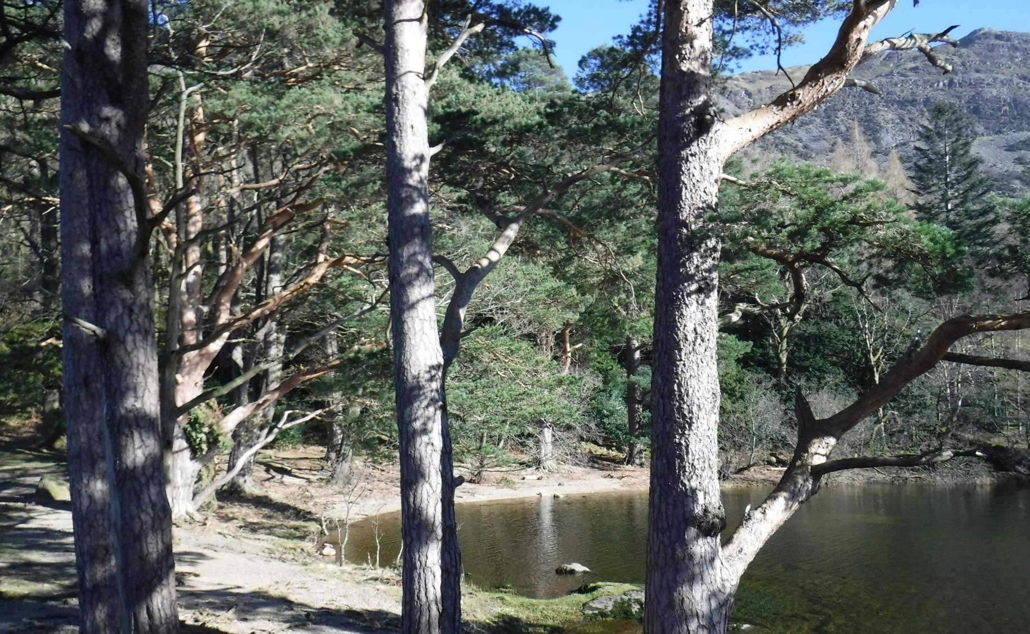
Section 4: Compartment Summaries

Slide 16
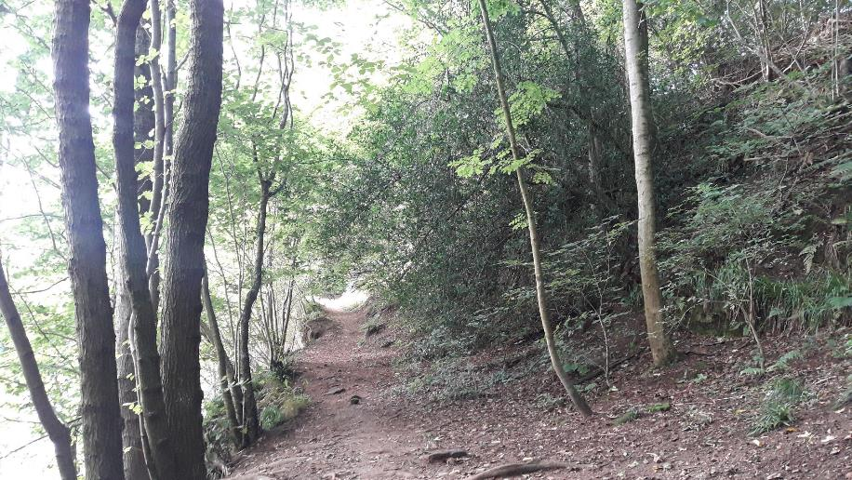
Compartment: Wetheral Wood (WE1)
Species: Oak, sycamore, beech, small-leaved lime, wych elm, holly and other mixed species
Size: 8.45ha Designations: Next to River Eden SSSI & SAC; St Constantine’s Cave SAM
Description: Linear ancient woodland lining the south and west bank of the River Eden near Wetheral, Carlisle. It is well-structured, with a range of sizes and ages of trees, and includes varied species – the presence of good numbers of small-leaved lime and wych elm are notable. Some of the oaks and other species are developing veteran features. The woodland is well-used by the local community and has a significant archaeological feature in St Constantine’s Cave. It provides significant habitat value.
Issues: The degree of canopy closure makes it too dark for light-demanding species such as oak to regenerate, and some young trees above the caves are poorly-rooted.
Aims: To maintain a diverse and healthy ancient woodland for wildlife and the enjoyment of woodland users, whilst protecting the significant archaeological feature.
Proposed works: lightly thin trees along footpaths to allow more light to path edges for wildflowers; fell one small group of 5-7 oak trees to the south of the wood to allow enough light in for tree regeneration (recruiting young oak, rowan and other light-demanding trees); fell one small ‘scallop’ adjacent to the path where the river bends to create an area of open space for wildflowers and associated wildlife.

Slide 17
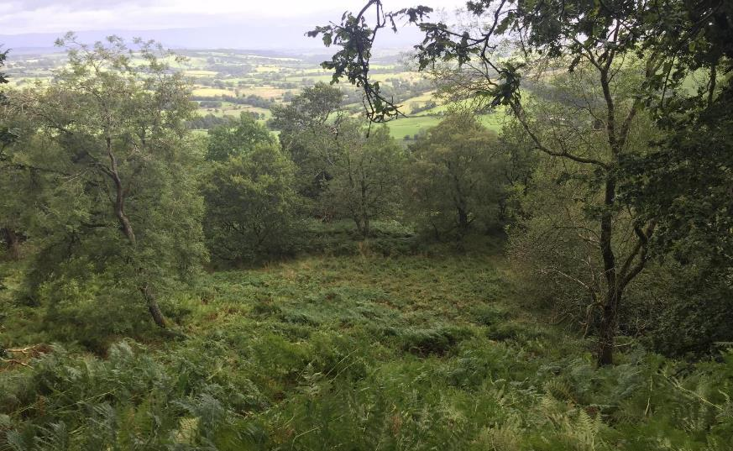
Compartment: Routing Wood/Great Mell Fell (GM1)
Species: Oak, ash, sycamore and elm with birch and other mixed broadleaves, along with beech, larch and Scots pine towards the summit
Size: 66.7ha Designations: LDNP, WHS & ASNW
Description: Ancient woodland to the lower south-eastern slopes of Great Mell Fell, near Matterdale. The wood is a mix of oak and birch on acidic soils with ash, sycamore and elm on more base-rich areas, with a patch of alder to the east; the summit has windswept beech, larch and Scots pine along with oak and other broadleaves. Trees are mostly mature, though tree regeneration (particularly rowan) is beginning to show following relatively recent easing of grazing. Bracken dominated open spaces, though varied woodland flowers are also present, and veteran trees and fallen deadwood provide good habitat.
Issues: The expected loss of ash with ash dieback will lead to some habitat loss, and will make sycamore (an ecologically-similar species) important to retain. Beech and larch, although non-native, pose little problem at their current, relatively low proportions.
Aims: Maintain a healthy and wildlife-rich woodland, with continuation of the light seasonal grazing with horses enabling tree regeneration under a ‘wood pasture’ system.

Slide 18
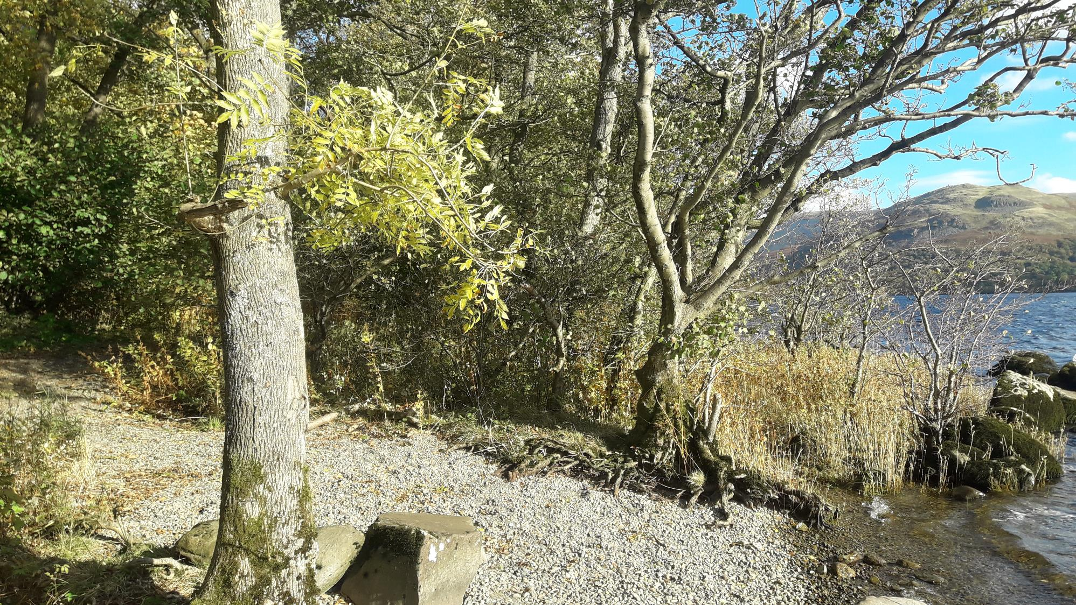
Compartment: Gowbarrow Lakeshore (GW1)
Species: Hazel, common alder, willow, ash, sycamore, oak, birch and other mixed broadleaves
Size: 2.5ha Designations: LDNP and WHS; Gowbarrow SSSI and bordering Ullswater SSSI/SAC
Description: Thin, linear strip of woodland and trees between the A592 and Ullswater lake. Alder, willow and ash & sycamore are common on the lakeshore itself; further up-slope is more hazel, oak and birch. Most trees are young or early-mature, and are closing canopy. Trees around lay-bys have been periodically coppiced or pollarded to open up views, and visitors regularly use the wood to access the lakeshore.
Issues: Fly-camping leaves litter and causes damage to trees through fires or attempts to cut firewood
Aims: To maintain lakeside woodland with well-formed trees for habitat and water quality protection, whilst keeping views open from lay-bys
Proposed works: Lightly thin, particularly around lay-bys, to favour trees of best form to develop large crowns and greater stability; also coppicing trees/shrubs on the immediate roadside where appropriate to maintain visibility for drivers.

Slide 19
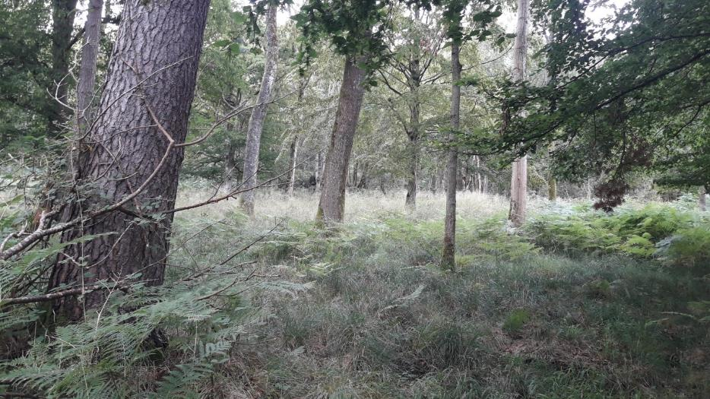
Compartment: Silverwood (GW2)
Species: Common alder in most of the wood, with mature oak to east (sub-cpt 2a); mixed broadleaves including beech, hornbeam, oak, ash and birch with Scots pine to the west (sub-cpt 2b)
Size: 9.5ha across two sub-compartments Designations: LDNP, WHS, Gowbarrow SSSI, and partly ASNW
Description: GW2a (east) is predominantly ancient semi-natural wet-woodland dominated by alder with some ash; to the east of this are widely-spaced magnificent open-grown oaks. GW2b (west) is a mixture of broadleaves, some planted, with Scots pine. Recognised in SSSI citation as significant relict ancient woodland with well-developed ground flora. The wood is managed as part of the Gowbarrow Park wood-pasture area, extensively grazed by cattle.
Aims: Maintain diverse and healthy woodland, ensuring long-term viability through enabling young trees to regenerate and blurring the boundaries between ‘woodland’ and the surrounding wood pasture
Proposed works: Lightly thin the closing canopy stand of beech, oak and sycamore to the north of GW2b to promote the oaks and sycamore (the latter in light of ash dieback) to develop full crowns and become future mature and veteran trees.

Slide 20
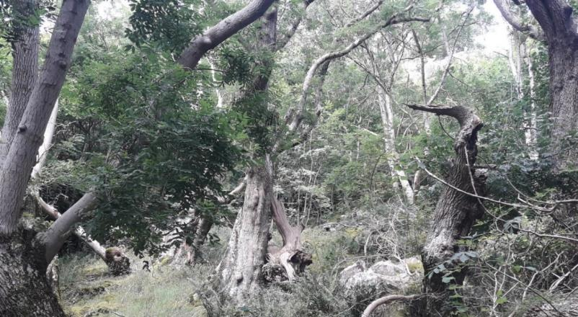
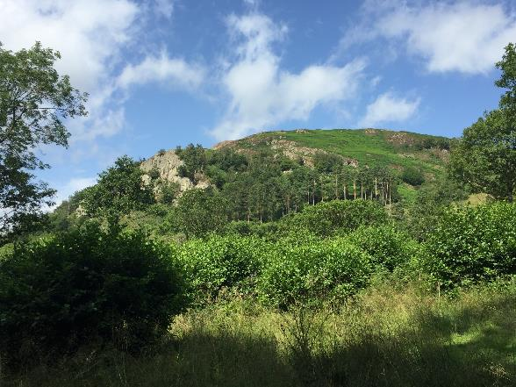
Compartment: Yew Crag (GW4) (n.b. former conifer plantation GW3 felled in 2015 and now part of Gowbarrow Park wood pasture)
Species: Hazel/ash/wych elm at the bottom of crags; alder woodland along road-edge; sessile oak, birch and other broadleaves to upper end of crags
Size: 6.5ha Designations: LDNP, WHS, Gowbarrow SSSI and ASNW
Description: Woodland on and below Yew Crags, to the south of Gowbarrow Fell. Significant for having three distinct semi-natural woodland types, with wet alder woodland at the southern-limit, more base-rich and flushed ash/hazel/wych elm on the lower slopes of the crags, and more acidic sessile oak/birch/rowan to the upper levels. Regeneration, especially to the upper levels, is good following fencing off of the wood. Ancient oaks, yews and ashes are all present, with the ash particularly significant for lichens. The habitat value is significant due to the relict woodland types with ground flora, breeding bird fauna and lower plant diversity, as recognised by the SSSI citation. The wood is managed as part of the Gowbarrow Park wood-pasture area, extensively grazed by cattle.
Issues: The expected loss of ash with ash dieback will lead to some habitat loss as veteran ash die, and will make sycamore (an ecologically-similar species) important to retain. The veteran trees generally are beginning to be shaded by tree regeneration on upper slopes
Aims: Maintain diverse and healthy woodland with the different woodland types continuing to be present, whilst maintaining the habitat value of veteran trees and recruiting new trees as future veterans
Proposed works: Halo-thinning veteran trees to allow more light to them, as well as pollarding selected younger oaks and birch to create new veteran tree features. Work with tenant farmers and Natural England to assess and, if needed, undertake any need for supplementary planting of ecologically similar species to ash (e.g. aspen, sycamore and field maple).

Slide 21
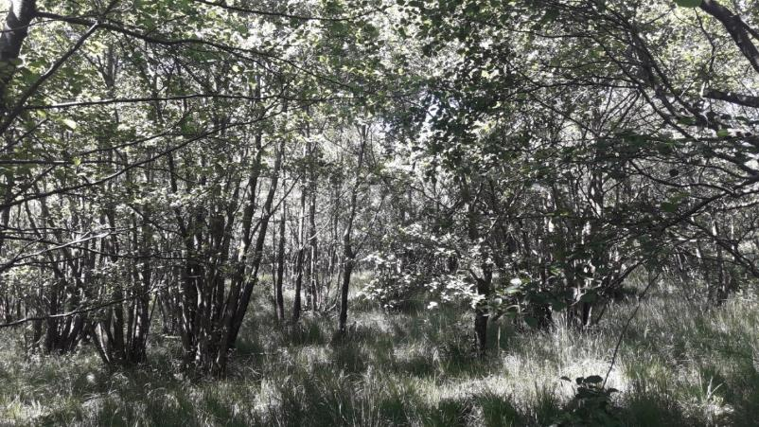
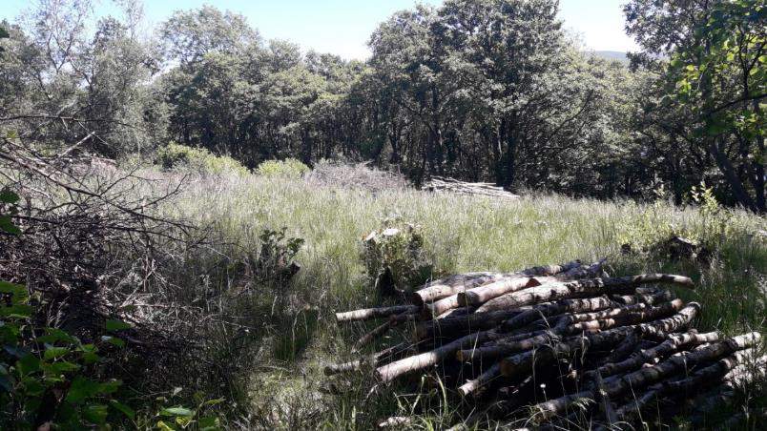
Compartment: Dobbin Wood (GW6) (n.b. former conifer plantations GW5, GW7 & GW8 felled in 2015 and now part of Gowbarrow Park wood pasture)
Species: Common alder with occasional ash, oak and blackthorn
Size: 7.9ha Designations: LDNP, WHS, SSSI and ASNW
Description: Extensive ancient semi-natural wet woodland on the well-flushed lower slopes of Gowbarrow Fell, linking to Yew Crags to the west and so forming part of the belt of wood and wood pasture in this location. As with GW2 & GW4, the SSSI citation recognises its significant habitat value due to varied relict woodland types with ground flora and habitat for breeding birds. Historic coppice management in the centre of the wood has been reinstated, with coupes (groups) last coppiced in the 1980s now worked by volunteers as part of a ‘woodshare’ coppicing scheme, leading to good structural diversity. Occasional veteran trees, including ash and oak, are dotted throughout woodland, along with some significant-aged alder stools. As well as the coppicing, the wood is managed as part of the Gowbarrow Park wood-pasture area, extensively grazed by cattle.
Issues: Some veteran trees are being shaded by uncoppiced alder.
Aims: Maintain a woodland with active coppicing and uncoppiced areas to overall give an uneven-aged structure with varied habitat types; continue to promote woodland expansion through alder regeneration at edges into wood pasture; maintenance of the veteran trees, including halo-thinning to allow them more light where appropriate.
Proposed works: continued coppicing, through ‘woodshare’ scheme as well as coppicing two new coupes, including pollarding to create veteran tree habitat and halo-thinning veteran oak, as part of current Felling License 010/45203/2018.

Slide 22
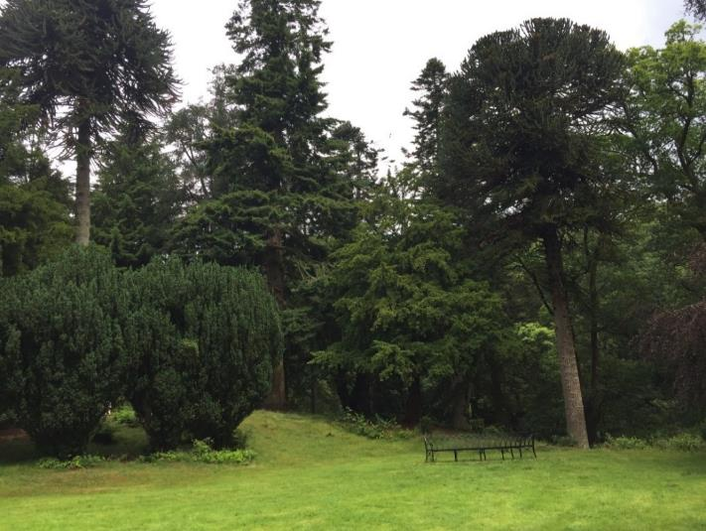
Compartment: Aira Force car park (GW9)
Species: Mostly sessile oak with occasional other broadleaved species
Size: 2.0ha Designations: LDNP and WHS
Description: Various belts of trees surrounding Aira Force car park and visitor reception areas, mostly dominated by sessile oak with occasional other species. Closer to the visitor centre, tree cover consists of more mature trees, including occasional veteran features; the belt immediately west of the car park is of younger trees, undersown with wildflowers.
Aims: to maintain tree cover surrounding Aira Force infrastructure, providing amenity value, greening of built infrastructure, shade and pollution amelioration, and habitat value.
Proposed works: Lightly thin belt closest to car park, which consists of younger trees, to promote trees of best form and vigour to go on to be significant and well-formed mature trees
Compartment: Aira Force Pinetum (GW10)
Species: Mixed conifers, including Douglas and grand firs, yews, Corsican pine and western hemlock; broadleaves including sessile oak, birch and sweet chestnut
Size: 1.6ha Designations: LDNP, WHS and ASNW
Description: A significant part of the Aira Force designed landscape, with specimen conifers surrounding a designed ‘glade’ and more naturalistic broadleaved trees along river edges and heading up towards Aira Force itself. Ground flora reflects the more natural acidic oakwood woodland type. Although mostly non-native conifers, the trees provide habitat value for red squirrel and have significant amenity value through high visitor numbers.
Issues: Views of specimen trees are becoming obscured by relatively dense mid-aged western hemlocks; invasive rhododendron is present to north of compartment; root compaction through significant usage will impact tree roots and their long-term health.
Aims: maintain and display a diverse mix of specimen conifers as part of the designed landscape, whilst ensuring young specimen trees can grow on to maturity; reduce extent of rhododendron as part of plant health and invasive species control
Proposed works: Lightly thin conifers, focussing on selectively removing some mid-aged western hemlocks, to maintain and enhance the best specimen trees; reduce extent of rhododendron on gorge sides

Slide 23
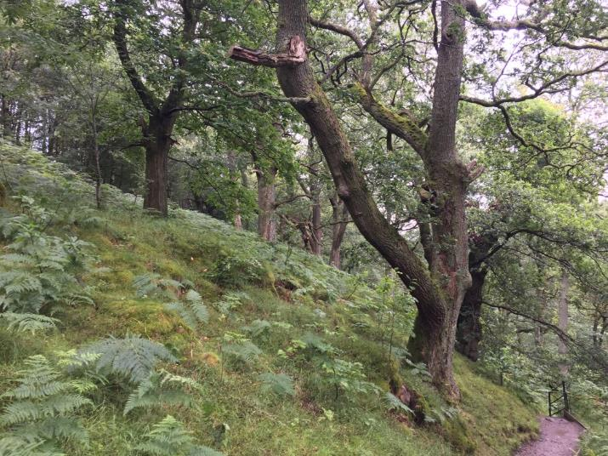
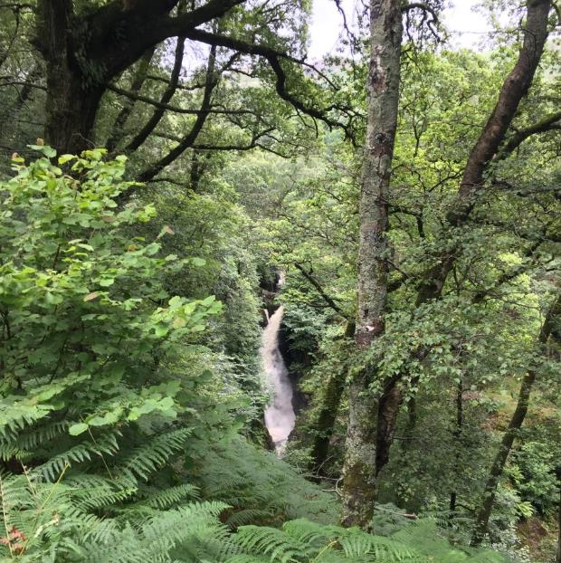
Compartment: Aira Force (GW11)
Species: Sessile oak, birch and rowan with areas of beech, alder, wych elm and
other broadleaves; occasional specimen conifers towards boundary with the arboretum
Size: 3.9ha Designations: LDNP & WHS; ASNW
Description: Woodlands surrounding Aira Beck and the Aira Force waterfall itself. They are predominantly acidic oakwood in character, with sometimes significant mature oak and birch, rowan, sweet chestnut and hazel. Alder and wych elm are more prevalent to the flushed beck edge, and there is more diversity of species closer to the visitor centre end (more beech, wild cherry and other broadleaves). Younger, pole stage broadleaves are present to eastern boundary. Flora on the shady, wet gorge edges especially is diverse. Due to the waterfall and footpaths coming off Gowbarrow, the wood is highly visited and hence of significant amenity value.
Issues: root compaction through significant usage will impact tree roots and their long-term health; rhododendron is spreading on gorge edges
Aims: to maintain a diverse natural woodland, whilst maintaining views to Aira Force and facilitating visitor enjoyment
Proposed works: lightly thin younger trees to promote future well-formed mature trees; coppice young trees in select areas to maintain views of the waterfall, and reduce the extent of rhododendron on gorge edges

Slide 24
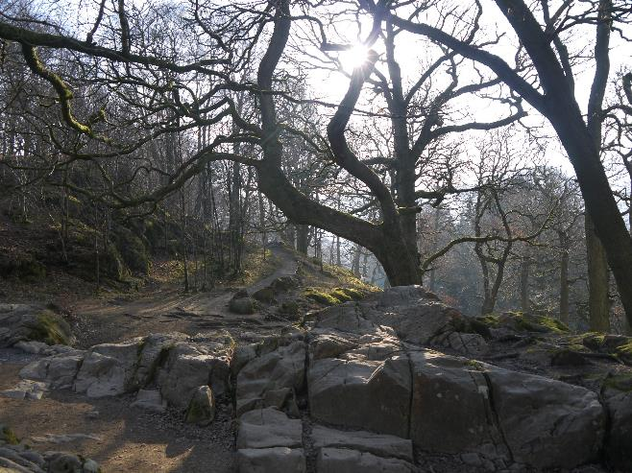
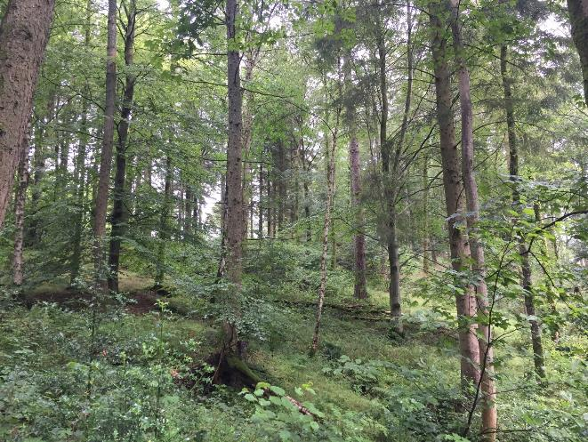
Compartment: High Force (GW12)
Species: Sessile oak, birch, alder and hazel
Size: 7.3ha Designations: LDNP, WHS and ASNW
Description: The riverside woodland extending upstream of Aira Force along Aira beck. North of the river is more oakwood in character, with mature sessile oak and areas of birch and hazel; alder is occasional by the river, and ground flora is typical. South of the river is more alder-dominated, again with hazel, reflecting more flushed soils. The river is highly visited, with a good footpath network, and walkers to/from Gowbarrow fell often pass through the wood. Oak fern is notable as part of the generally good fern flora along beck.
Aims: to maintain varied woodland along the river for habitat, water quality, and amenity value
Proposed works: Occasionally coppice patches of hazel and individual younger trees to maintain viewpoints through to river from footpaths
Compartment: Riley’s Planting (GW13)
Species: Larch and other mixed conifers, with occasional broadleaves, including sycamore, oak and lime
Size: 1.8ha Designations: LDNP and WHS
Description: A rectangular plantation around High Cascades car park, predominantly coniferous with a good mixture of broadleaves (especially towards the edge) and a strip of mature sycamore. Oak, Scots pine and other native species are scattered throughout the plantation, as well as forming a shrub layer with regeneration.
Issues: Closed-canopy of predominantly non-native conifers limits light to young trees and woodland flowers
Aims: Continue transition towards more natural woodland type, although maintaining some conifers scattered throughout for red squirrels
Proposed works: Thin plantation, potentially in two separate, spaced operations, to reduce the percentage of conifers and release broadleaves, especially oak, to develop into canopy trees.

Slide 25
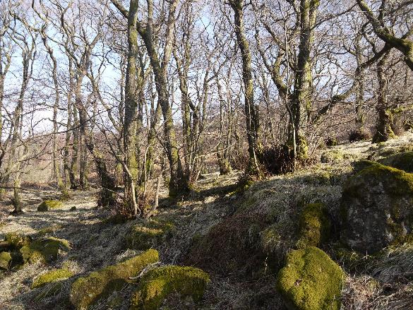
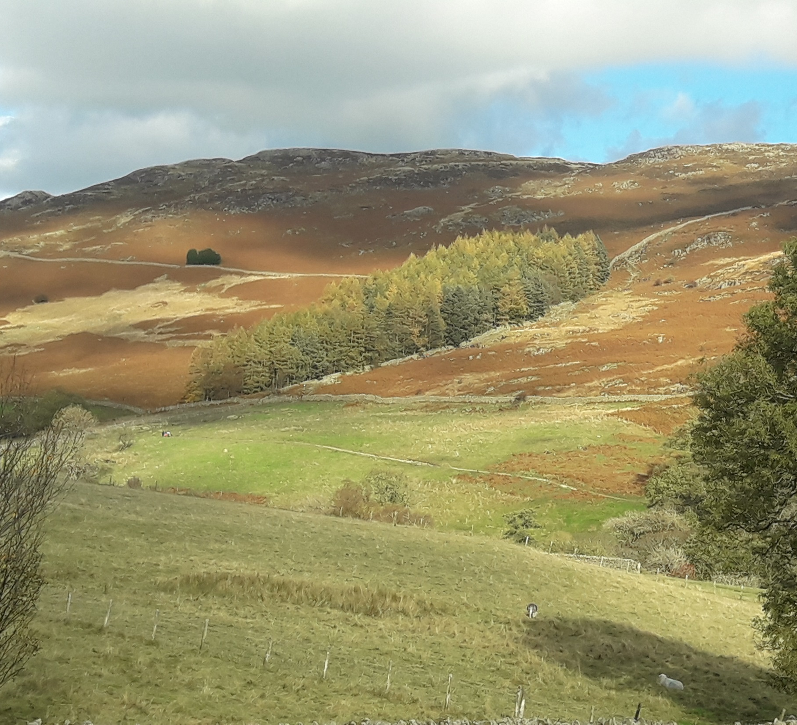
Compartment: Snake Planting (GW14)
Species: Common alder, birch and ash, with occasional other broadleaves
Size: 3.8ha Designations: LDNP and WHS
Description: River-edge woodland extending upstream of Aira Beck and along tributaries flowing off Gowbarrow fell, along with more widely-spaced birch, ash and hawthorn in bracken beds between streams. The beck-edge trees are predominantly alder, with ash. Open space between tributaries is dominated by bracken with limited tree regeneration. Walkers to/from Gowbarrow fell often pass through the woodland.
Aims: expand tree cover into bracken beds whilst maintaining a natural feel with open space
Proposed works: clumped tree planting at relatively low overall densities into bracken beds; occasional deer exclosures to monitor impact of red deer
Compartment: Milses’ Planting (GW15)
Species: Mostly larch with Scots pine, as well as some alder and sycamore and other occasional mixed broadleaves interspersed
Size: 1.7ha Designations: LDNP and WHS
Description: A rectangular and steeply sloping plantation between the Aira Force area and Dockray, on the sides of Gowbarrow fell. Mostly a larch plantation, with a strip of alder and other species present in low quantities. It provides habitat for woodland creatures within an otherwise open landscape, though the quality of the conifer-dominated canopy could be improved. A stock-fenced area to north of current tree cover has failed to regenerate and soften this edge.
Issues: Closed-canopy of predominantly non-native conifers limits light to young trees and woodland flowers, as well as the ‘blocky’ appearance of the wood on the fell-side
Aims: Move towards more natural woodland type, softening visual appearance, whilst maintaining some conifers for red squirrels
Proposed works: groups of larch will be felled along with thinning under felling license 010/37/17-18, with natural regeneration and some replanting of mixed broadleaves with Scots pine, to ‘break up’ the uniform canopy and create more varied age structure. Clumped planting of broadleaves in stock-fenced area to the north will help blur this woodland edge, reducing straight lines.

Slide 26
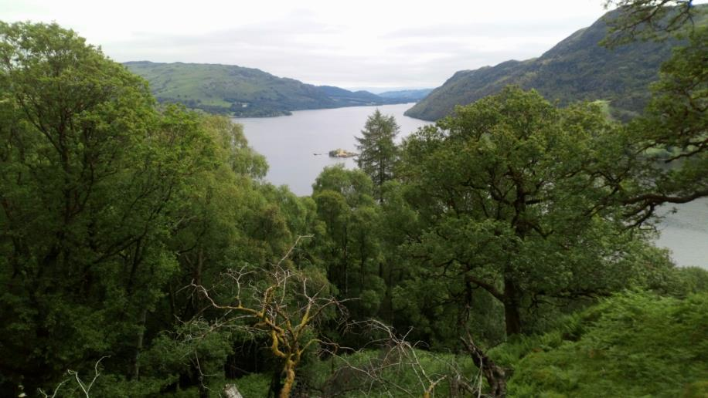
Compartment: Glencoyne Wood (GC1a)
Species: Sessile oak, silver birch, hazel, rowan and other mixed broadleaves
Size: 24.9ha Designations: LDNP, WHS, SSSI, SAC and ASNW
Description: Extensive ancient semi-natural woodland above Stybarrow and Glencoyne, which is predominantly acidic oakwood in character and with its habitat value being recognised through SAC and SSSI designation. The occasional more base-rich areas have sycamore, wych elm, yew and other species, especially below Moss Crag. The density of trees varies with some open space and widely-grown, veteran trees, improving its habitat value; younger tree regeneration is occasional in bracken-dominated open areas especially. The lower plant flora (e.g. lichens, mosses and liverworts) is particularly rich, along with nesting birds.
Issues: Regeneration is relatively sparse, although present in places, through the impact of herbivore browsing.
Aims: Maintain and where possible expand the existing well-structured woodland for wildlife value, promoting structural diversity including tree regeneration and veteran tree habitat
Proposed works: Fell one regeneration/group fell and temporary deer fence in an even-aged and simplified stand of oak on the lower slopes, to promote regeneration of light-demanding species and diversify stand structure; survey woodland for younger trees of appropriate form to potentially pollard for veteran tree habitat creation (which may include further halo thinning once identified).

Slide 27
Compartment: Seldom Seen, Corner Planting & Glencoyne Larches (GL1b-d/g)
Species: European larch, Japanese larch, Scots pine, occasional other conifers, and occasional sessile oak, hazel, rowan and birch
Size: 3.3ha (Seldom Seen), 0.75ha (Corner Planting), 23.1ha (Glencoyne Larches) Designations: LDNP, WHS, ASNW and PAWS
Description: Three areas of predominantly larch of varying ages on the north-facing slopes above Glencoyne Farm and Seldom Seen cottages. Seldom Seen (GL1b) is mixed larch/Scots pine/Douglas fir and occasional other conifer, approaching economic maturity. Corner planting (GL1c) is younger larch/pine plantation, relatively uniform in structure. Glencoyne larches (GL1d & g) is a mature stand of impressive landscape European larch up and onto a plateau, with occasional Scots pine and beech above GL1a. Within GL1b and GL1d especially are occasional mature sessile oak and other broadleaves, including a relatively inaccessible crag within GL1d with remnant native broadleaved trees persisting. Despite conifer dominance and simplified structure, the size of this stand provides good habitat for forest creatures, including red squirrels.
Issues: Simplified structure (i.e., few younger trees) and single-species dominance; shading of mature oaks and remnant broadleaves; lack of tree regeneration due to browsing pressure.
Aims: Gradual PAWS restoration within the majority of Seldom Seen and lower Glencoyne Larches stand, to predominantly broadleaf woodland, expanding Glencoyne Wood native broadleaves species into it, whilst retaining some conifers for red squirrel and other habitat values. Retention of upper and relatively inaccessible larch on plateau as non-intervention to become over-mature with associated habitat values of deadwood, old trees and limited disturbance. Thin Corner Planting until trees are to economic maturity, then remove and regenerate with broadleaves.
Proposed works:
General silvicultural thinning in younger conifers (GL1b & GL1c) to promote best trees and allow light to the woodland floor, favouring wherever possible native species (Scots pine or broadleaves)
halo thinning older broadleaf trees scattered through all stands
general thinning of larch below steep crags in GL1d to promote better trees, aiming for eventual broadleaf tree regeneration in the understory and gradually removing more larch over coming decades;
Retention of most of the upper part of GL1d as non-intervention;
Group/regeneration fell (with temporary deer fence) in GL1b near a group of older oak to diversify structure and encourage broadleaved woodland recovery;
Group/regeneration fells in GL1d (with temporary deer fencing) above and below a steep crag with remnant broadleaf woodland and adjacent to old oaks to northwest, to encourage regeneration and expansion of oakwood species;
Thinning above Moss Crag on the border with GL1a to allow light to oaks and encourage regeneration of broadleaves into GL1d;
Stock fencing bracken beds on boundary between GL1d and GL1a to encourage expansion of oak woodland.

Slide 28
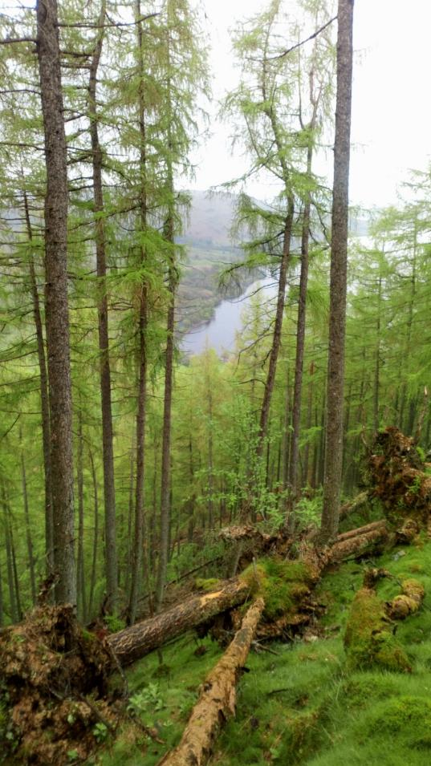
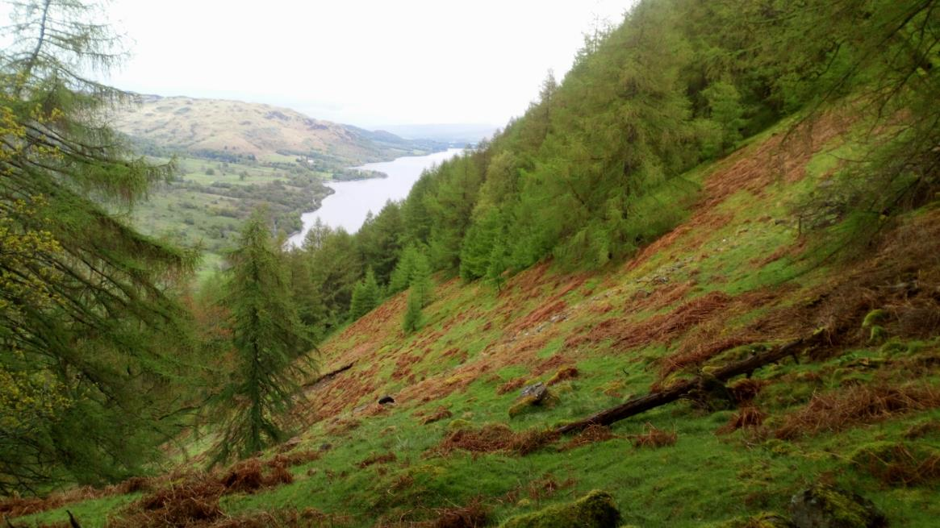
Compartment: Seldom Seen, Corner Planting & Glencoyne Larches (GL1b-d/g)

Slide 29
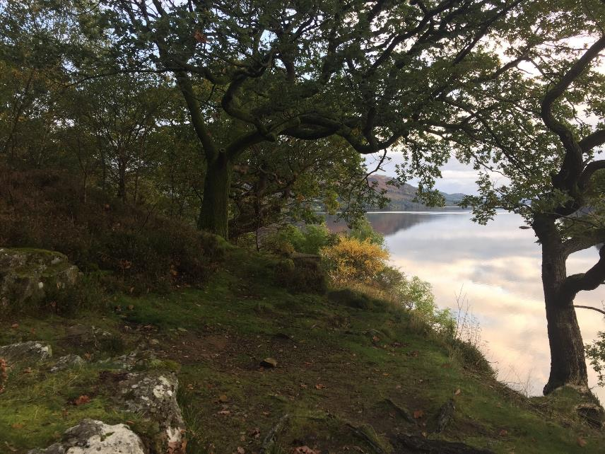
Compartment: Glencoyne Lakeshore (GL1e/f)
Species: Mixed broadleaves including sessile oak, birch, beech, hornbeam, sycamore and alder; occasional Scots pine and larch
Size: 3.9ha into two sub-compartments Designations: LDNP & WHS; adjacent to Ullswater lake (SSSI/SAC)
Description: Thin, linear woodlands between the A592 and Ullswater lake, predominantly oakwood in character with significant areas of beech, and occasional Scots pine on knolls. Alder, willow and some aspen are present in wetter areas, further increasing the diversity of the species for a relatively small woodland. A footpath from Glenridding village runs through the wood, which is popular in the summer, especially for visitors accessing the lake.
Aims: Maintain a well-structured and species-rich woodland for ecological and amenity values
Proposed works: General silvicultural thin to release competing trees and promote those of best form and vigour, maintaining a varied species composition

Slide 30
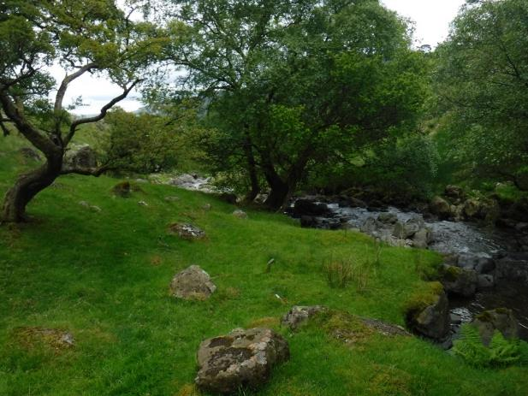
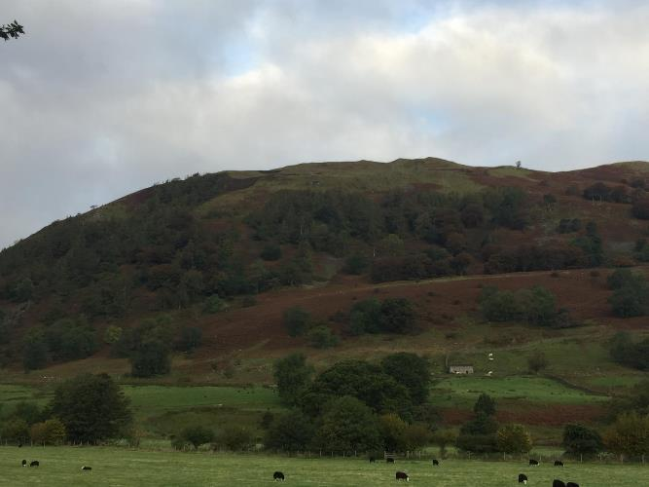
Compartment: Glencoyne Beck (GL2)
Species: Alder, ash, wych elm, sycamore and hazel with sessile oak and birch on drier soils
Size: 4.15ha Designations: LDNP & WHS
Description: Riparian tree cover behind Glencoyne Farm, predominantly ash/hazel/sycamore and elm, giving way to alder in places. Occasional archaeological features include a nearby sawmill. Ground flora along the beck itself is diverse, especially wetter flushes and fern flora.
Issues: the expected impacts of ash dieback leading to loss of ash trees, and lack of younger trees due to grazing
Aims: Maintain riparian tree cover for ecological and water protection purposes
Proposed works: monitor the impact of ash dieback and, if this is considerable, work in partnership with tenant farmers to plant ecologically-similar species (e.g. aspen) in gaps
Compartment: Glencoyne Brow (GL5)
Species: Beech, Scots pine and larch with ash, oak and hawthorn
Size: 67.5ha Designations: LDNP, WHS, and patches of ASNW
Description: Large area of sloping scree/hillside put into livestock exclusion for woodland expansion above Glencoyne Farm. Woodland types consist of both spaced ash wood-pasture with hawthorn, and 1800s plantation beech, larch and Scots pine. Larch particularly is regenerating well in areas, but there is otherwise limited structural diversity and tree regeneration could be greater. Open spaces are mostly dominated by bracken.
Issues: Poor tree regeneration, suspected to be due to red deer browsing and occasional ingress sheep when boundaries fail.
Aims: Continue to promote woodland expansion through natural regeneration
Proposed works: regular boundary checks and repairs; erect deer exclosures and areas of bracken control to investigate further causes of regeneration suppression

Slide 31
Compartment: Toby’s Wood (GL3a) and Groove Gill (GL3b)
Species: GL3a – alder with sessile oak, rowan and other broadleaves; GL3b – ash, hazel and birch with oak, rowan and other broadleaves
Size: 0.8ha & 4.9ha Designations: LDNP, WHS & ASNW
Description: Two more wooded blocks within the wider Glencoyne Park wood pasture, with livestock excluded. Toby’s Wood is small rectangular stand of early-mature alder with occasional other broadleaves adjacent to the A592. It is relatively well-structured, though with younger trees starting to close canopy, and occasional veteran sessile oaks on the boundary at risk of becoming shaded. Groove Gill is a large exclosure further uphill with mature riparian tree cover, predominantly ash, birch and hazel, with other mature trees spreading out onto flatter ground either side. Around this has been planting of oak and rowan, with dense birch regeneration, and younger trees are now closing canopy as well as shading some mature trees. Occasional patches of other species e.g. alder, Scots pine, mixed in through woodland matrix.
Issues: Deer browsing hinders tree regeneration within Groove Gill and some deer damage can be seen on trees in Toby’s Wood; both have early-mature trees closing canopy and shading older trees and the woodland floor.
Aims: Maintain woodland blocks with mixed tree sizes and species, including habitat features such as veteran tree features
Proposed works: General silvicultural thin in Toby’s Wood and in planted and birch-regenerated areas of Groove Gill, including halo-thinning veteran trees to allow more light.
Compartment: Glencoyne Bay (GL6)
Species: sessile oak with other mixed broadleaves, including whitebeam, sycamore, alder and wild cherry
Size: 1.7ha Designations: LDNP, WHS & ASNW
Description: A small triangle of woodland between the A592 and Ullswater, with Ullswater steamer landing at the point. Mature trees along the road are mostly sessile oak, with alder especially in wetter areas and a good mixture of native broadleaves regenerating in the areas left unmown. Apart from managing tree safety issues due to the busy road and path to the steamer, the area is most valuable for amenity and wildlife purposes.
Aims: Maintain native tree cover and amenity value, along with maintaining footpath for steamer users.
Proposed works: None at present aside from tree safety works if necessary.

Slide 32
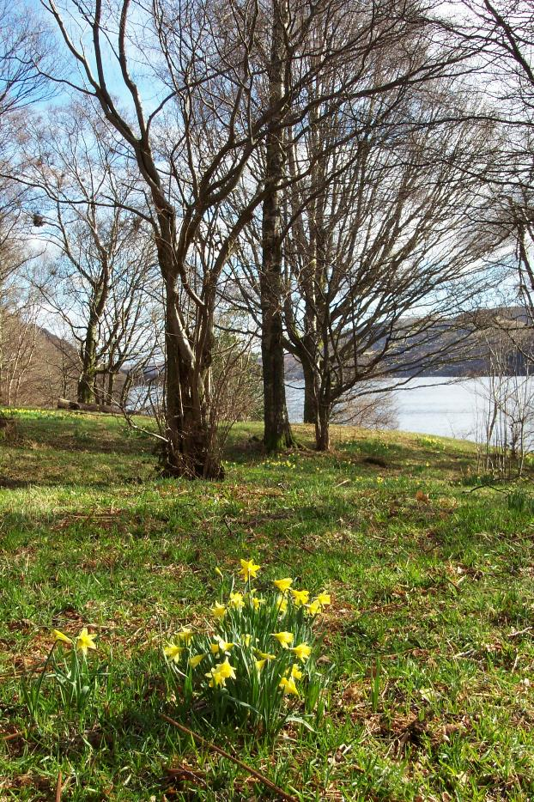
Compartment: Wordsworth’s Daffodils (GL4)
Species: Sessile oak, ash, alder, sycamore, hazel, birch and other broadleaves
Size: 1.1ha
Designations: LDNP & WHS; adjacent to Ullswater lake (SSSI/SAC)
Description: Small lakeshore compartment of woodland, made famous through association with Wordsworth’s poetry and the display of daffodils that inspired him. The tree cover is formed of mostly mature and early-mature tree of various broadleaved species, with good regeneration. Apart from daffodils, the ground flora is typical of oakwoods with general woodland flora.
Issues: Tree canopy closure could inhibit daffodil flowering
Aims: Maintain mixed species lake-side tree cover with a good display of native, wild daffodils for their cultural associations.
Proposed works: Lightly thin to maintain the required light levels reaching woodland floor, benefitting daffodils, along with coppicing occasional hazel.

Slide 33
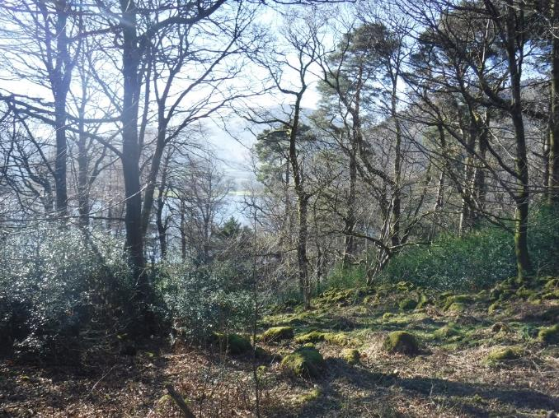
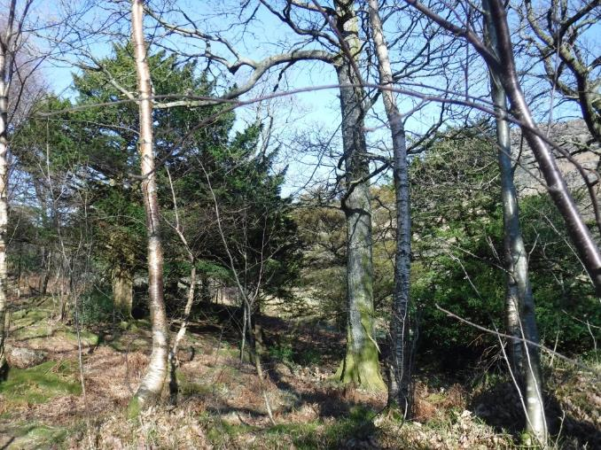
Compartments: Purse Point Wood (PA1) and Blowick Bay (PA2)
Species: Sessile oak, birch, rowan, Scots pine, holly and other mixed broadleaves
Size: PA1 – 1.65ha; PA2 – 1.3 Designations: LDNP & WHS; adjacent to Ullswater lake (SSSI/SAC)
Description: Two small woodland compartments on lakeshore north of Side Farm. Both are predominantly oakwood (sessile oak, birch, rowan and hazel), but with significant amounts of Scots pine and with a holly understory becoming very dense in places. PA1 has a smattering of non-natives such as Norway spruce, Norway maple and larch, as well as occasional other natives such as wych elm and yew. In both compartments regeneration is very good, with dense birch in places; juniper has also regenerated under pine in PA1. Provides significant wildlife habitat in amongst the surrounding more open landscape.
Issues: Dense holly regeneration is smothering ground flora
Aims: Maintain a mixed species, structurally diverse woodland for habitat and amenity value
Proposed works: cut back patches of holly to allow light to woodland floor, whilst maintaining other dense clumps for nesting birds; thin/respace the birch regeneration; one group/regeneration fell of most of the larch and some of the beech in PA1 (to the south of the compartment) and allow to regenerate naturally with more varied species; ring-bark the occasional non-native in PA1 to increase standing deadwood habitat

Slide 34
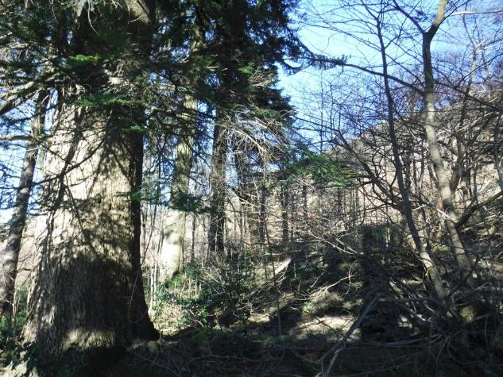
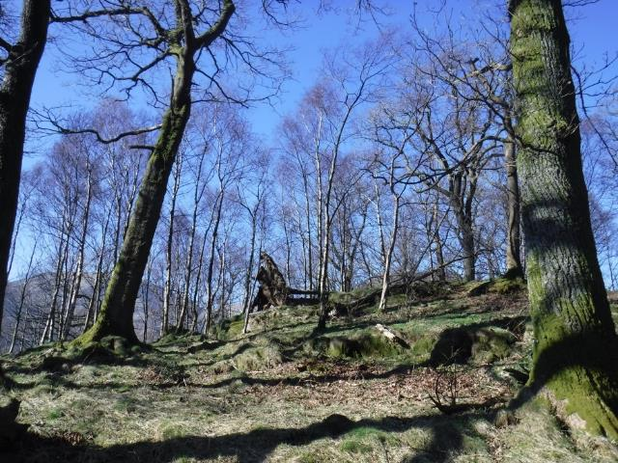
Compartment: Blowick East (PA3)
Species: Silver fir, Norway spruce, sessile oak, Scots pine with alder, sycamore, wych elm, other mixed broadleaves
Size: 0.15ha Designations: LDNP & WHS
Description: a small group of trees to the northern end of the NT holding around Side Farm and Blowick, dominated by mature specimen firs with good natural regeneration underneath. Mature oak and Scots pine in lighter gaps, with sycamore/elm/alder and other species along a wetter flush.
Issues: Small size and isolation from other woodlands, meaning there is limited space for young trees to grow into
Aims: Maintain as a group of landscape trees, including specimen conifers for visual amenity.
Proposed works: thin out three sub-canopy conifers to allow light in to younger fir saplings, to promote next generation of significant trees
Compartment: Middle Wood (PA4)
Species: Sessile oak, birch, rowan, yew and holly
Size: 0.9ha Designations: LDNP & WHS
Description: Two small copses divided by track to Blowick House. Both are dominated by sessile oak canopy with yew sub-canopy and, in gaps, birch, rowan and other broadleaf trees. As with PA1 & PA2, holly is forming dense understory in places.
Issues: Dense holly regeneration in areas is smothering ground flora; a small patch of invasive rhododendron is present nearest the lake
Aims: Maintain a mixed species, structurally diverse woodland for habitat and amenity value
Proposed works: cut back patches of holly to allow light to woodland floor, whilst maintaining other dense clumps for nesting birds; remove rhododendron

Slide 35
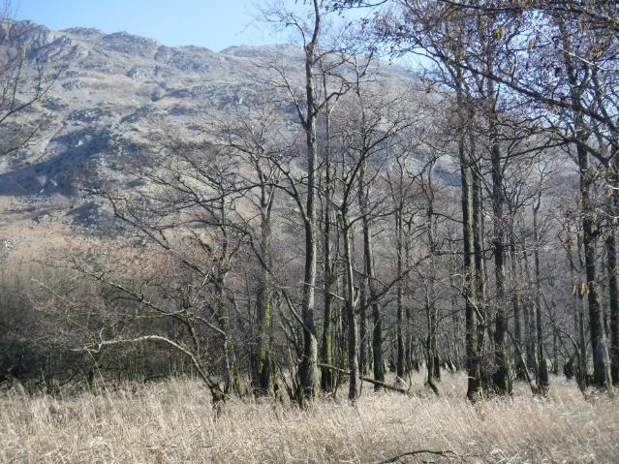
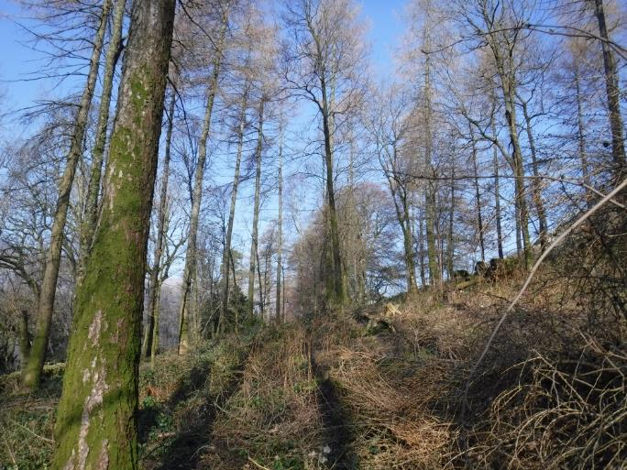
Compartment: Lakehead (PA5)
Species: Common alder and willow, with some hornbeam and other mixed broadleaves
Size: 1.1ha Designations: LDNP & WHS; adjacent to Ullswater lake (SSSI/SAC)
Description: Wet woodland at the head of Ullswater lake, predominantly alder and willow but with a patch of a more varied mixture of broadleaves to the west, including hornbeam and downy birch
Issues: repeated fence damage and stock ingress, though limited
Aims: Maintain tree cover for habitat, and diversify structure of the generally uniform alder/willow stand
Proposed works: coppice one coupe/patch of alder; repair fence as required after floods and explore more resilient options such as hedging
Compartment: Pig Wood (PA6)
Species: Japanese larch, sessile oak, alder, birch, and other mixed broadleaves
Size: 1.0ha Designations: LDNP & WHS
Description: A small and rectangular plantation above bridleway from Side Farm, with a well-spaced larch overstory and oak/mixed broadleaf understory. It was last thinned in 2017 to reduce the overstory larch and allow more space and light for oaks and other broadleaves to grow into.
Aims: Maintain a mixed species, structurally diverse woodland for habitat and amenity value, retaining some larch to over-maturity but aiming for mostly native broadleaved woodland over time

Slide 36
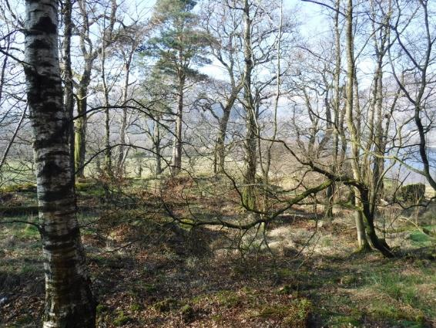
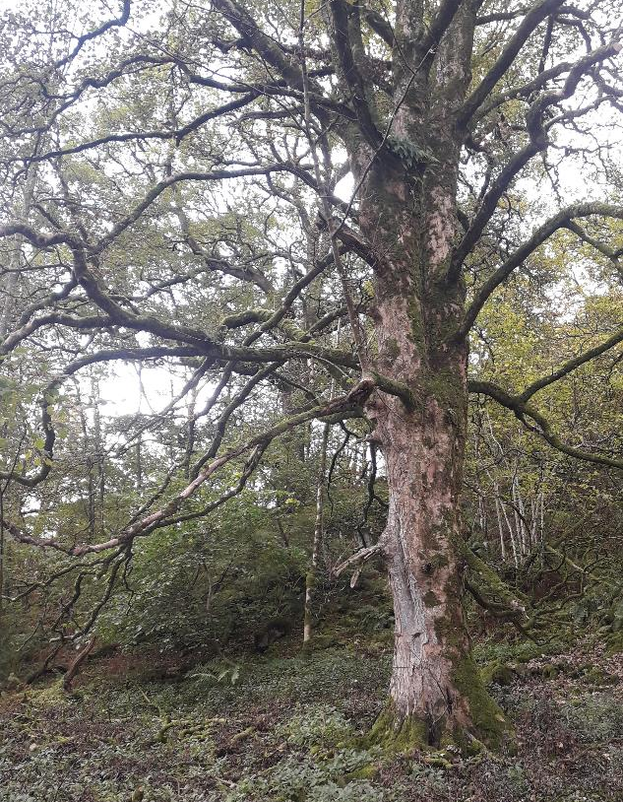
Compartment: Harriman’s Wood (PA7)
Species: Sessile oak, yew, Scots pine, sycamore, ash, alder, other mixed broadleaves
Size: 1.1ha Designations: LDNP & WHS
Description: Mixed woodland below the bridleway from Side Farm; typical of other surrounding compartments in being generally sessile oakwood in character, though with a significant element of yew. It is well-structured with mixed broadleaf regeneration, including areas of pole-stage trees now closing canopy.
Issues: Fence to west needs repairing
Aims: Maintain mixed species, structurally diverse woodland for habitat and amenity value
Proposed works: fence repairs and thinning/respacing of pole-stage broadleaves to promote trees of a mixture of species with the best form and vigour
Compartment: Glenridding (PA8)
Species: Sessile oak, birch, sycamore and ash, with other mixed broadleaves
Size: 0.15ha Designations: LDNP & WHS
Description: A very small compartment of woodland owned by NT within wider belt of woodland owned by Patterdale Hall, sitting above the War Memorial and A592. It is dominated by a large, mature sycamore and typical sessile oakwood on rocky knolls, and provides habitat value through being a part of the larger belt of trees/woodland along this side of Ullswater.
Aims: Maintain mixed species, structurally diverse woodland for habitat and amenity value, within the context of this area of woodland as a whole
Proposed works: removal of old tree tubes

Slide 37
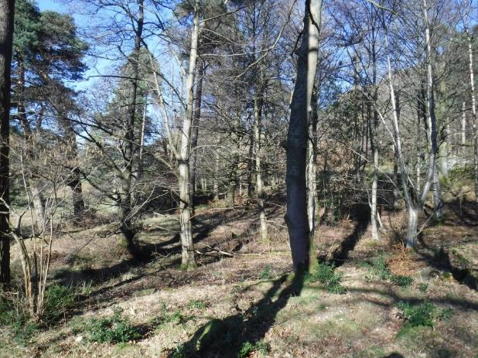
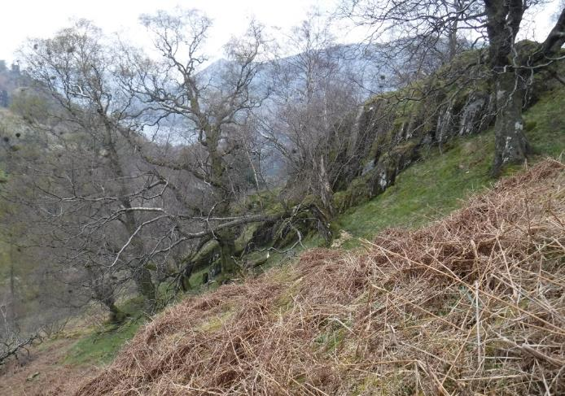
Compartment: Blowick (PA9)
Species: Sessile oak, Scots pine, beech, sycamore and other mixed broadleaves
Size: 0.45ha Designations: LDNP & WHS
Description: A small, mixed shelterbelt near Blowick House and above Side Farm fields. As with other nearby compartments, sessile oak and Scots pine are prevalent; also significant is sycamore, beech and Norway map. Relatively well-structured with well-developed shrub layer.
Issues: fence requires repairs
Aims: Maintain a mixed species, structurally diverse woodland for habitat and amenity value
Proposed works: thinning, focussing on sycamore and Norway maple as well as other broadleaves, to promote trees of best form; also undertake fence repairs
Compartment: Glenamara Park (PA10)
Species: Alder, birch, hazel, ash and other mixed broadleaves
Size: 69.0ha Designations: LDNP, WHS and ASNW
Description: An extensive and historic deer park with patches of remnant woodland/wood pasture within it. Alder wood, with good regeneration, lines Hag Beck, whilst other stands of trees are generally of old or veteran specimens of birch, hazel and ash. Occasional juniper can be found at upper reaches of the park, and scattered outside of wooded blocks are stand alone trees or hawthorns/crab apples. Managed by extensive cattle grazing.
Issues: Lack of tree regeneration through sheep ingress, deer browsing, and possibly bracken dominance.
Aims: Manage as wood pasture to attain scattered tree regeneration
Proposed works: erect livestock exclosures, deer exclosures, and areas of bracken control to investigate causes of regeneration suppression and allow young trees to regenerate.

Slide 38
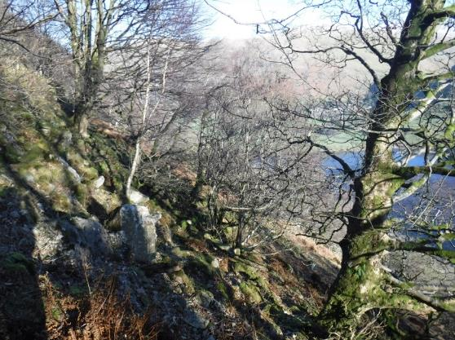
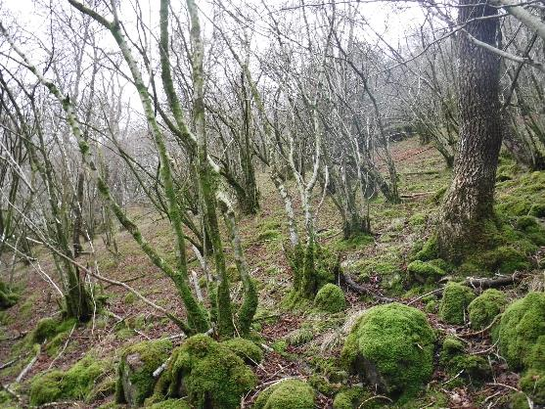
Compartment: Low Wood (HA1)
Species: Hazel, ash, sessile oak, birch and alder, with other broadleaves
Hectares: 61.6ha Designations: LDNP and WHS; ASNW and SSSI & SAC (Ullswater oakwood)
Description: Another significant ancient woodland, along the slopes above Brotherswater and Hartsop Hall. Can be broadly divided into north (Low Wood), with sessile oak and, to the far north, wet alder woodland, and south (Wood Side) where ash, birch, hazel and some sycamore are more dominant on scree slopes. The wood grades out into more scattered scrub towards the upper edge of the ridge, including patches of juniper. The wood slopes steeply, often on bouldery ground, although wet flushes with more ash, and the wetter lower levels of alder, provide contrast to more acidic, typical oak-wood areas. Recognised through designation particularly for lower plants as well as varied semi-natural woodland communities (ash/hazel, alder and acidic oakwood), although ground flora is diminished slightly and open areas mostly dominated by bracken.
Issues: Limited or no tree regeneration and resulting simplification of structure; potential loss of ash to ash die-back
Aims: Maintain ancient semi-natural woodland, ensuring long-term viability through enabling young trees to regenerate to preserve more natural woodland types.
Proposed works: Renew a stock-fenced enclosure on upper slopes, following repairs to deer and stock fencing about Cow Bridge in 2019; thin out ash along A592 roadside if ash die-back develops and poses safety risks; coppice four coupes of hazel within a deer-fenced exclosure following coppicing of first coupe 2019/20; two group/regeneration fells (with temporary deer fencing) within oak-dominated stand to southern of Brotherswater, to enable regeneration of oak, birch, rowan etc. and diversify age structure, as well as two coppice coupes of alder (with temporary stock fencing) to the north of the wood to diversify age structure here; continued deer impact assessments using the stock and deer-fenced exclosures.

Slide 39
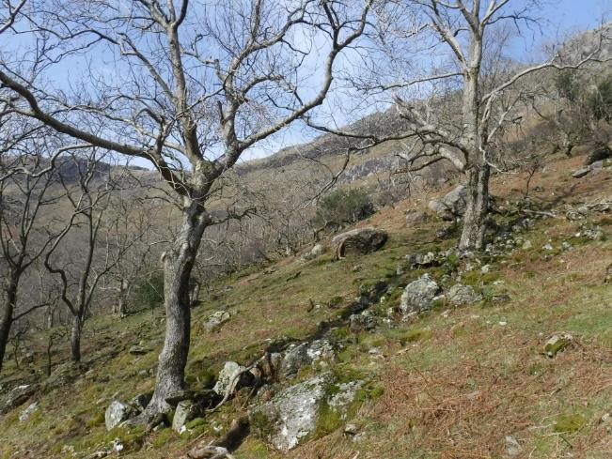
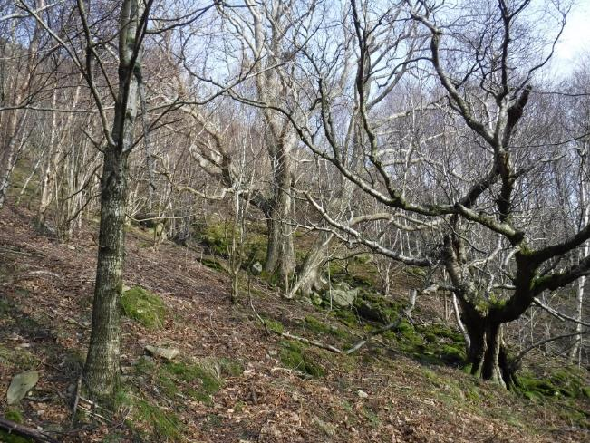
Compartment: Dovedale (HA2)
Species: Ash, hazel and birch with alder and other mixed broadleaves
Hectares: 13.2ha Designations: LDNP and WHS; ASNW and partly within Low Wood SSSI & SAC (Ullswater oakwood)
Description: Area of mixed woodland and wood-pasture contiguous with the southern end of Low Wood, split into three sub-compartments a-c. Sub-compartments a & c are both dominated by widely spaced ash with hazel/birch, forming more of a wood-pasture; alder and wych elm are also present, particularly along Dovedale Beck, along with other shrubs such as holly and hawthorn. Sub-compartment 2b is deer fenced, although this is in need of repair, and has younger, planted sessile oak, rowan and hazel along with natural birch regeneration and other broadleaves, often dense. All three compartments have significant veteran trees, and a ground flora of ancient woodland flowers, as well as good deadwood.
Issues: Lack of tree regeneration and resulting aging of tree population, as well as potential loss of ash to ash die-back
Aims: Maintain tree’d landscape of varying density, with future veteran tree habitat and well-formed future landscape trees
Proposed works: Scattered, low level but regular planting of trees in guards within sub-compartments a & c, including hazel, hawthorn, rowan, oak and birch, as well as sycamore and aspen as ecologically-similar species to ash; thin the denser areas of young trees in sub-compartment b and pollard groups of oak to create future pollards, as well as repairing fence.

Slide 40
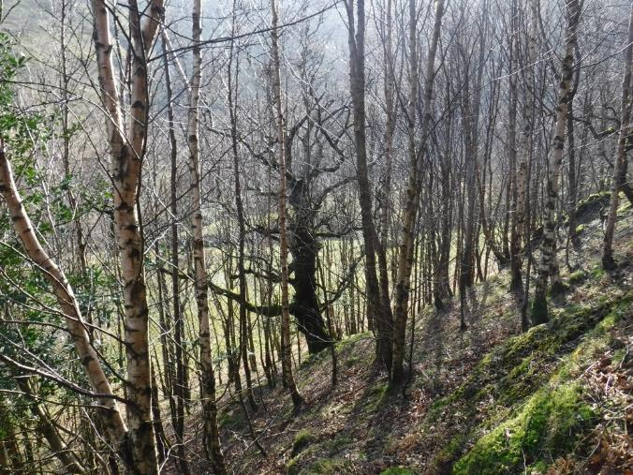
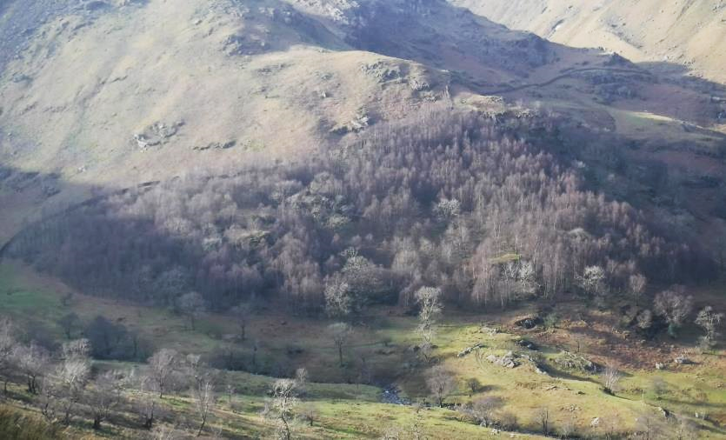
Compartment: Hogget Gill (HA3)
Species: HA3a – silver birch with oak, rowan, ash and holly; HA3b – ash, alder, birch and hazel
Hectares: 6.4ha Designations: LDNP and WHS
Description: HA3a, to the south, is a deer-fenced early-mature woodland dominated by birch regeneration with oak, rowan and hazel; occasional scattered, mature trees (e.g. ash, holly and crab apple) are mixed throughout, and the canopy is generally closed. HA3b is more similar to Dovedale, with scattered mature trees and open spaces dominated by bracken. It is stock-fenced, although with some boundary gaps, and some scattered tree planting in tubes is present. Both areas have good deadwood and general woodland flora.
Issues: Sheep and deer ingress, including deer damage to planted trees in b; shading of veteran trees by regeneration in sub-comp a; closed canopy and strongly defined edges creating a block-like visual impact of sub-comp. a; ash die-back and the expected loss of older ash trees
Aims: enable more densely wooded areas in this area to develop, but with a mosaic of open space and varying density of tree cover; maintain veteran trees in good condition even within stands of younger trees
Planted works: Variable density thinning in sub-comp. a to release trees of best form, including halo thinning around veteran trees, under existing felling license 010/37/18-19; scallop the edges of sub-comp. a to create more natural, wavy woodland edge; repair the deer fence and heighten the stock fence around b to a deer fence to protect planted trees.

Slide 41
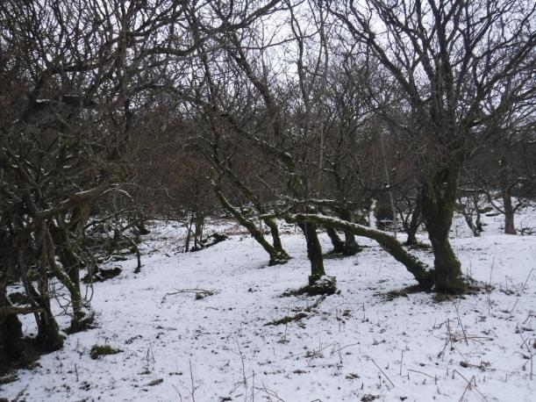
Compartment: New Close/Kirkstone Foot (HA4)
Species: Hazel, ash, holly, sessile oak and sycamore, with other broadleaves
Hectares: 6.9ha Designations: LDNP & WHS
Description: A rectangular wood above A592 opposite Brotherswater, consisting mostly of scattered, mature groups of hazel with occasional holly and other trees on a mostly bracken-dominated area of ground. Above this is a deer-fenced planting of mostly oak, rowan, hazel and ash surrounding older boundary trees on sloping, bouldery ground.
Issues: Younger, planted trees are now closing canopy. With some shading of boundary veteran trees, whilst there is a lack of regeneration outside the deer fence.
Aims: Maintain a woodland of varying density and tree species, with a mixture of ages
Proposed works: Planting hazel, holly and trees in cages within bracken beds; repair deer fence and thin younger, planted trees here, along with coppicing hazel coupes and occasional pollarding across all areas to create future veteran tree habitat.
Compartment: Calf Close (HA5)
Species: Sycamore, ash, sessile oak and birch
Hectares: 7.4ha
Designations: LDNP and WHS; ASNW
Description: Woodland on sloping, bouldery ground below Lingy Crag, between Angletarn and Eden becks to the north of Hartsop. Mostly mixed ash/sycamore and oak/birch, depending on the local soils, in varying density, which grade into hazel and then on to open fell above. Occasional shrub provides understory, such as holly and hawthorn. The wood has previously been recognised for good bryophyte and lower plant flora, although tree regeneration is lacking and open areas instead remain open and dominated by bracken.
Issues: Lack of tree regeneration
Aims: Maintain woodland cover and general habitat value. No significant works proposed at present, as the terrain generally inhibits small-scale temporary fencing of gaps that could promote tree regeneration.

Slide 42
Compartment: Dub How Woods (HA6)
Species: HA6a: sessile oak, alder, ash and hazel; HA6b: birch, willow and alder
Hectares: 5.3ha Designations: LDNP & WHS; HA6a is ASNW
Description: Woodland along the lower valley, bordering Goldrill Beck to the north of Hartsop. Sub-comp. a is a deer-fenced patch of ancient woodland, mostly of spaced mature oak with younger, planted and regenerating mixed broadleaves including alder, ash, rowan and birch. Hazel is more dominant on bouldery slopes to the north. Sub-comp. b is more valley bottom wet woodland, mostly downy birch with alder and willow, with Goldrill beck proposed to be realigned through the centre as part of Riverlands project. Both provide habitat value along the beck edge, as well as water quality.
Issues: Younger trees in HA6a are now closing canopy, and the deer fence needs repair
Aims: Maintain a woodland of varying density and promote trees of best form; wet woodland habitat improvement and water quality protection is expected as a result of the realignment of Goldrill Beck
Proposed works: Lightly thin younger trees in HA6a, and repair fence
Compartment: Beckstones (HA7)
Species: Sessile oak with sycamore, ash and other broadleaves, and a small stand of European larch
Hectares: 3.95ha Designations: LDNP and WHS; ASNW
Description: Wood-pasture and scattered trees on sloping, rough ground to the north of Beckstones farmhouse, with mature sessile oak and occasional other species (e.g ash, sycamore, hawthorn and rowan), mostly on rock ends; one small stand of European larch at the top-most corner. Ash and oak particular have been planted in cages over the past 20-30 years into bracken beds and open ground between groups of trees.
Aims: Maintain open tree cover at variable density across the area.
Proposed works: continue to plant occasional trees in cages into open areas, and replace younger ash if affected by ash dieback.

Slide 43
Compartment: Brotherswater (HA8)
Species: Downy birch, alder and willow
Hectares: 5.1ha Designations: LDNP & WHS; partly within Brotherswater SSSI
Description: A wet woodland on the southern edge of Brotherswater, mainly birch/willow with patches of alder, forming a generally closed canopy grading into rushes on the lake shore. The woodland edge is blurred by occasional trees following along ditch-lines outside the stock-fenced main area.
Issues: Occasional boundary failure
Aims: Maintain woodland, and over time pursue options within neighbouring farm tenant’s business to gradually expand, continuing to provide ‘carr’ woodland habitat on the edge of Brotherswater
Proposed works: Repair stock-fence to maintain boundary
Compartment: Goldrill Knoll (HA9)
Species: Sessile oak with birch, ash, alder, rowan, cherry and other mixed broadleaves
Hectares: 1.0ha Designations: LDNP and WHS; borders Goldrill Beck SSSI
Description: Small, triangular woodland between the A592 and the current channel of Goldrill Beck. Consists of planted native broadleaves around remnant mature oaks on a rocky knoll, with alders and other broadleaves along the built-up beck-edge and occasional regenerating shrubs (e.g. holly, hazel and blackthorn).
Aims: Maintain as a small area of varied tree species and structure bordering on more open farmland.
Proposed works: thin planted trees to promote those of best form, as well as coppicing alder under existing felling license 010/231/16-17 to protect beck-edge wall from damage.

Slide 44
Compartment: Thinside (HA10)
Species: Ash, hawthorn, alder and birch
Hectares: 19.2ha Designations: LDNP & WHS
Description: A parcel of remnant wood pasture along southern slope of Dovedale and below Bull Crag, forming part of wider tree cover up this valley. Predominantly mature/veteran ash and hawthorn with birch and alder, scattered throughout sloping rough fellside. Occasional younger trees have been planted in cages, along with a deer-fenced exclosure and then area of new planting in cages to the east. Veteran trees are of significant ecological value, as well as the general habitat provided by trees in more open area.
Issues: Lack of natural tree regeneration, and the expected loss of ash due to ash dieback
Aims: Maintain tree cover at a similarly wide spacing to allow veteran tree development.
Proposed works: Continue to plant low numbers of trees in cages, including sycamore and aspen as ecological proxies for ash.
Compartment: Caiston Glen (HA11)
Species: Ash and hawthorn with other occasional mixed broadleaves
Hectares: 12.4ha Designations: LDNP & WHS
Description: Similar to Thinside, being remnant wood pasture along northern slope of Caiston below Bull Crag. Predominantly mature/veteran ash and hawthorn with occasional other broadleaves, scattered throughout sloping rough fellside. Occasional younger trees have been planted in cages, along with four fenced exclosures planted in the last decade with mixed broadleaves. Numerous trees are veteran, some in an active pollard cycle, with significant ecological value.
Issues: Lack of natural tree regeneration; dominance of ash and expected impact of ash dieback
Aims: Maintain tree cover at a similar wide spacing to allow veteran tree development.
Significant works: Continue to plant low numbers of trees in cages, including sycamore and aspen as ecological proxies for ash, as well as heightening small stock-fenced and planted exclosures to deer fence to promote successful planted tree growth.

